Slide 1
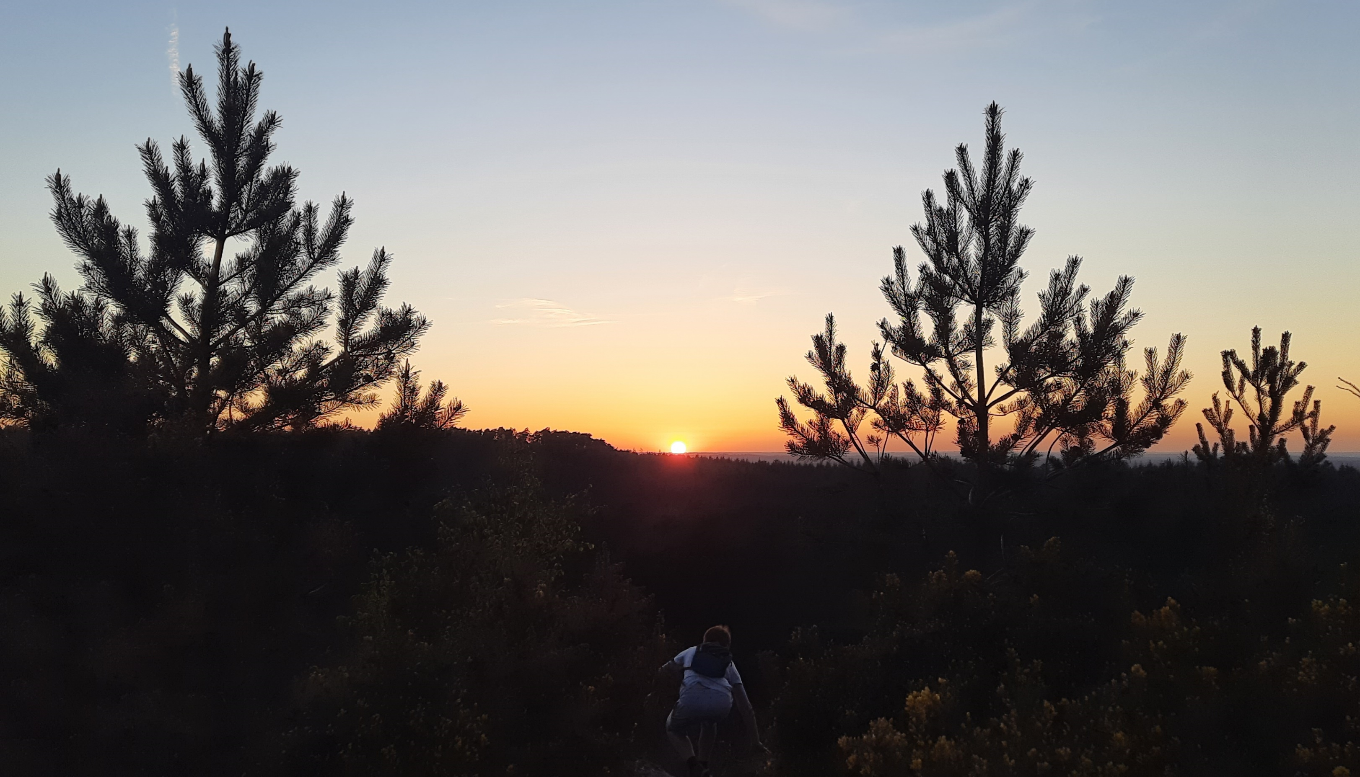
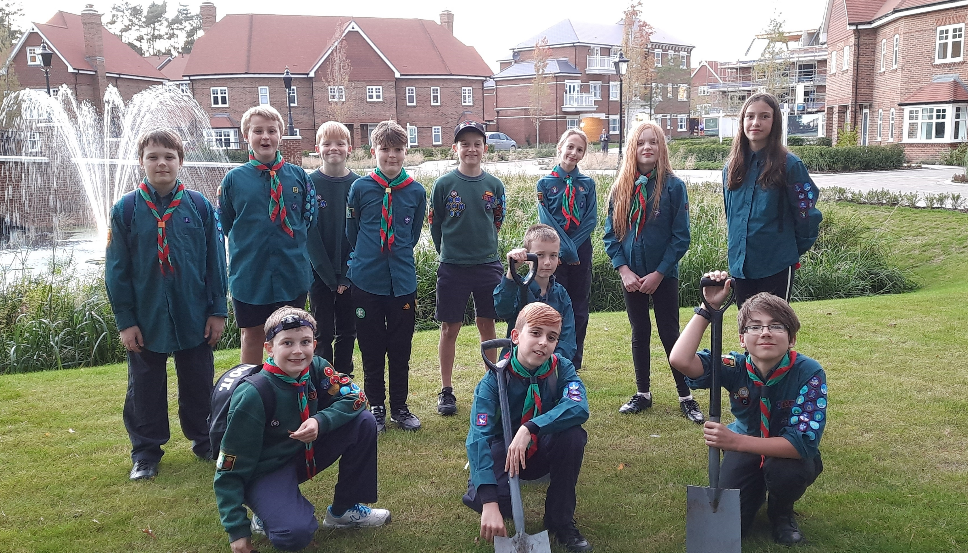
Peter Robertson
Thursday Scouts
Notes:
Huānyíng: hwan- yeen

Slide 2
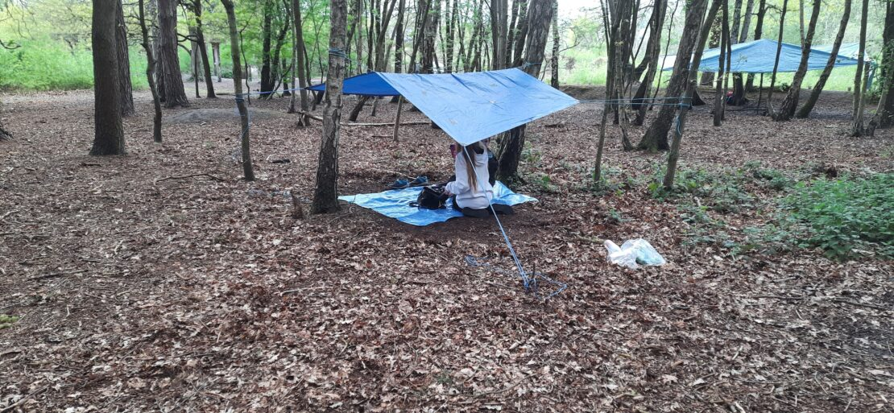
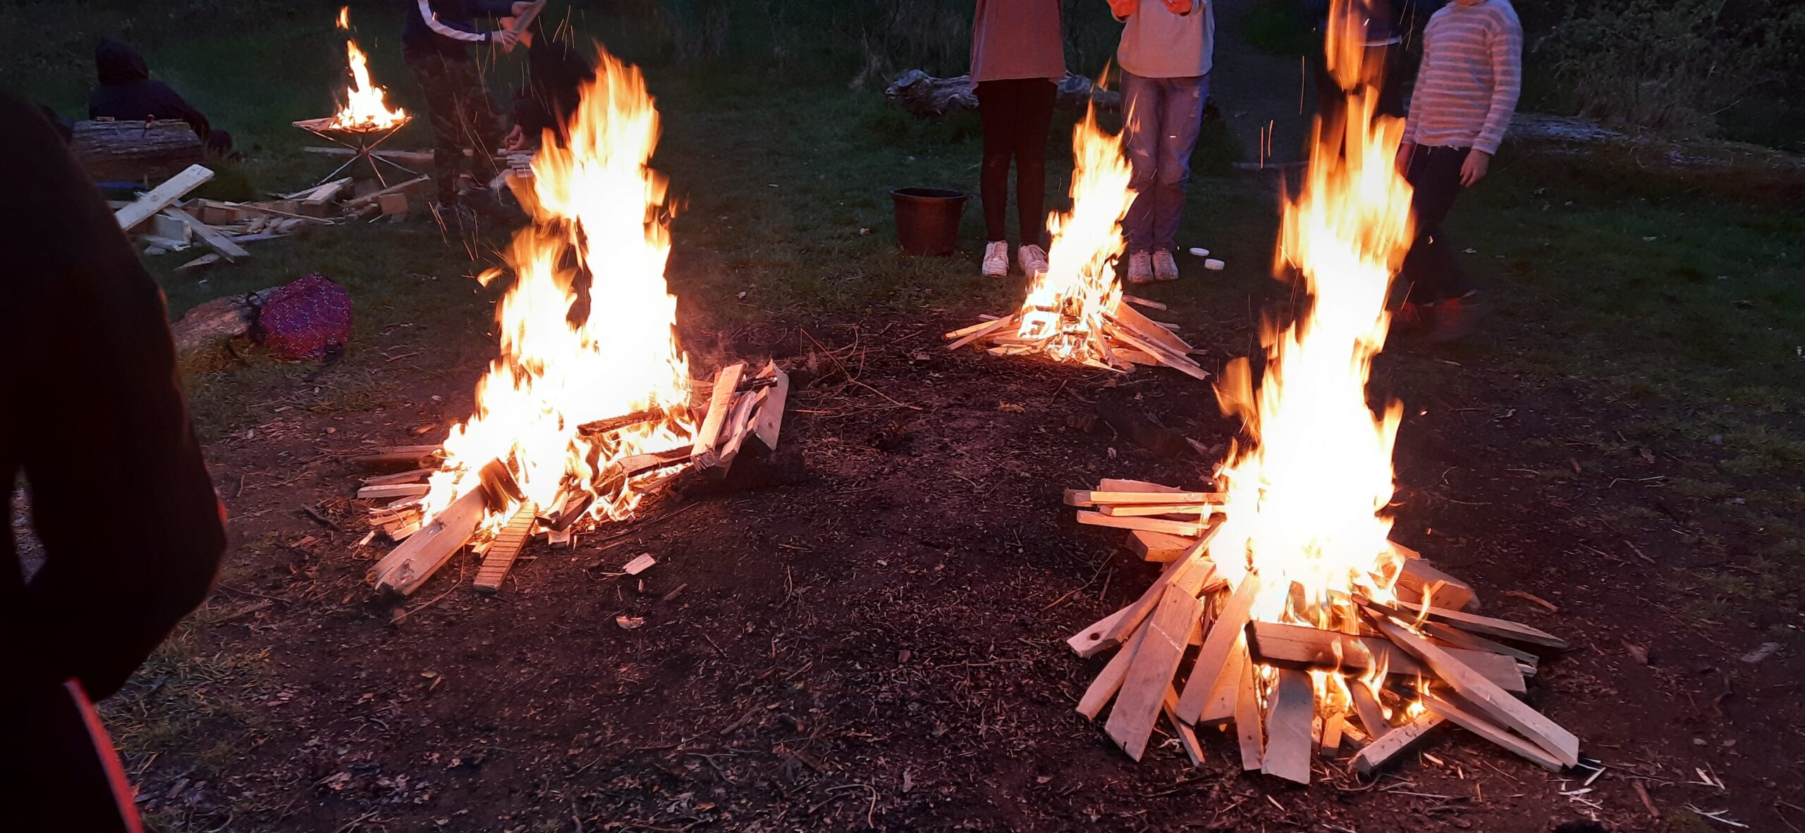
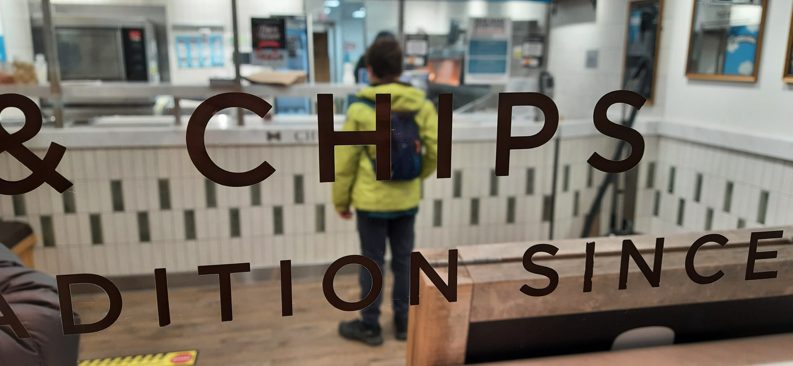
Thursday Scouts – Activities
Face to face
Shelter building
Fire lighting
Chip shop challenge
Navigation walks
Time-keeping hikes

Slide 3
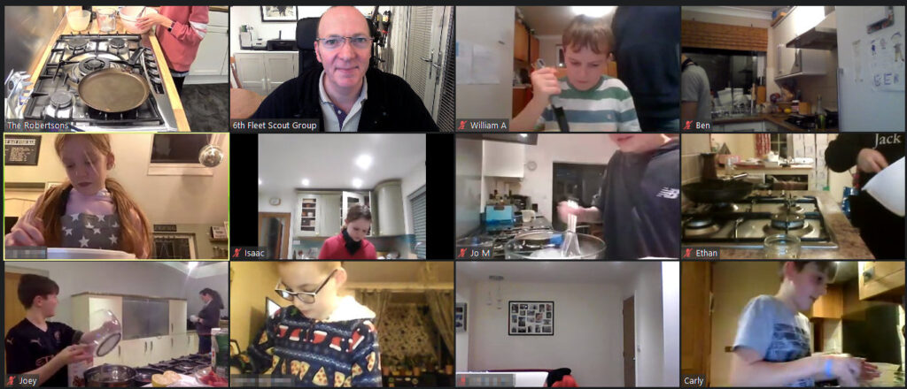
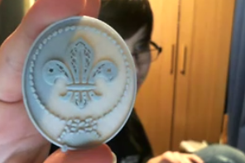
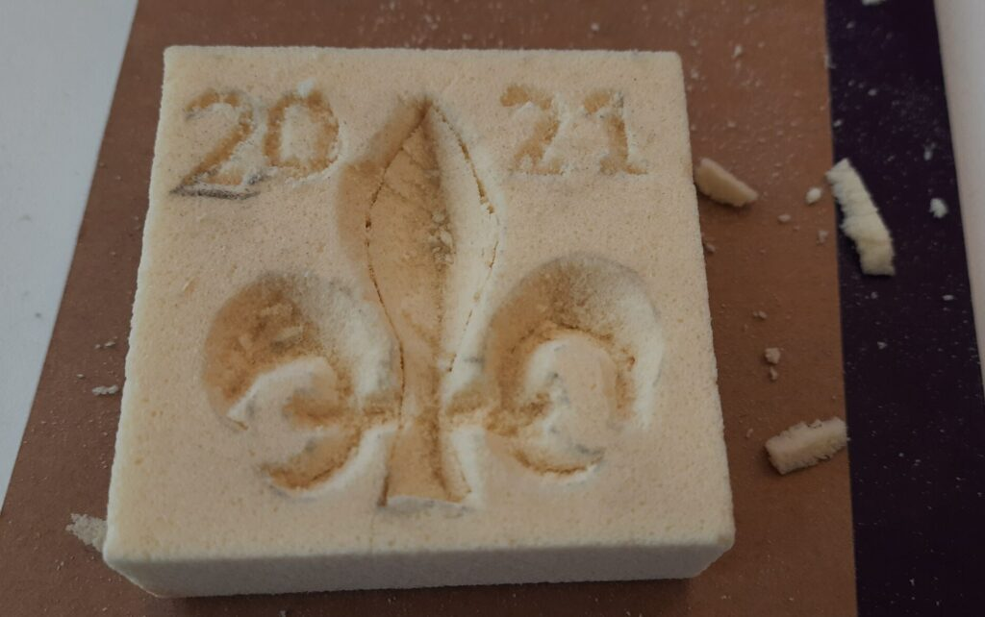
Thursday Scouts – Activities
Online via Zoom
Cooking pancakes
“Who Wants To Be A Millionaire?”
Carving & modelling

Slide 4
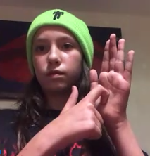
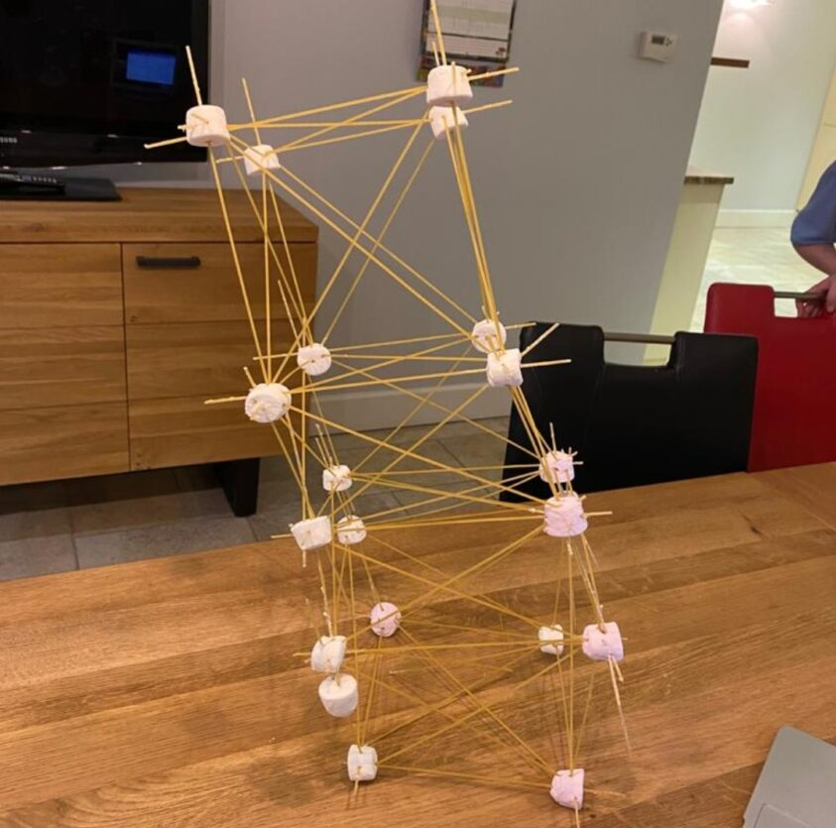
Thursday Scouts – Activities
Online via Zoom
Chinese New Year
Learning sign language
Spaghetti & marshmallow towers
Kahoot! quizzes and Escape rooms

Slide 5
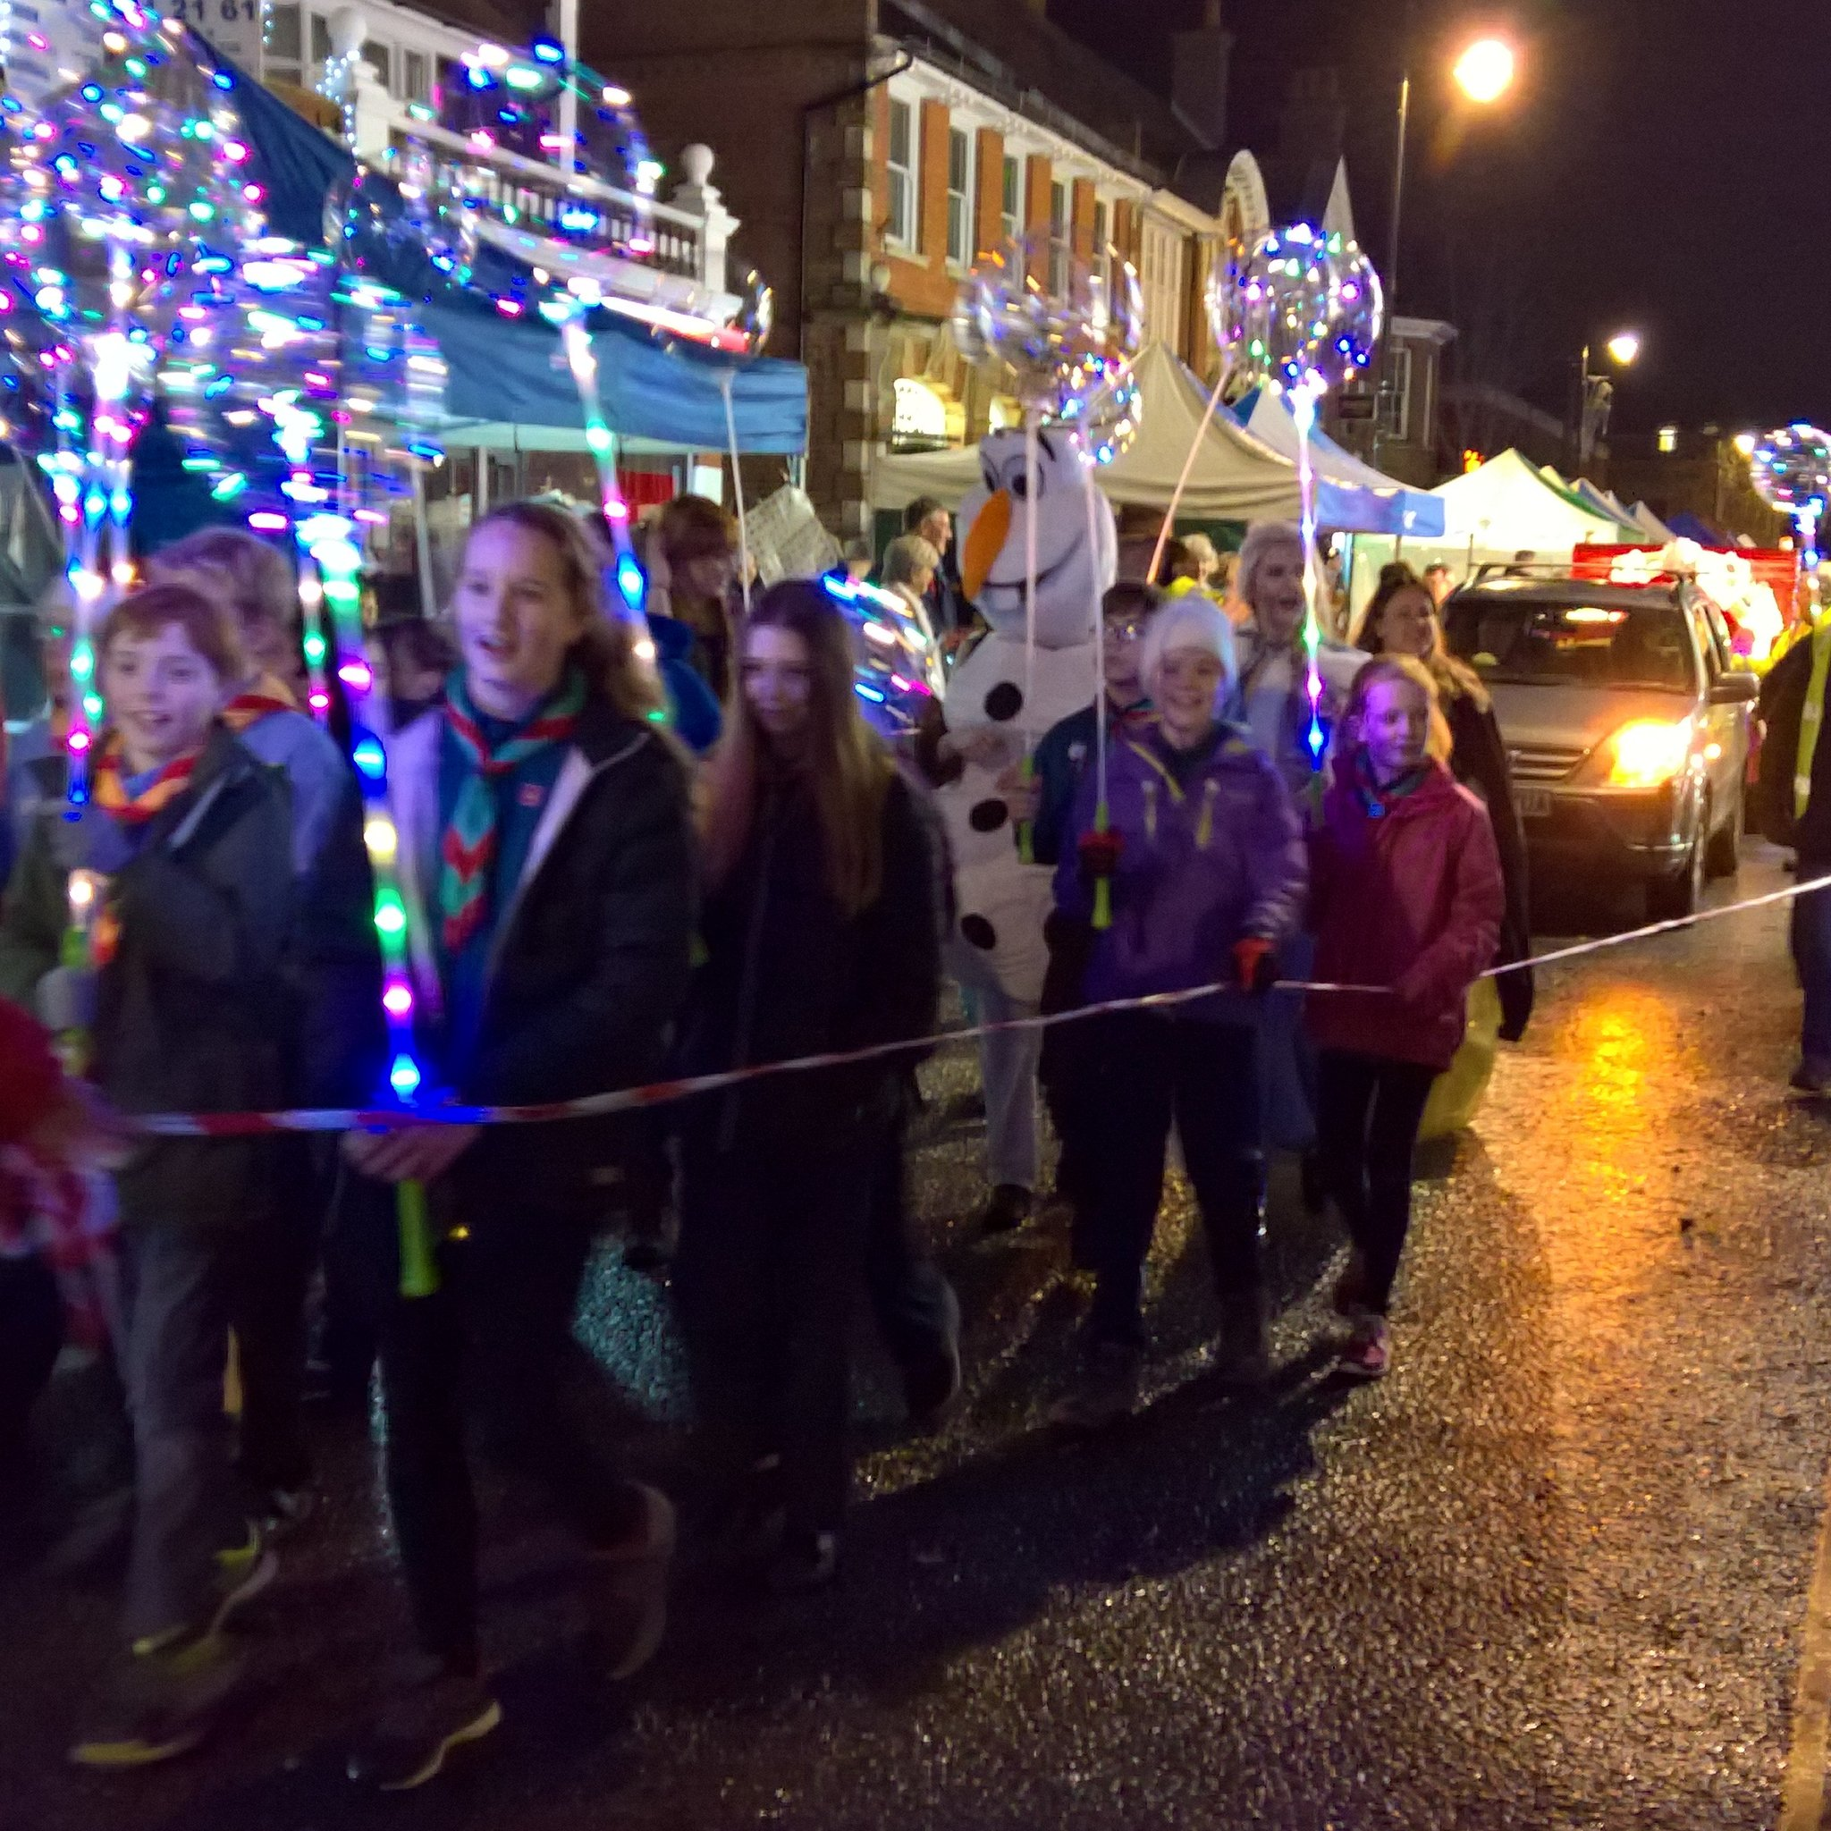
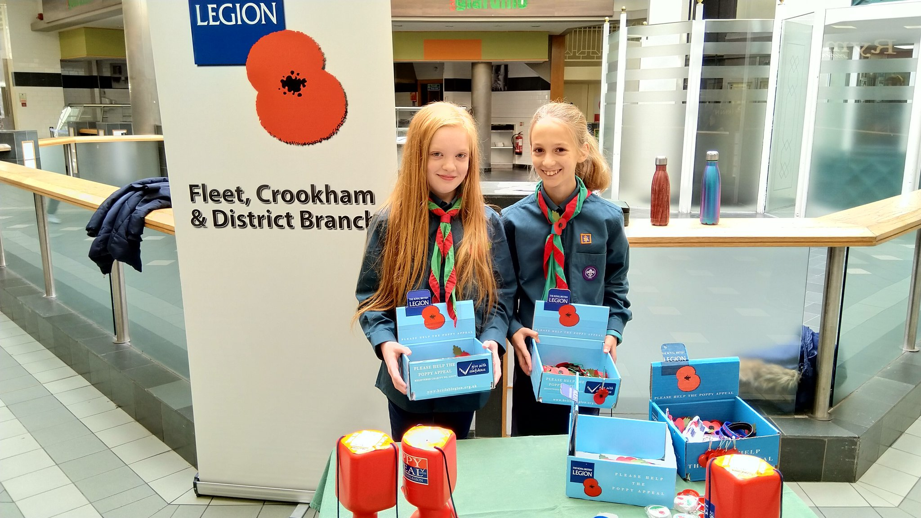
6th Fleet – Community engagement
2019
Poppy selling - £600
Remembrance parade
Santa’s Escort for Fleet Christmas lights

Slide 6
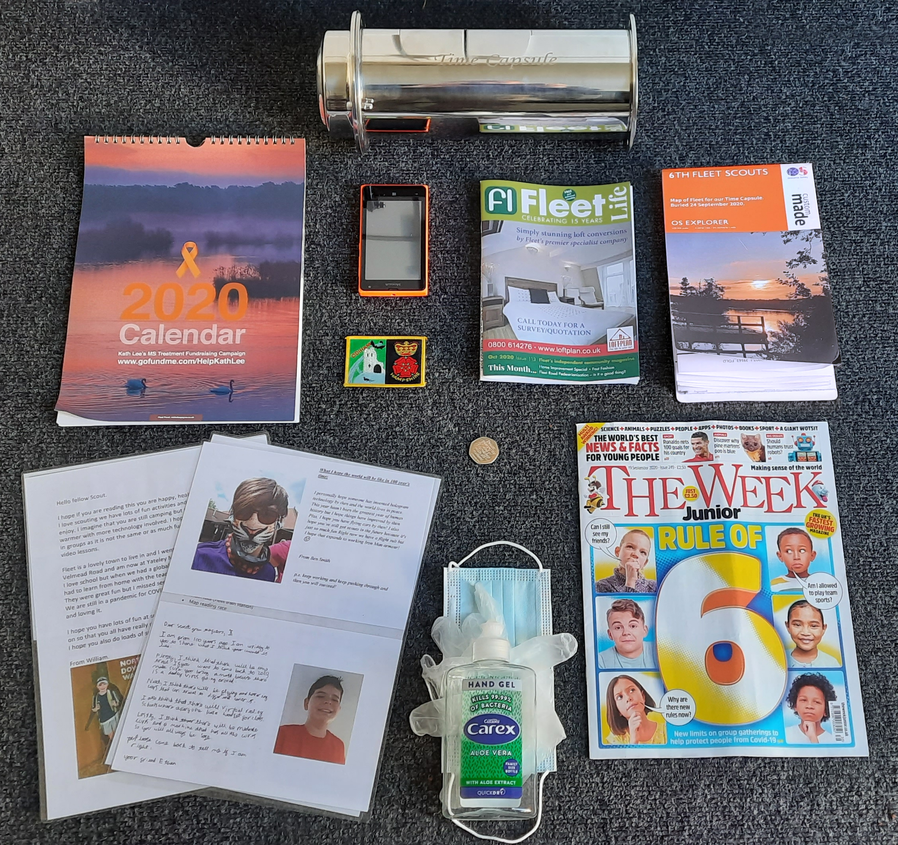
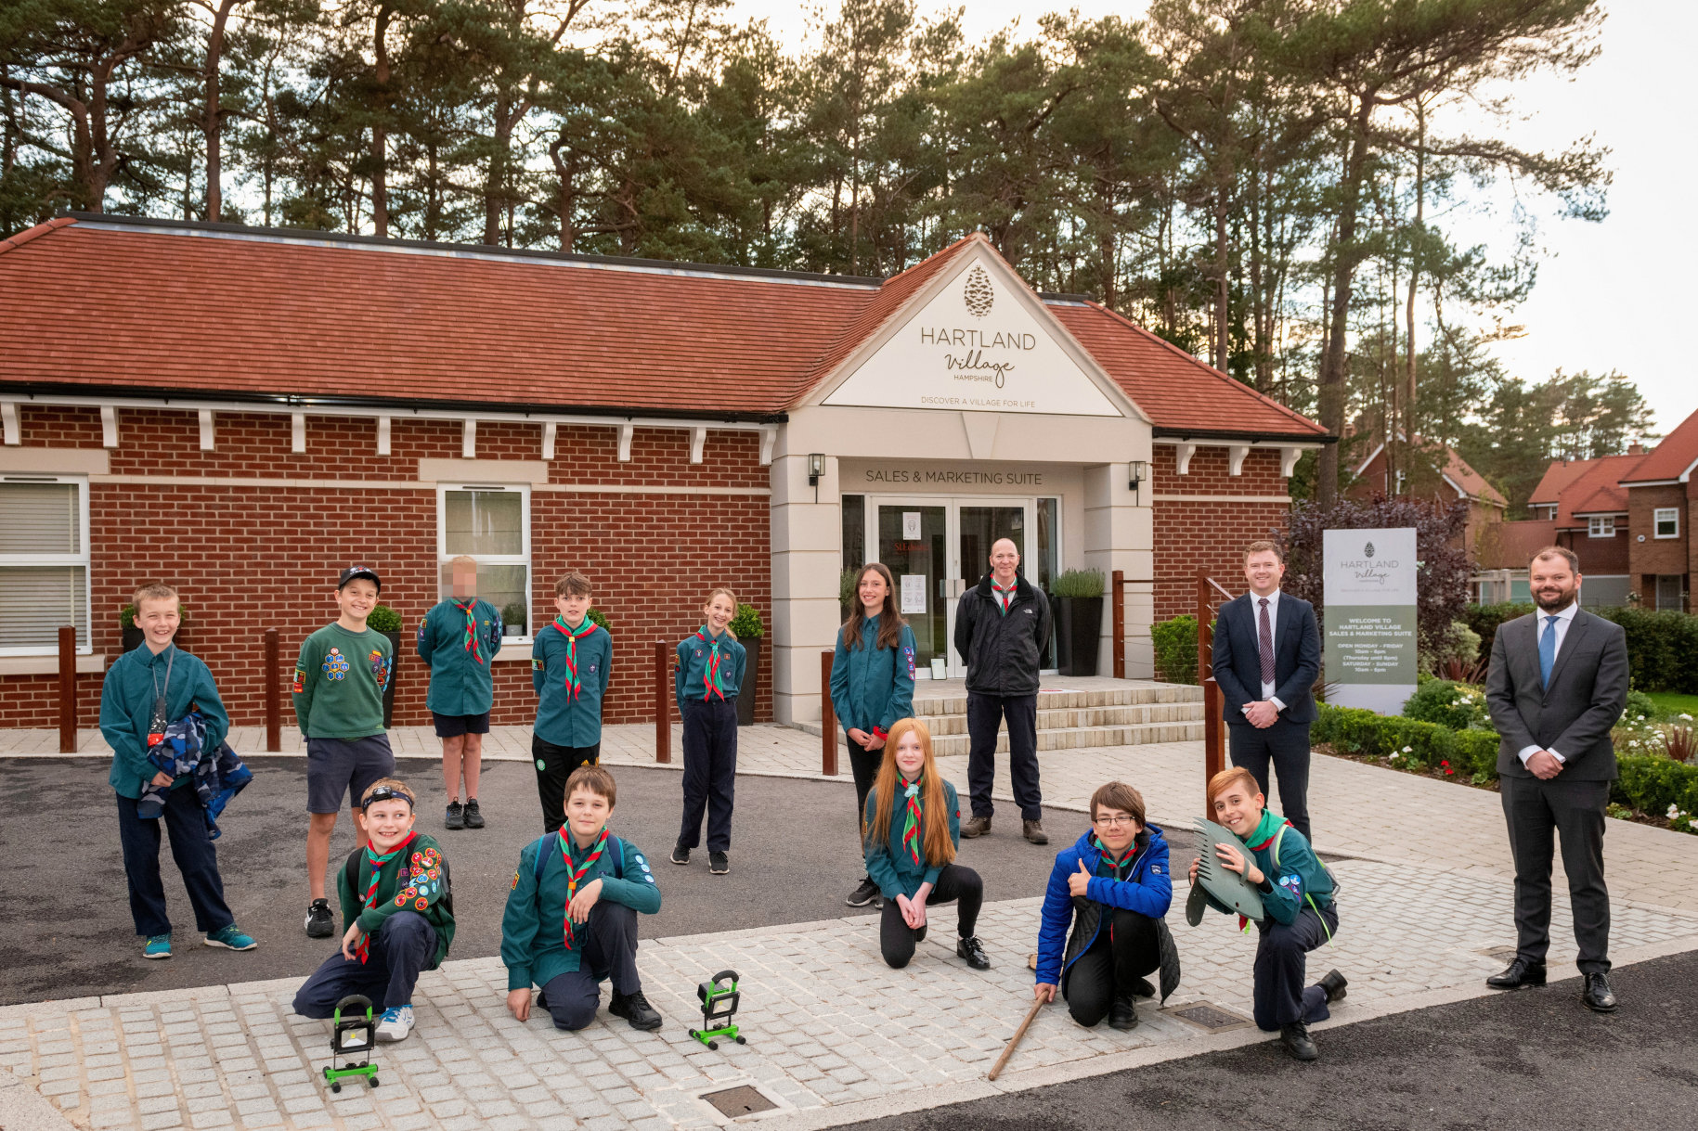
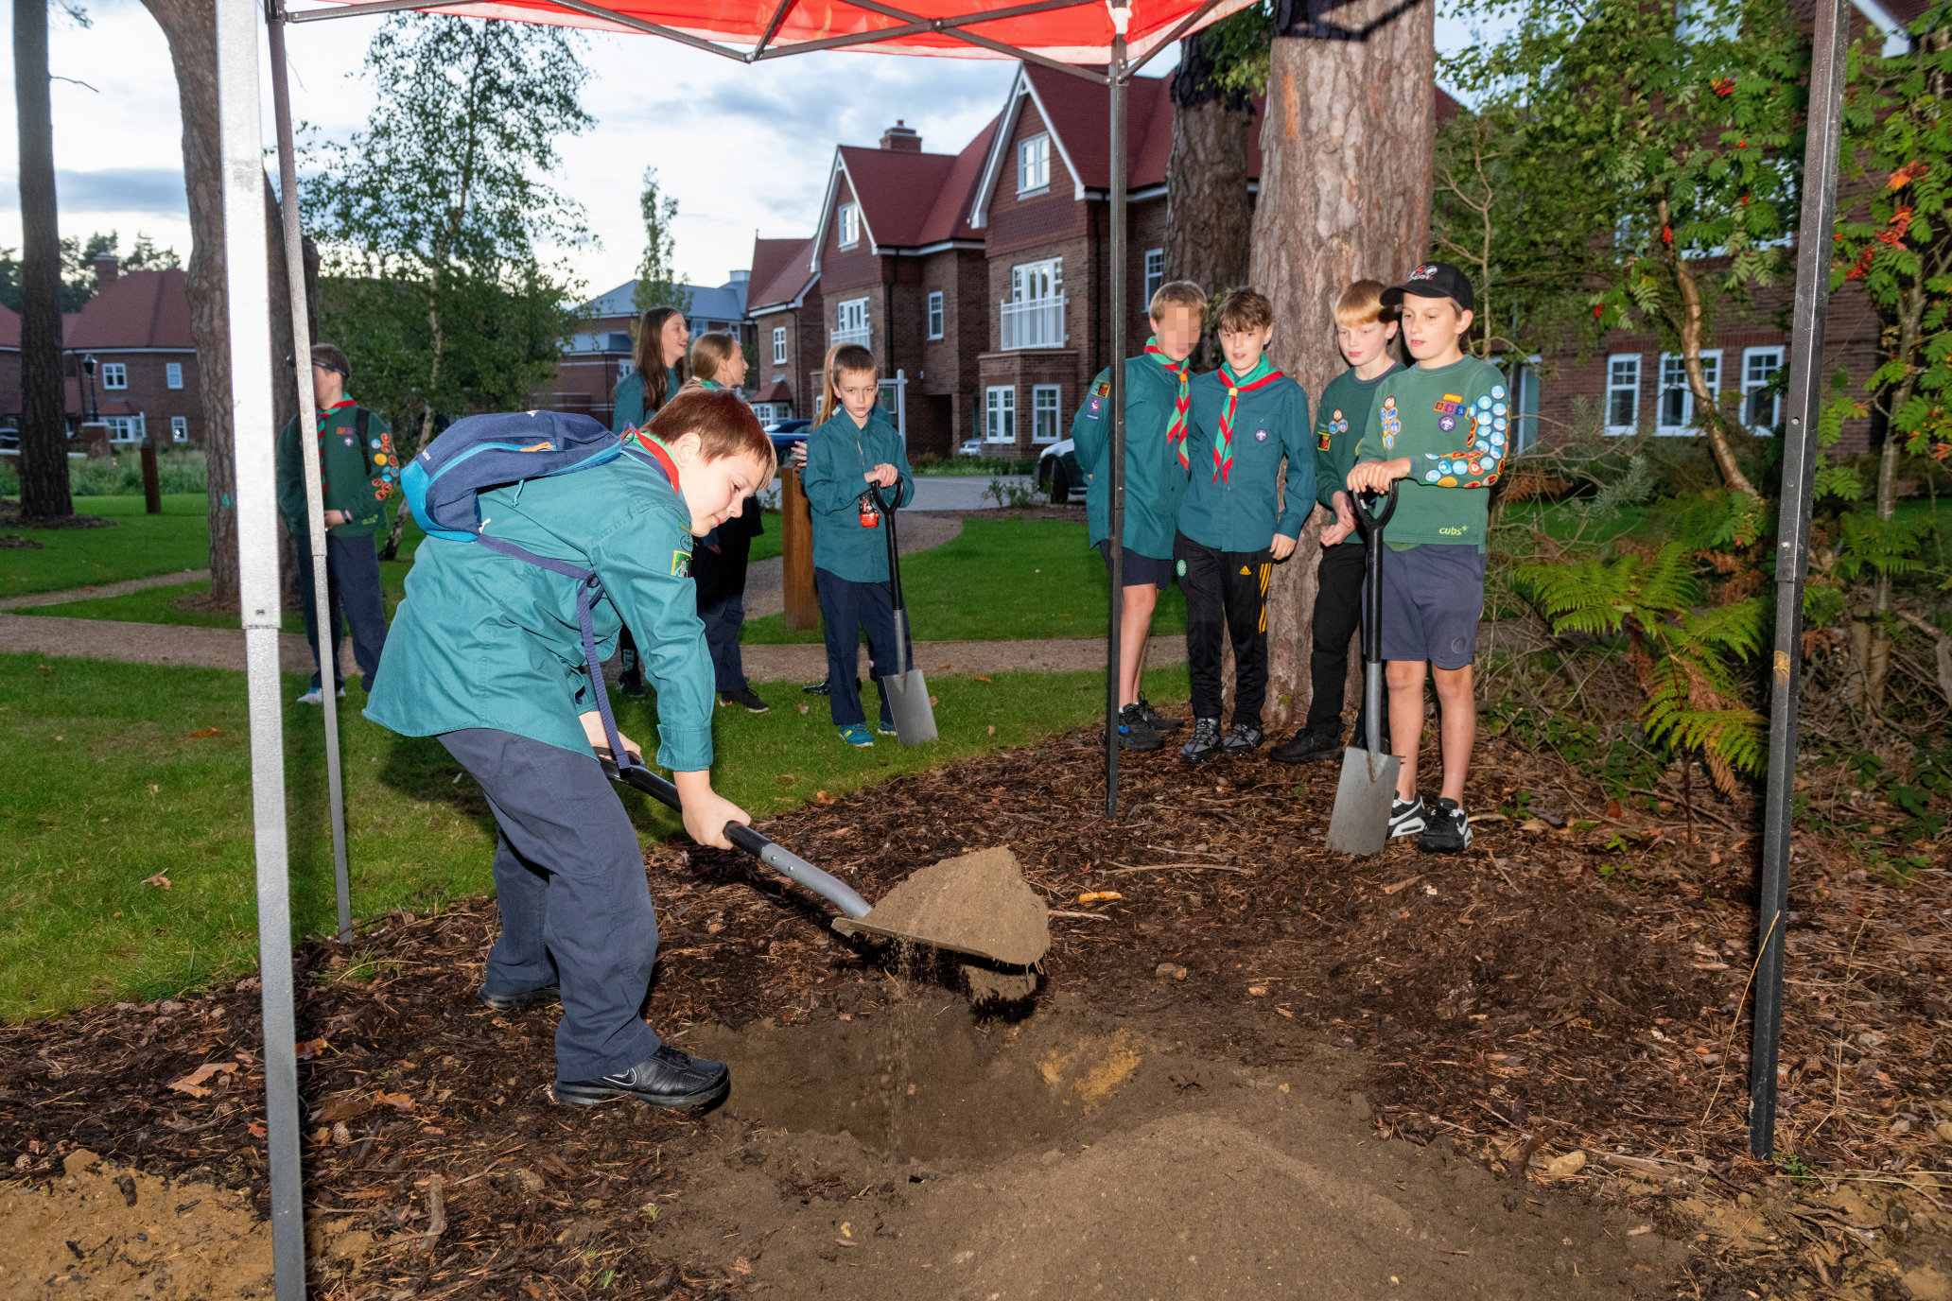
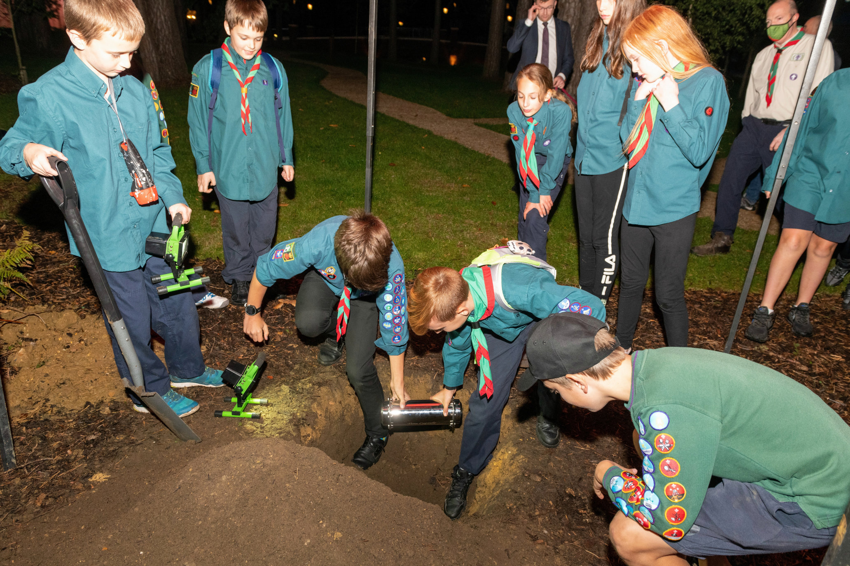
Thursday Scouts – Community engagement
2020
Hartland Village time capsule
2021
Friends of Ancells Farm table tennis open day 10 July

Slide 7
Thursday Scouts – Section growth
1 graduated to Explorers
4 left during lockdown
3 new starters
1 ASL left
1 new ASL started

Slide 9
Welcome

