Slide 1
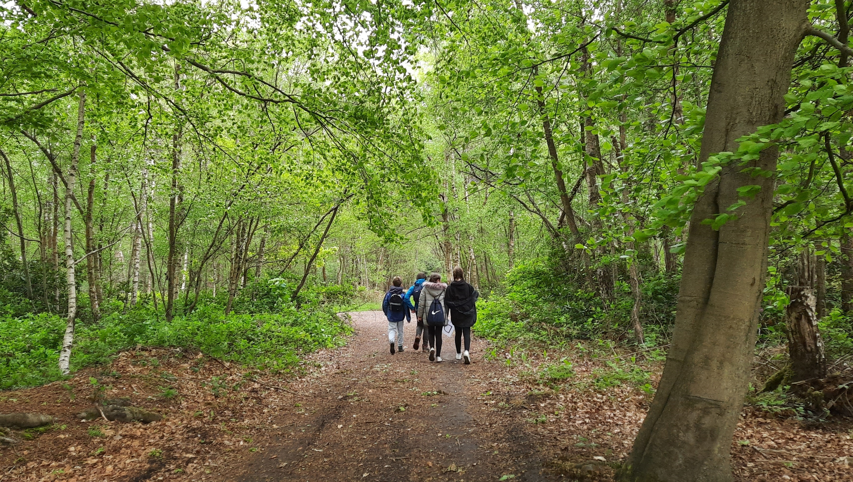
AGM 2022
Notes:
Huānyíng: hwan- yeen

Slide 2
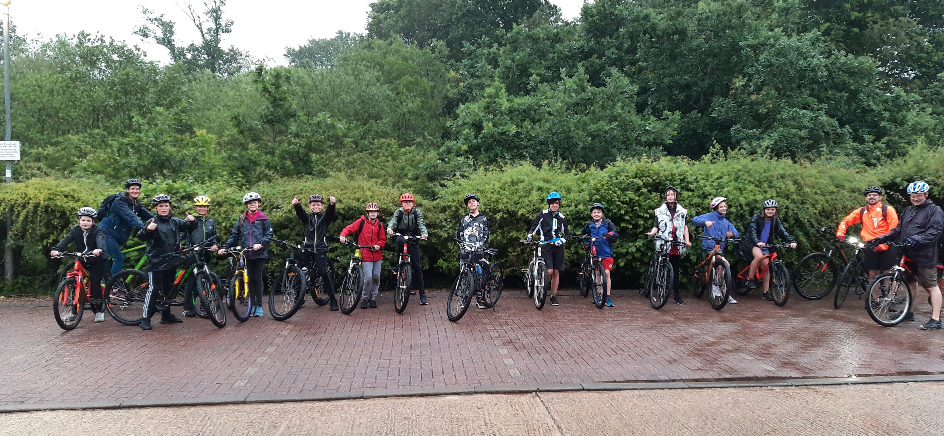
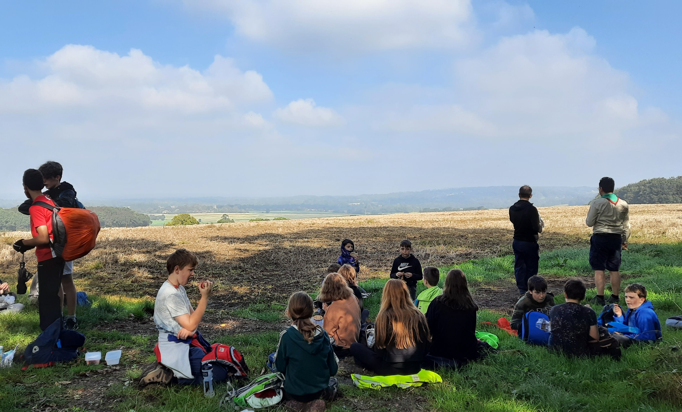
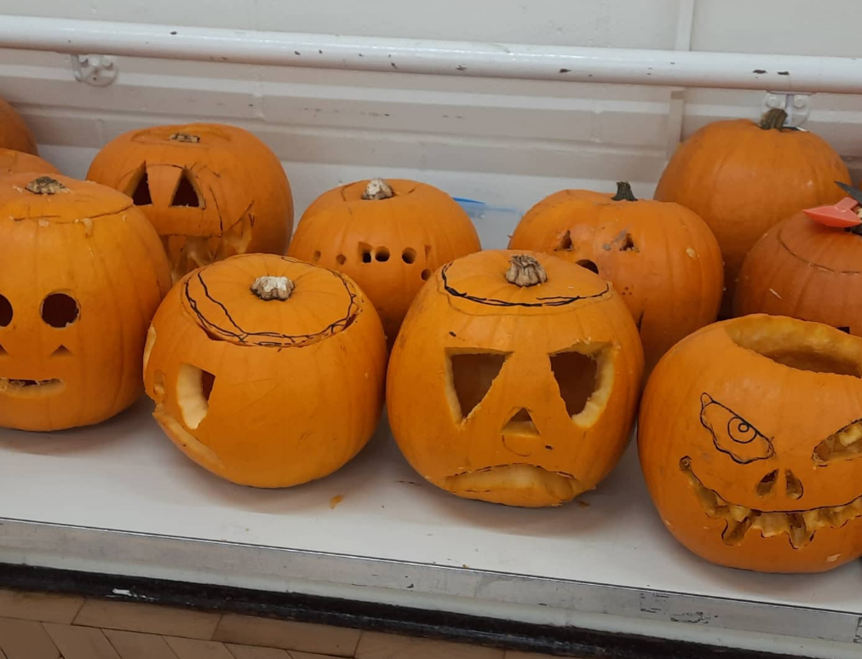
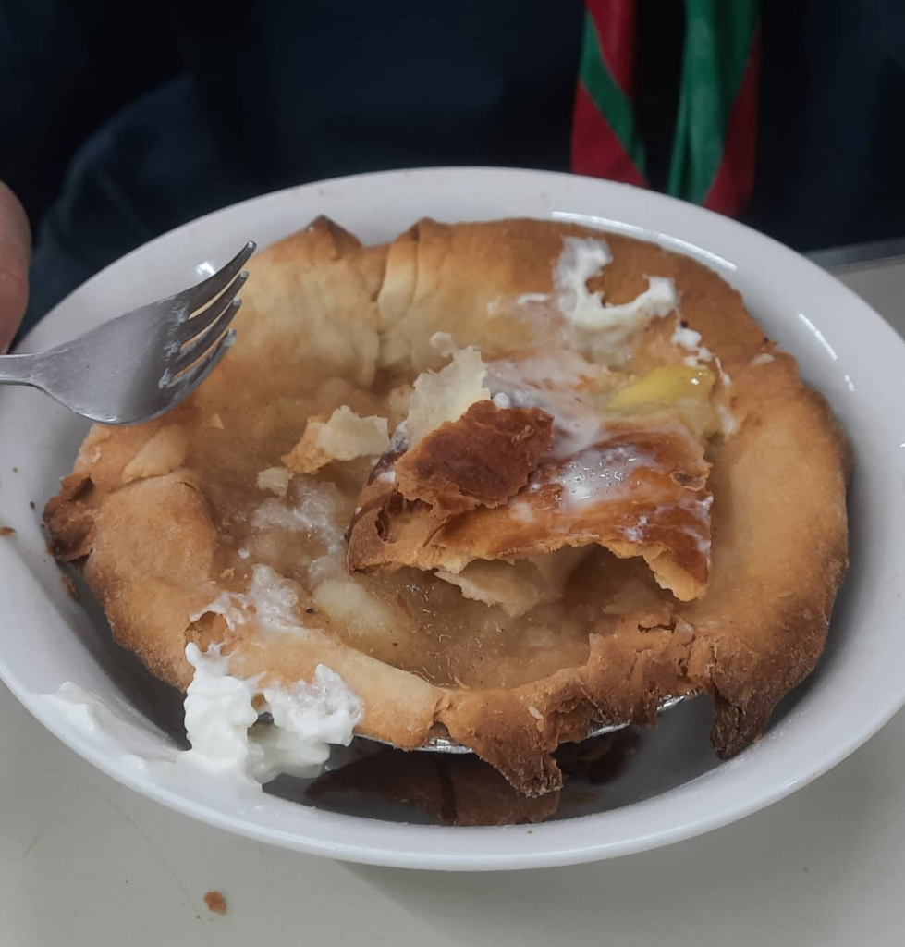
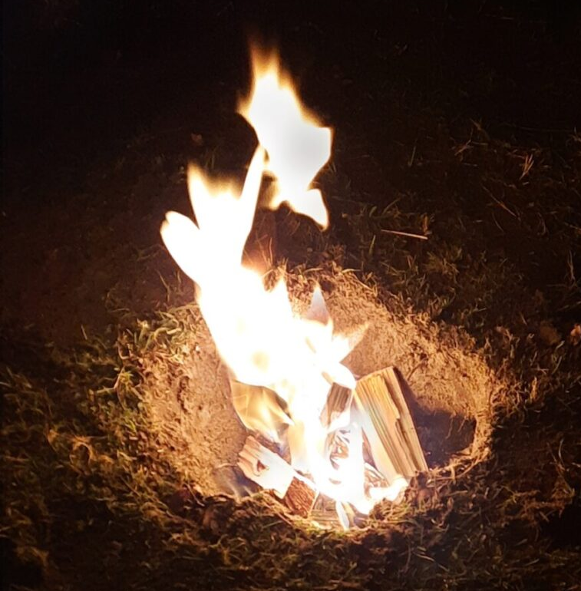
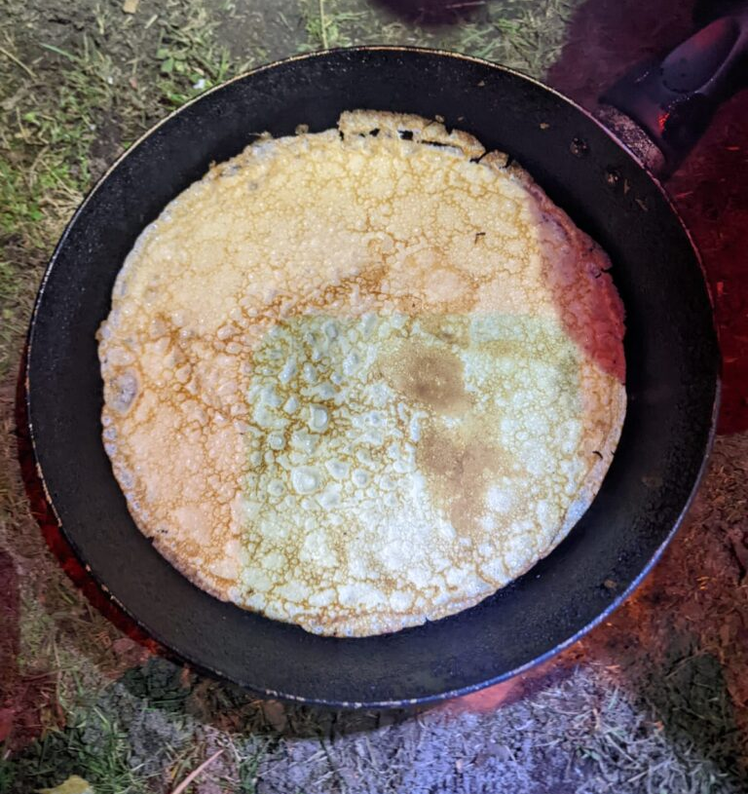
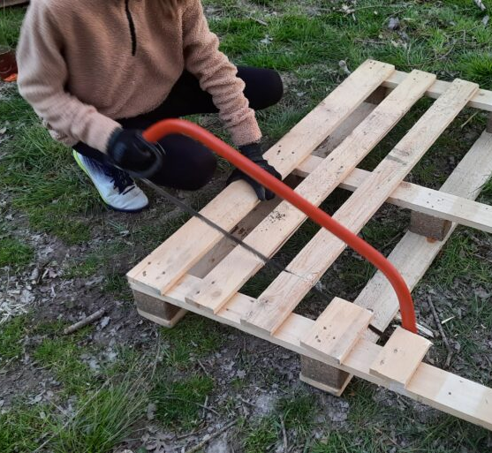
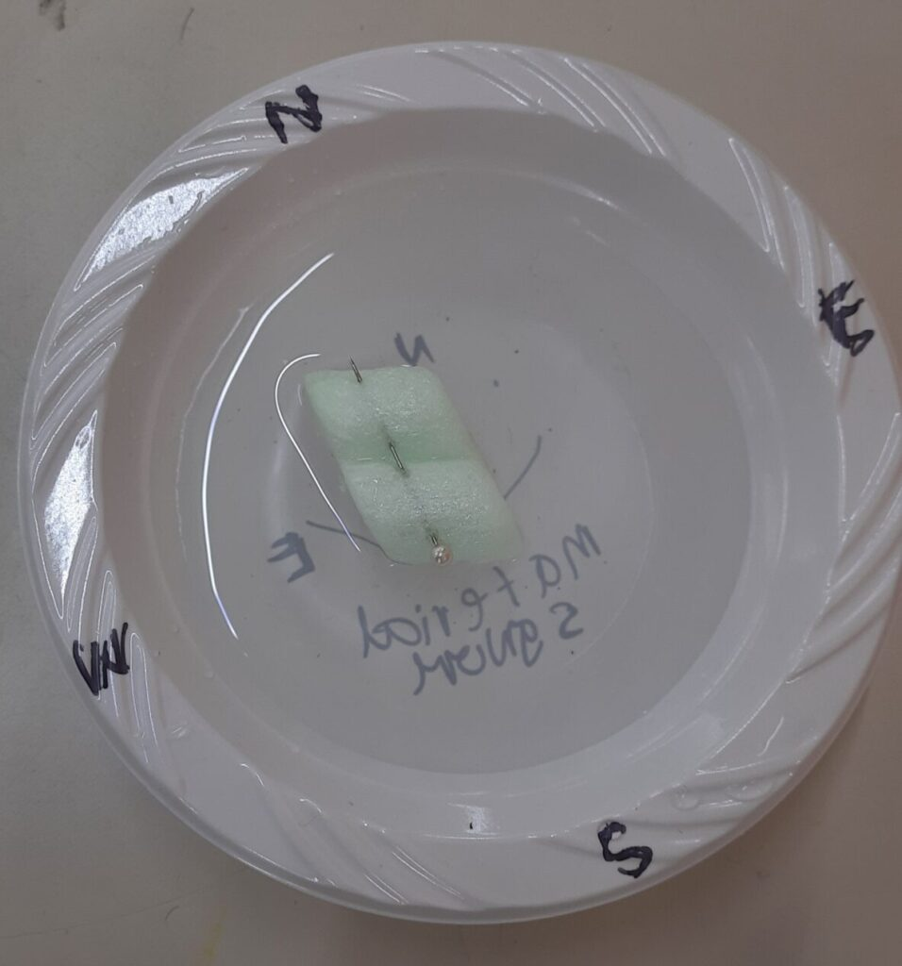
Thursday Scouts – Activities
Notes:
Camp
Hikes
Water sports
Pumpkin carving & conkers
Cooking inside & out
Bike rides
Outdoor skills: firelighting, axes & saws and shelter-building
Science

Slide 3
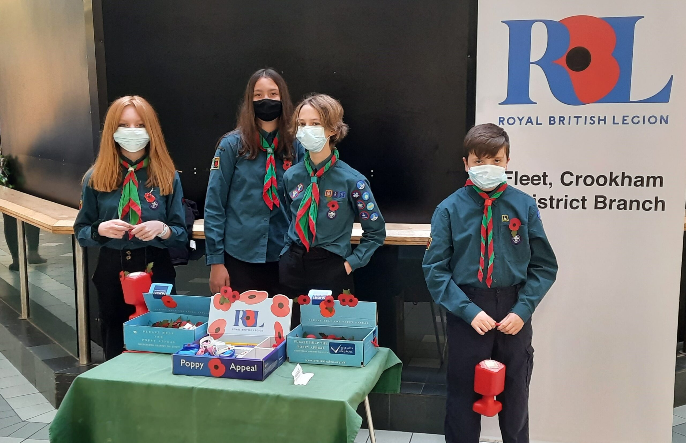
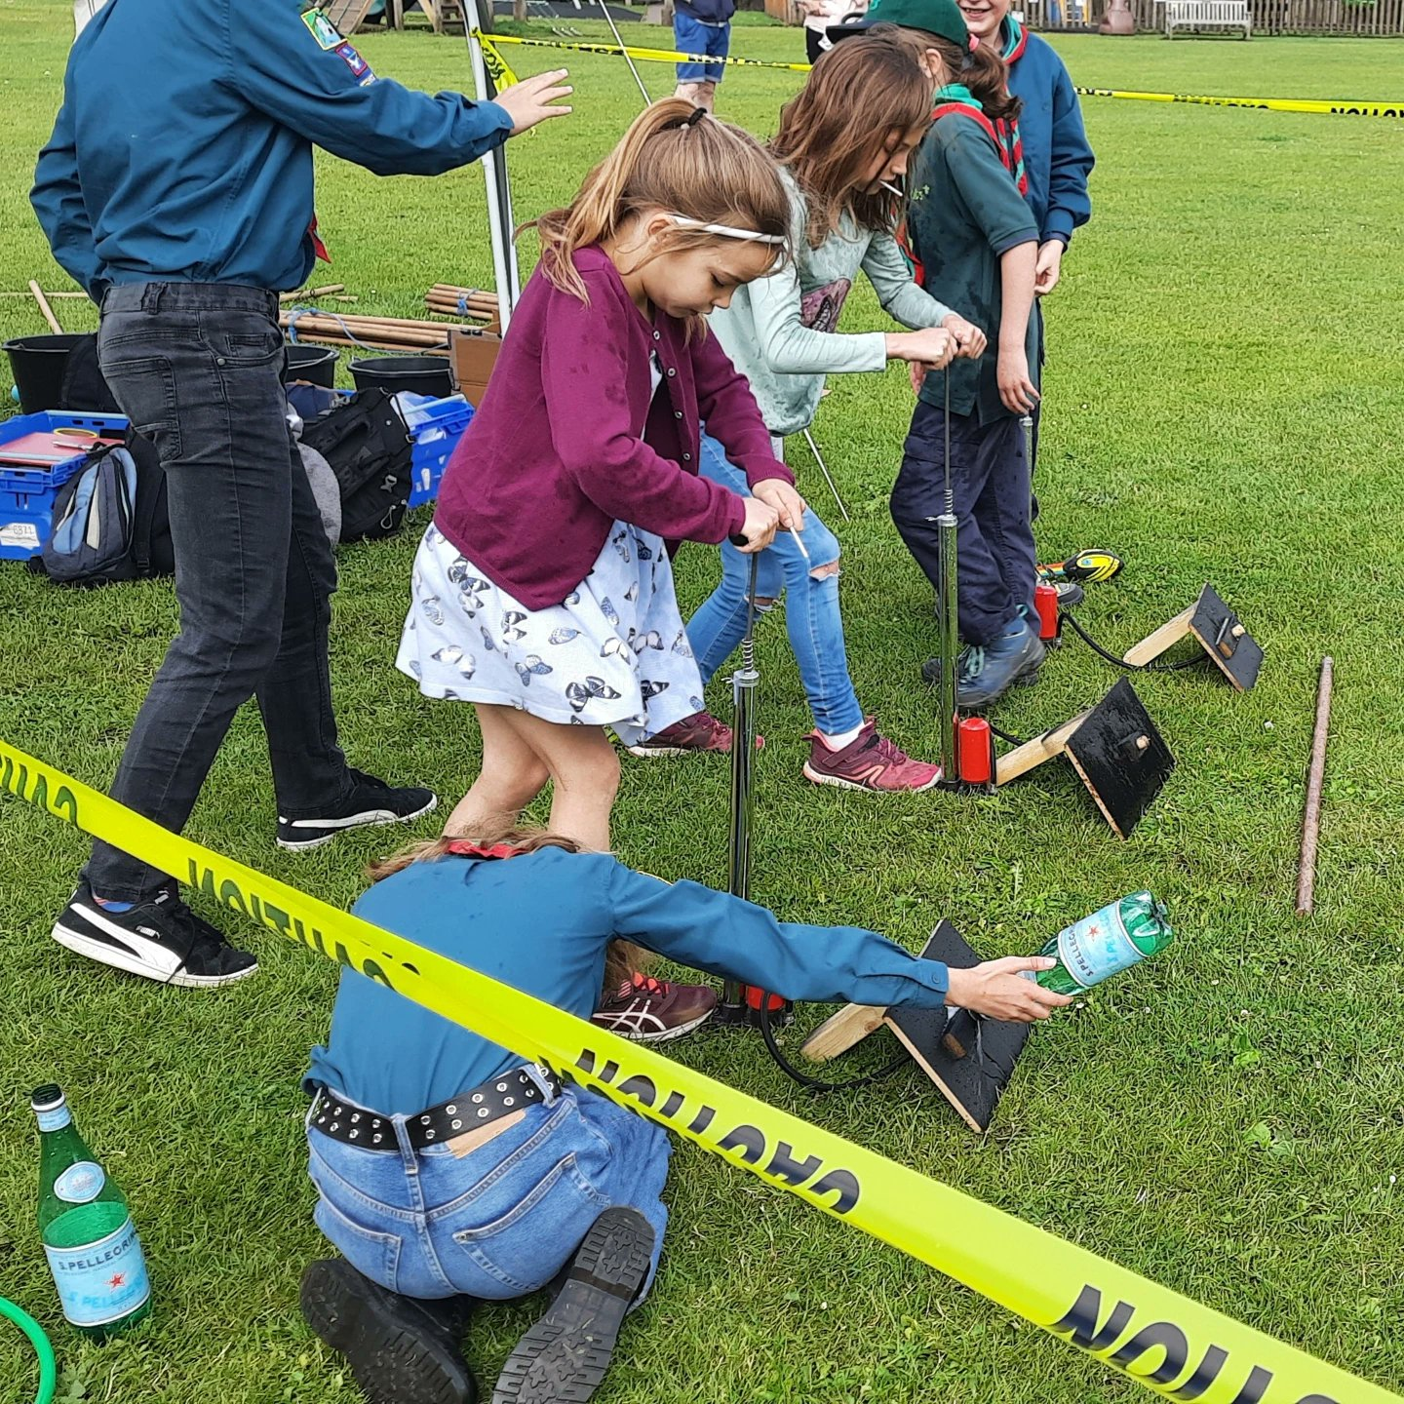
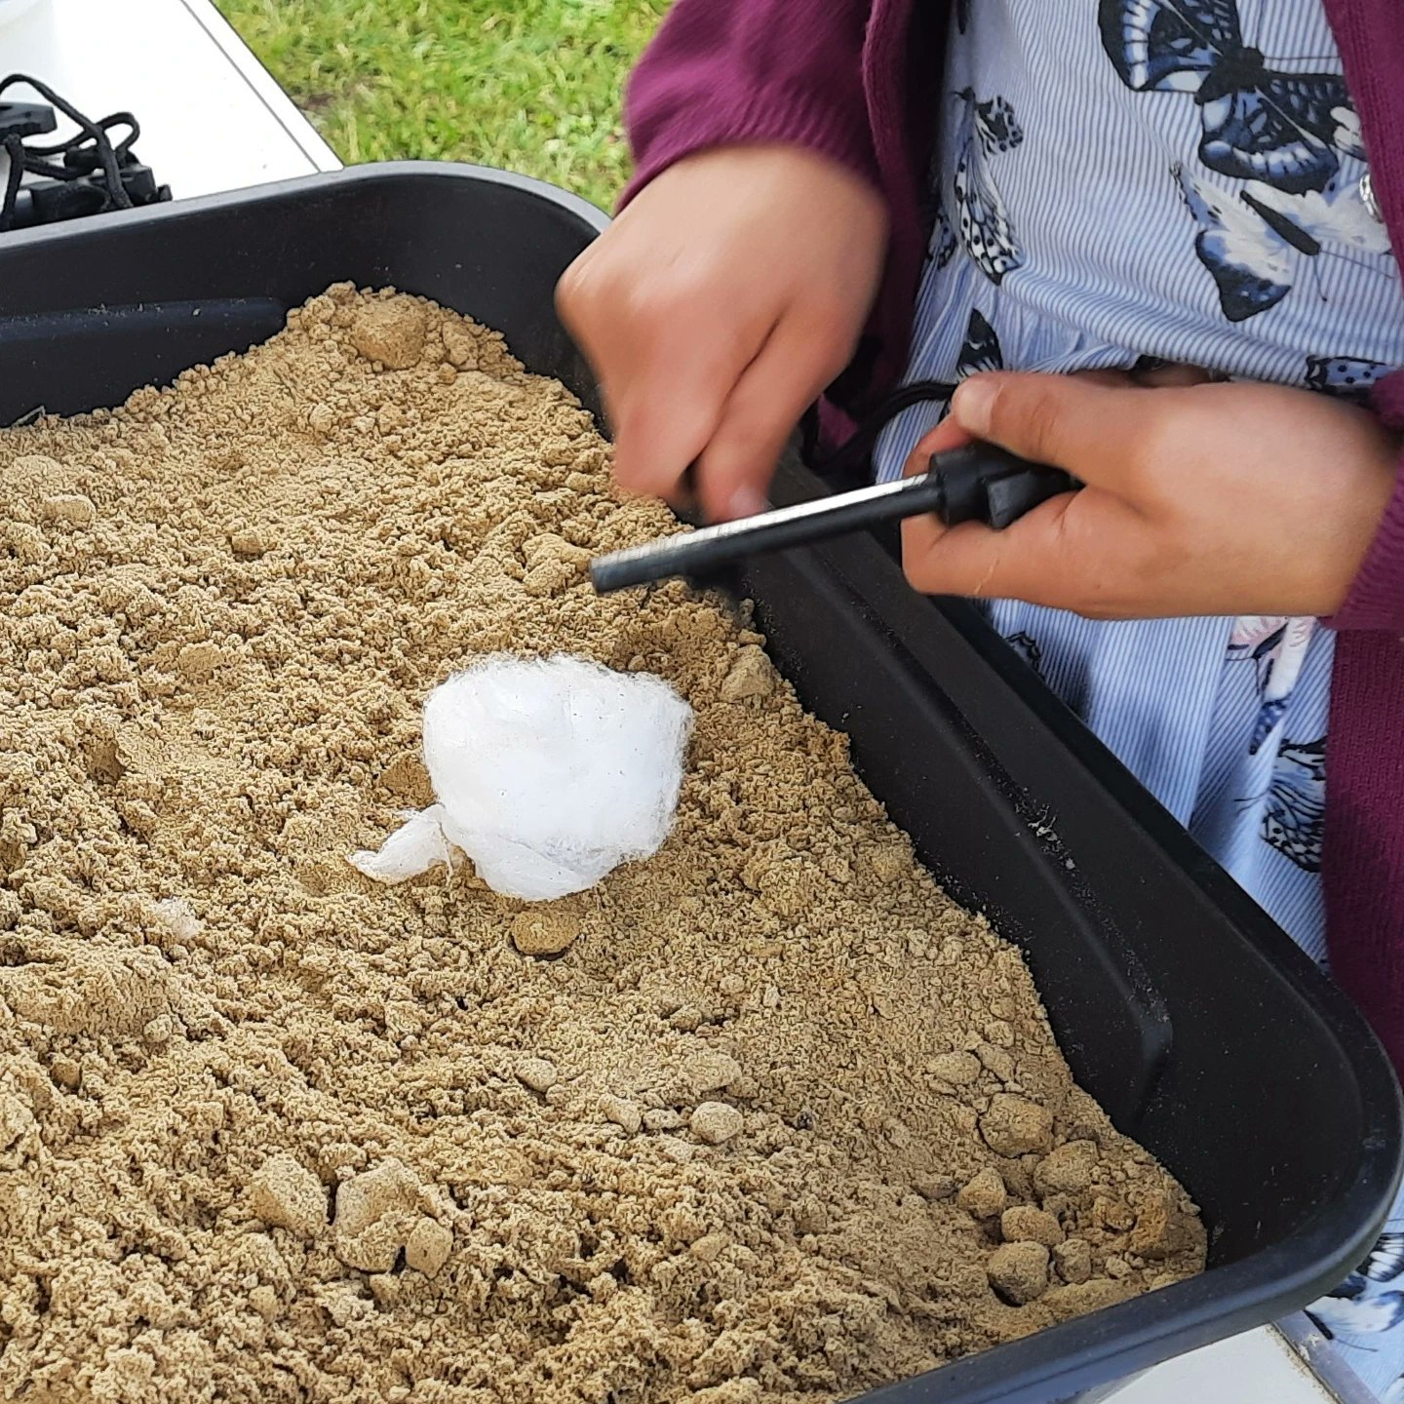
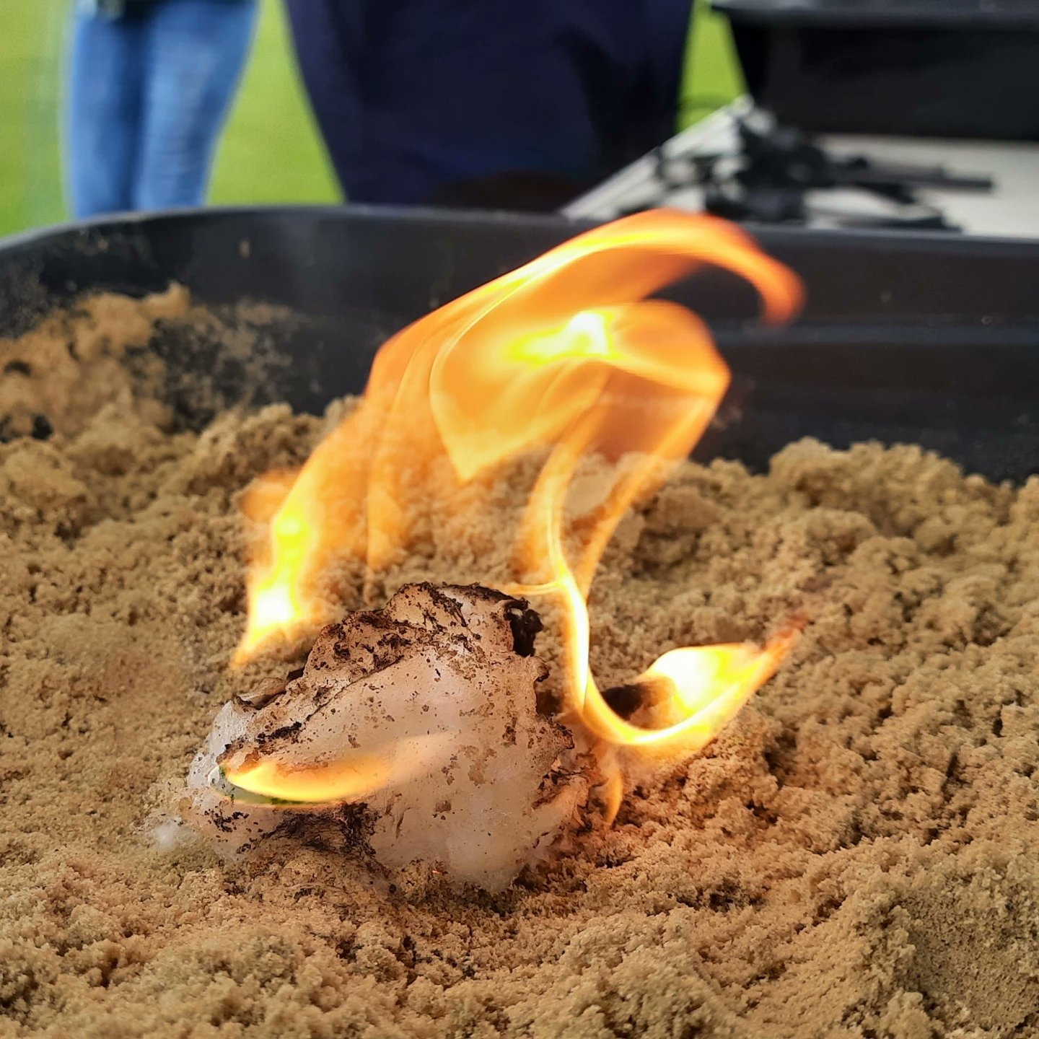
6th Fleet – Community engagement
Poppy selling - £190
Remembrance parade
Ancells Farm table tennis tournament

Slide 4
6th Fleet – Section growth
3 new invested leaders
1 new Scouts’ Badge secretary
Growing waiting list
1 new pre-provisional leader
Insufficient adults to grow

Slide 5
YouShape
Learn how to speak up and take the lead
Decide what you want to achieve
Work together
Take the lead
Represent your group

Slide 6
Awards and badges
168
56
183

Slide 7
Chief Scout’s Bronze Award
This is the highest award a Beaver can earn
A Beaver must earn four activity badges and six challenge awards:
My World
My Skills
My Outdoors
My Adventure
Teamwork
Personal
Congratulations to:
Harry Tulip, Kiana Coley, Charlie Willis, Oliver Kirke

Slide 8
Chief Scout's Silver Award
This is the highest award a Cub can earn
A Cub must earn six activity badges and seven challenge awards
Our World
Our Skills
Our Outdoors
Our Adventure
Teamwork
Team Leader
Personal
Congratulations to:
Grace Skidmore & Zoya Khurram

Slide 9
Chief Scout’s Gold Award
This is the highest award a Scouts can earn
A Scout must earn six activity badges and nine challenge awards
World
Skills
Creative
Outdoors
Adventure
Expedition
Teamwork
Team Leader
Personal
Congratulations to:
Reuban Oldreive

Slide 10
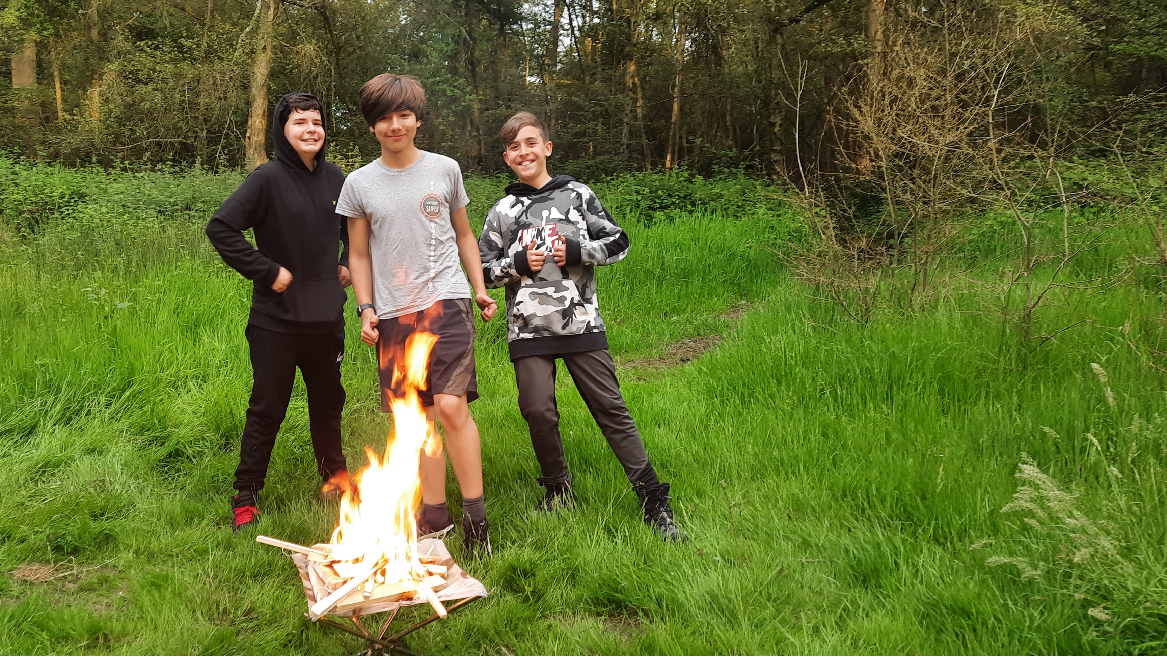
Thank you

