Slide 1
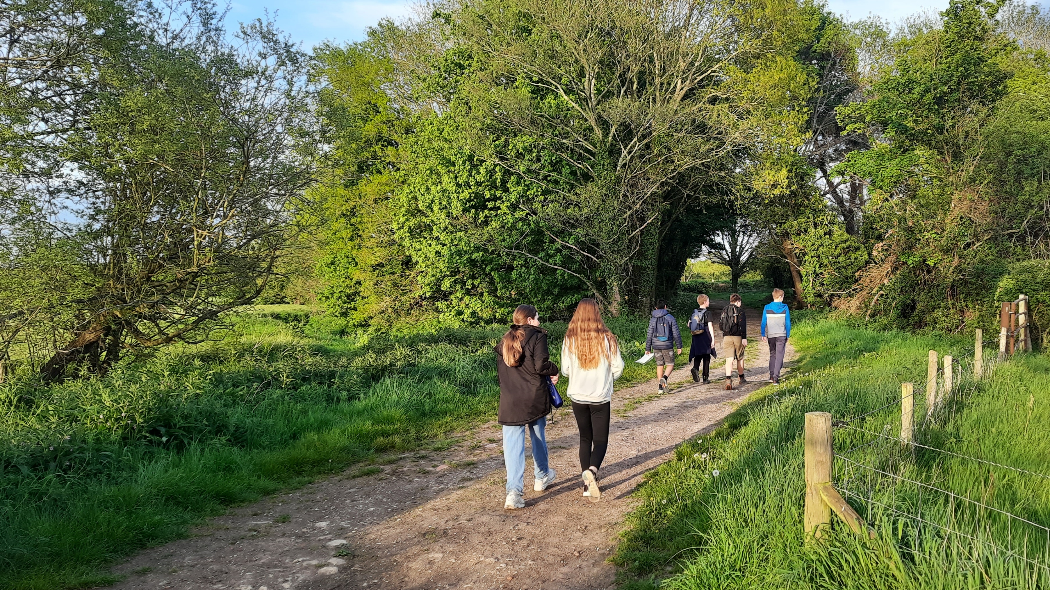
AGM 2023
Notes:
Huānyíng: hwan- yeen

Slide 2
Agenda
Welcome
Minutes of the last meeting (available at the entrance table)
Presentation by Friday (Alder) Beavers
Formal appointments & election
Entertainment by Friday (Tiger) Cubs
Accounts
Presentation by Friday Scouts
Presentation by Thursday Scouts
GSL to celebrate achievements
Close
Hot dogs

Slide 4
6th Fleet Group Accounts 2022
 | 2022 | 2021
Income
Subs & Activities | 7,580 | 7,053
Gift Aid | 1,383 | 1,799
Donations & Fundraising | 702 | 389
Other Income | 93 | 0
Total Income | 9,758 | 9,240
Expenses
Activities, Camps & Badges | 4,024 | 3,072
Rent & Insurance | 3,225 | 1,225
District, County & HQ Scout Membership | 1,960 | 2,930
Equipment & Other | 1,030 | 874
Total Expense | 10,239 | 8,101
Total (loss)/surplus for the year | (482) | 1,139
Operational funds | 7,914 | 8,396
Full year programme for the Beavers (2021 Covid)
Change in accounting year in 2021
Odiham District Benevity Donation
T-shirt sales
Full year programme of activities (Some of 2021 was still Covid restricted). Only pay for hall when it is used.
Members reduced from 63 to 40 (census taken mid Covid)
New Tents, hall keys and leader uniforms
Overall down £482
Group Treasurer: Daniel Taylor
Independently examined by Joanna Dewhirst (FCS BSC)

Slide 5
6th Fleet Membership Subs Increasing
+ Gift Aid & Donations
New
Subs
£40
£45
£50
New
Costs
Last increase was 2015 and costs have gone up
Maintain excellent programme of activities
Hall Rent increasing by 8%
District, County & HQ Membership increasing by 8%
Why
now?

Slide 7
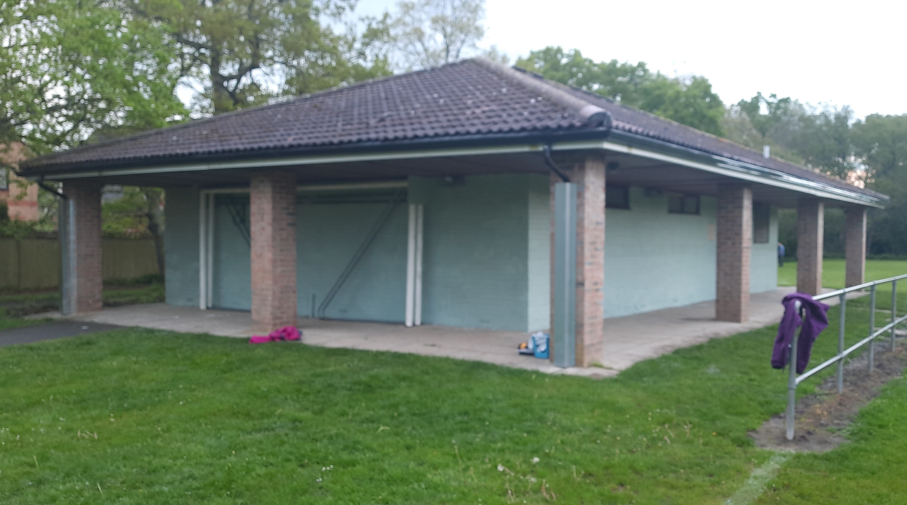
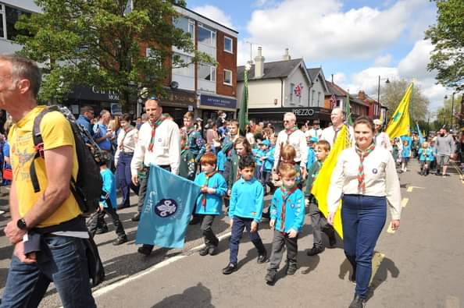
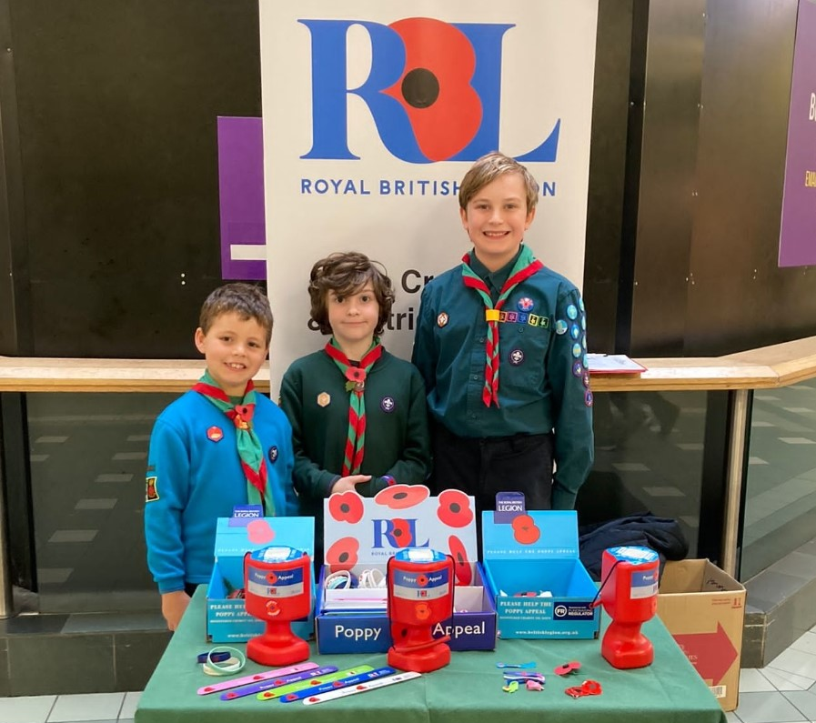
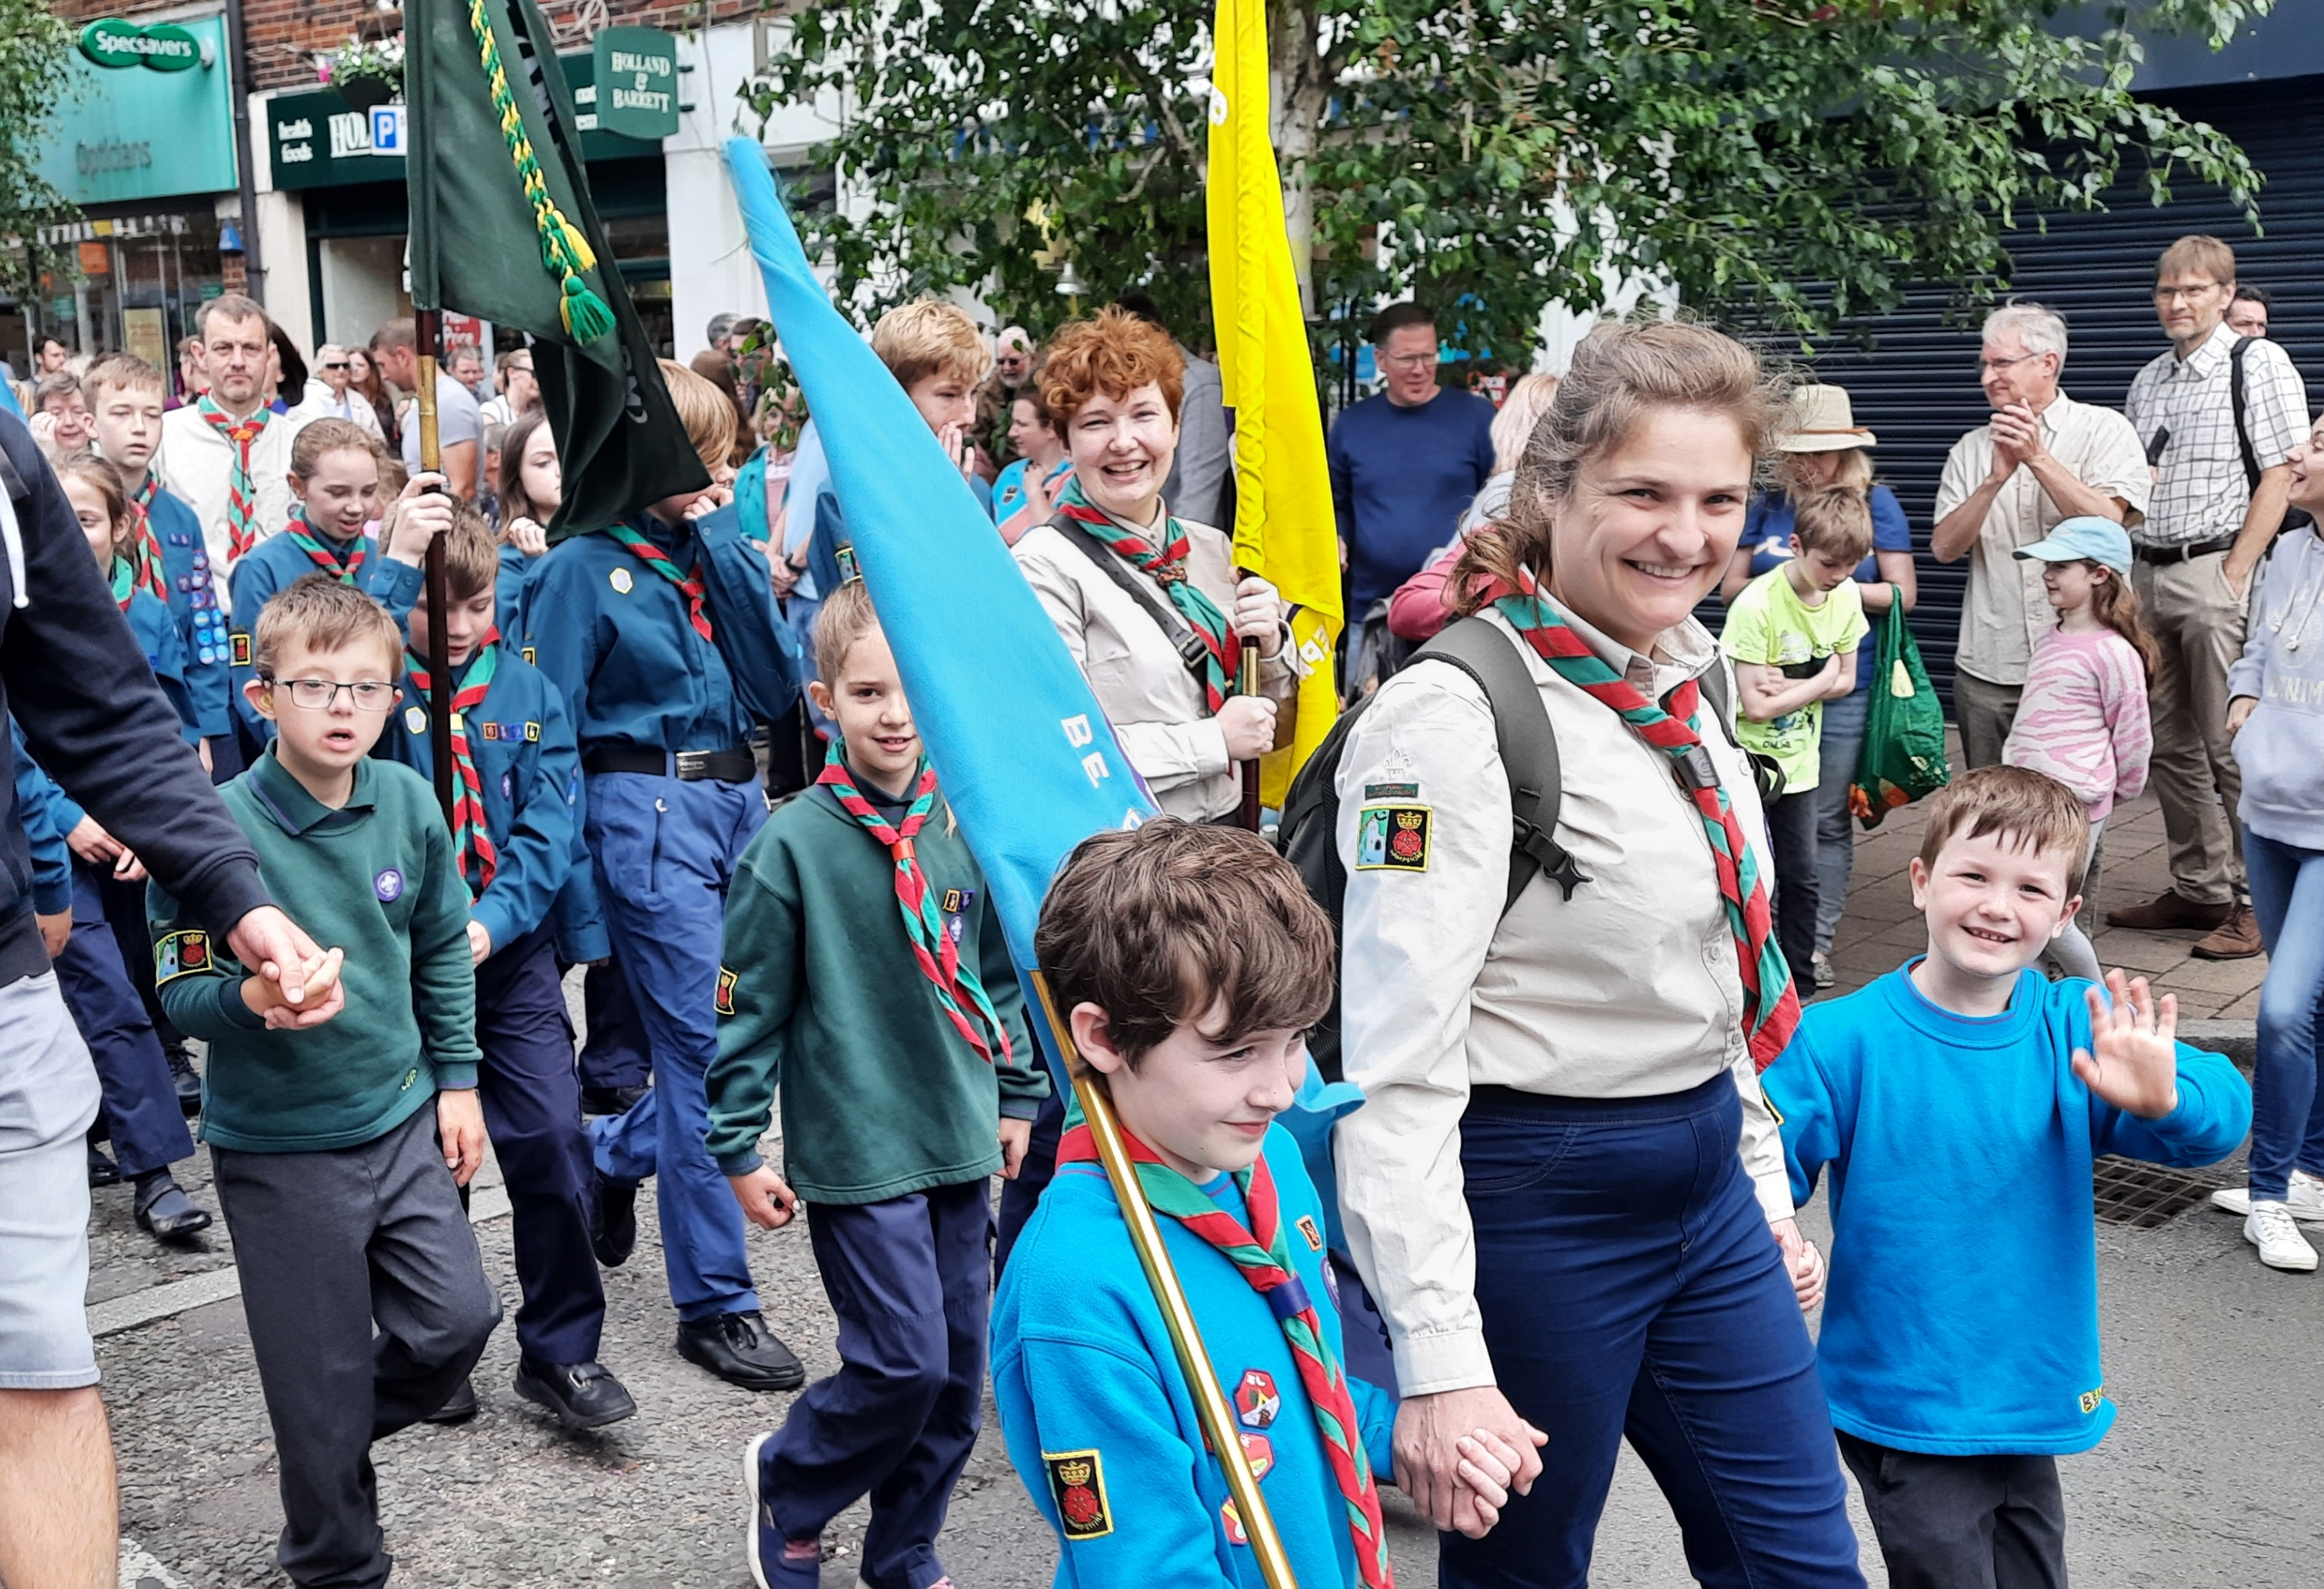
6th Fleet in the community
Pavilion painting for Friends of Ancell’s Farm
Platinum Jubilee
King Charles’ Coronation
Poppy selling for RBL

Slide 8
Group development
2 new Beaver Leaders
Gina & Steve.
Insufficient adults
Unable to split or grow Beavers.
Unable to support a waiting list.
Leader moves planned.
Group Secretary vacancy

Slide 9
Section changes
Thursday Scouts to close
Large year 9 cohort moving on.
Alternate homes found for most.
Friday leader shuffle.
New Explorer unit to open
For 6th Fleet and other groups.

Slide 10
Badges awarded
123
95
279

Slide 11
Chief Scout’s Bronze Award
This is the highest award a Beaver can earn
A Beaver must earn four activity badges and six challenge awards:
My World
My Skills
My Outdoors
My Adventure
Teamwork
Personal
Congratulations to:
Harry Tulip, Kiana Coley, Charlie Willis, Oliver Kirke

Slide 12
You Shape awards
Helping Beavers learn how to speak up and take the lead.
Young people will earn the central badge first and then choose the order in which they earn the rest.
Plan
Lead
Represent
Congratulations to:
Henry W, Oliver S, Jaxon V, Evie W, Joseph O, Kyle W, Sammy H, Joshua D & Eddie P.

Slide 13
Chief Scout's Silver Award
This is the highest award a Cub can earn
A Cub must earn six activity badges and seven challenge awards
Our World
Our Skills
Our Outdoors
Our Adventure
Teamwork
Team Leader
Personal
Congratulations to:
Joseph H & Hannah A

Slide 14
Chief Scout’s Gold Award
This is the highest award a Scouts can earn
A Scout must earn six activity badges and nine challenge awards
World
Skills
Creative
Outdoors
Adventure
Expedition
Teamwork
Team Leader
Personal
Congratulations to:
Tara B
Andrew B (now an Explorer)

Slide 15
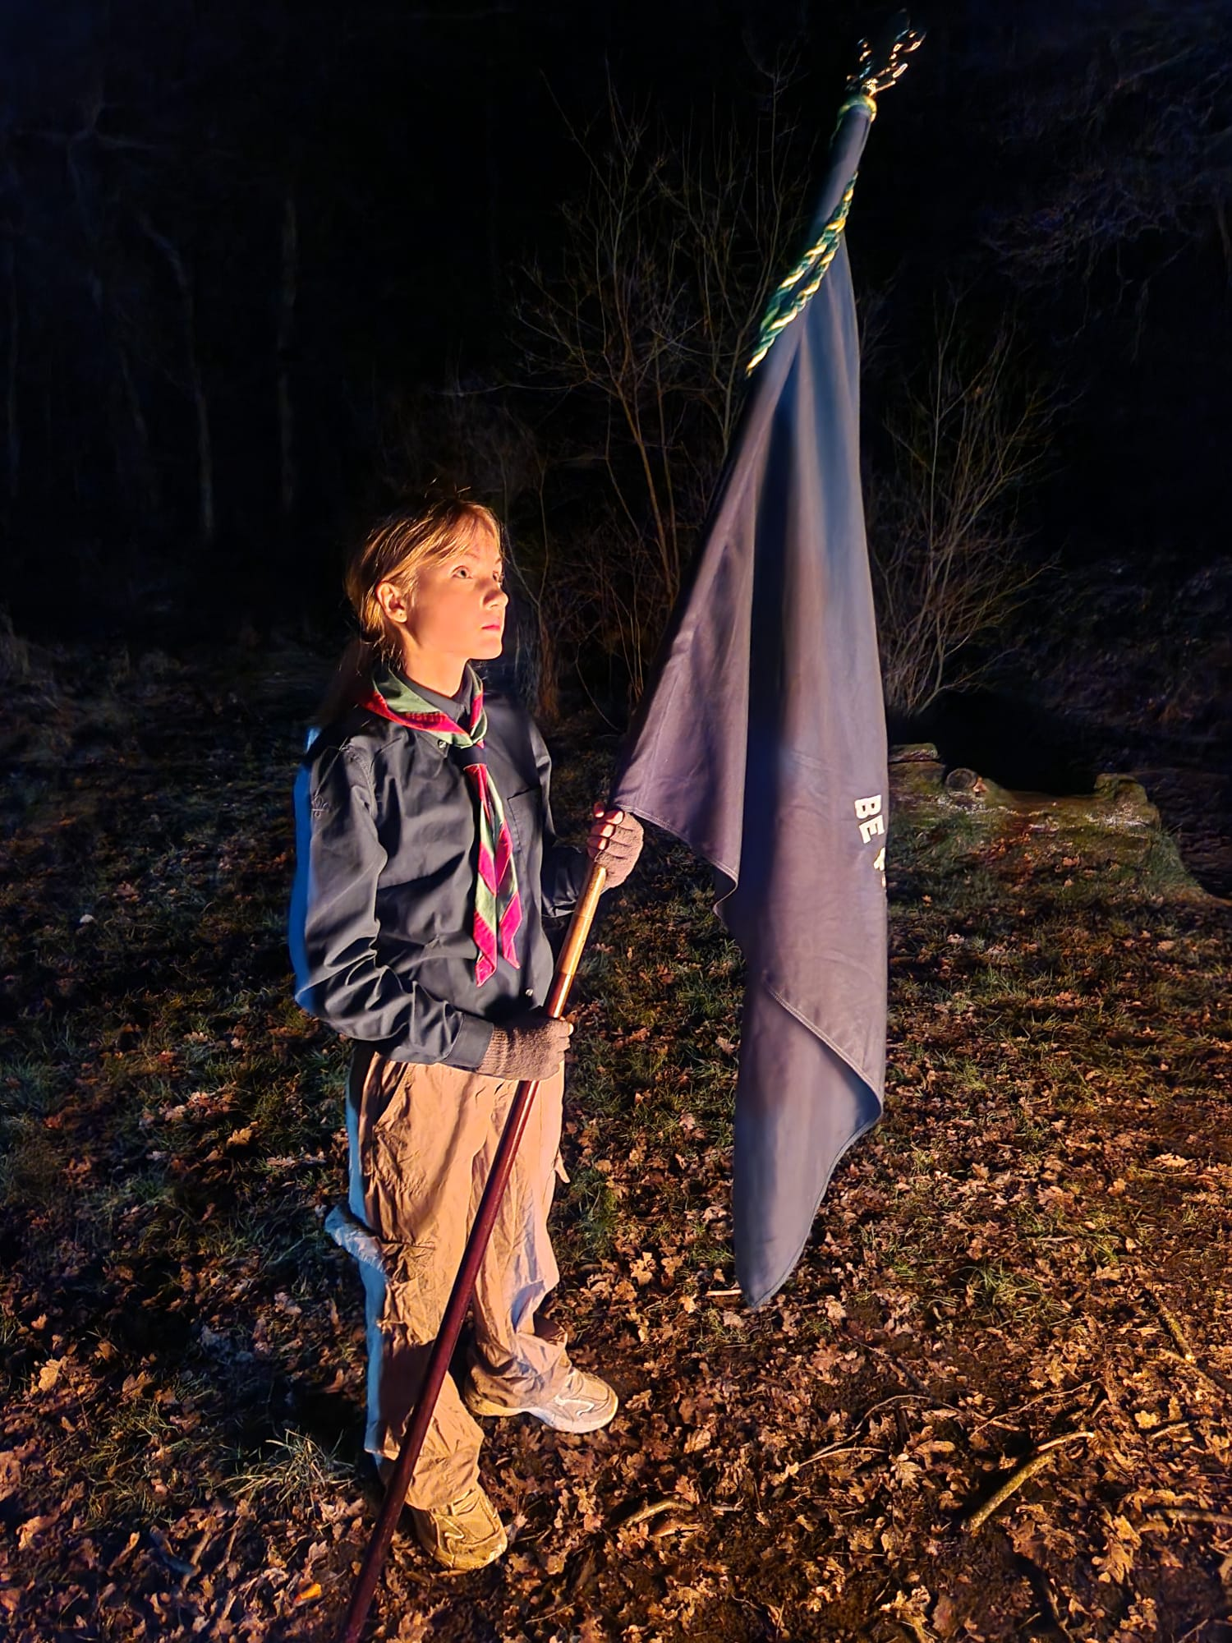
Thank you

