Slide 1
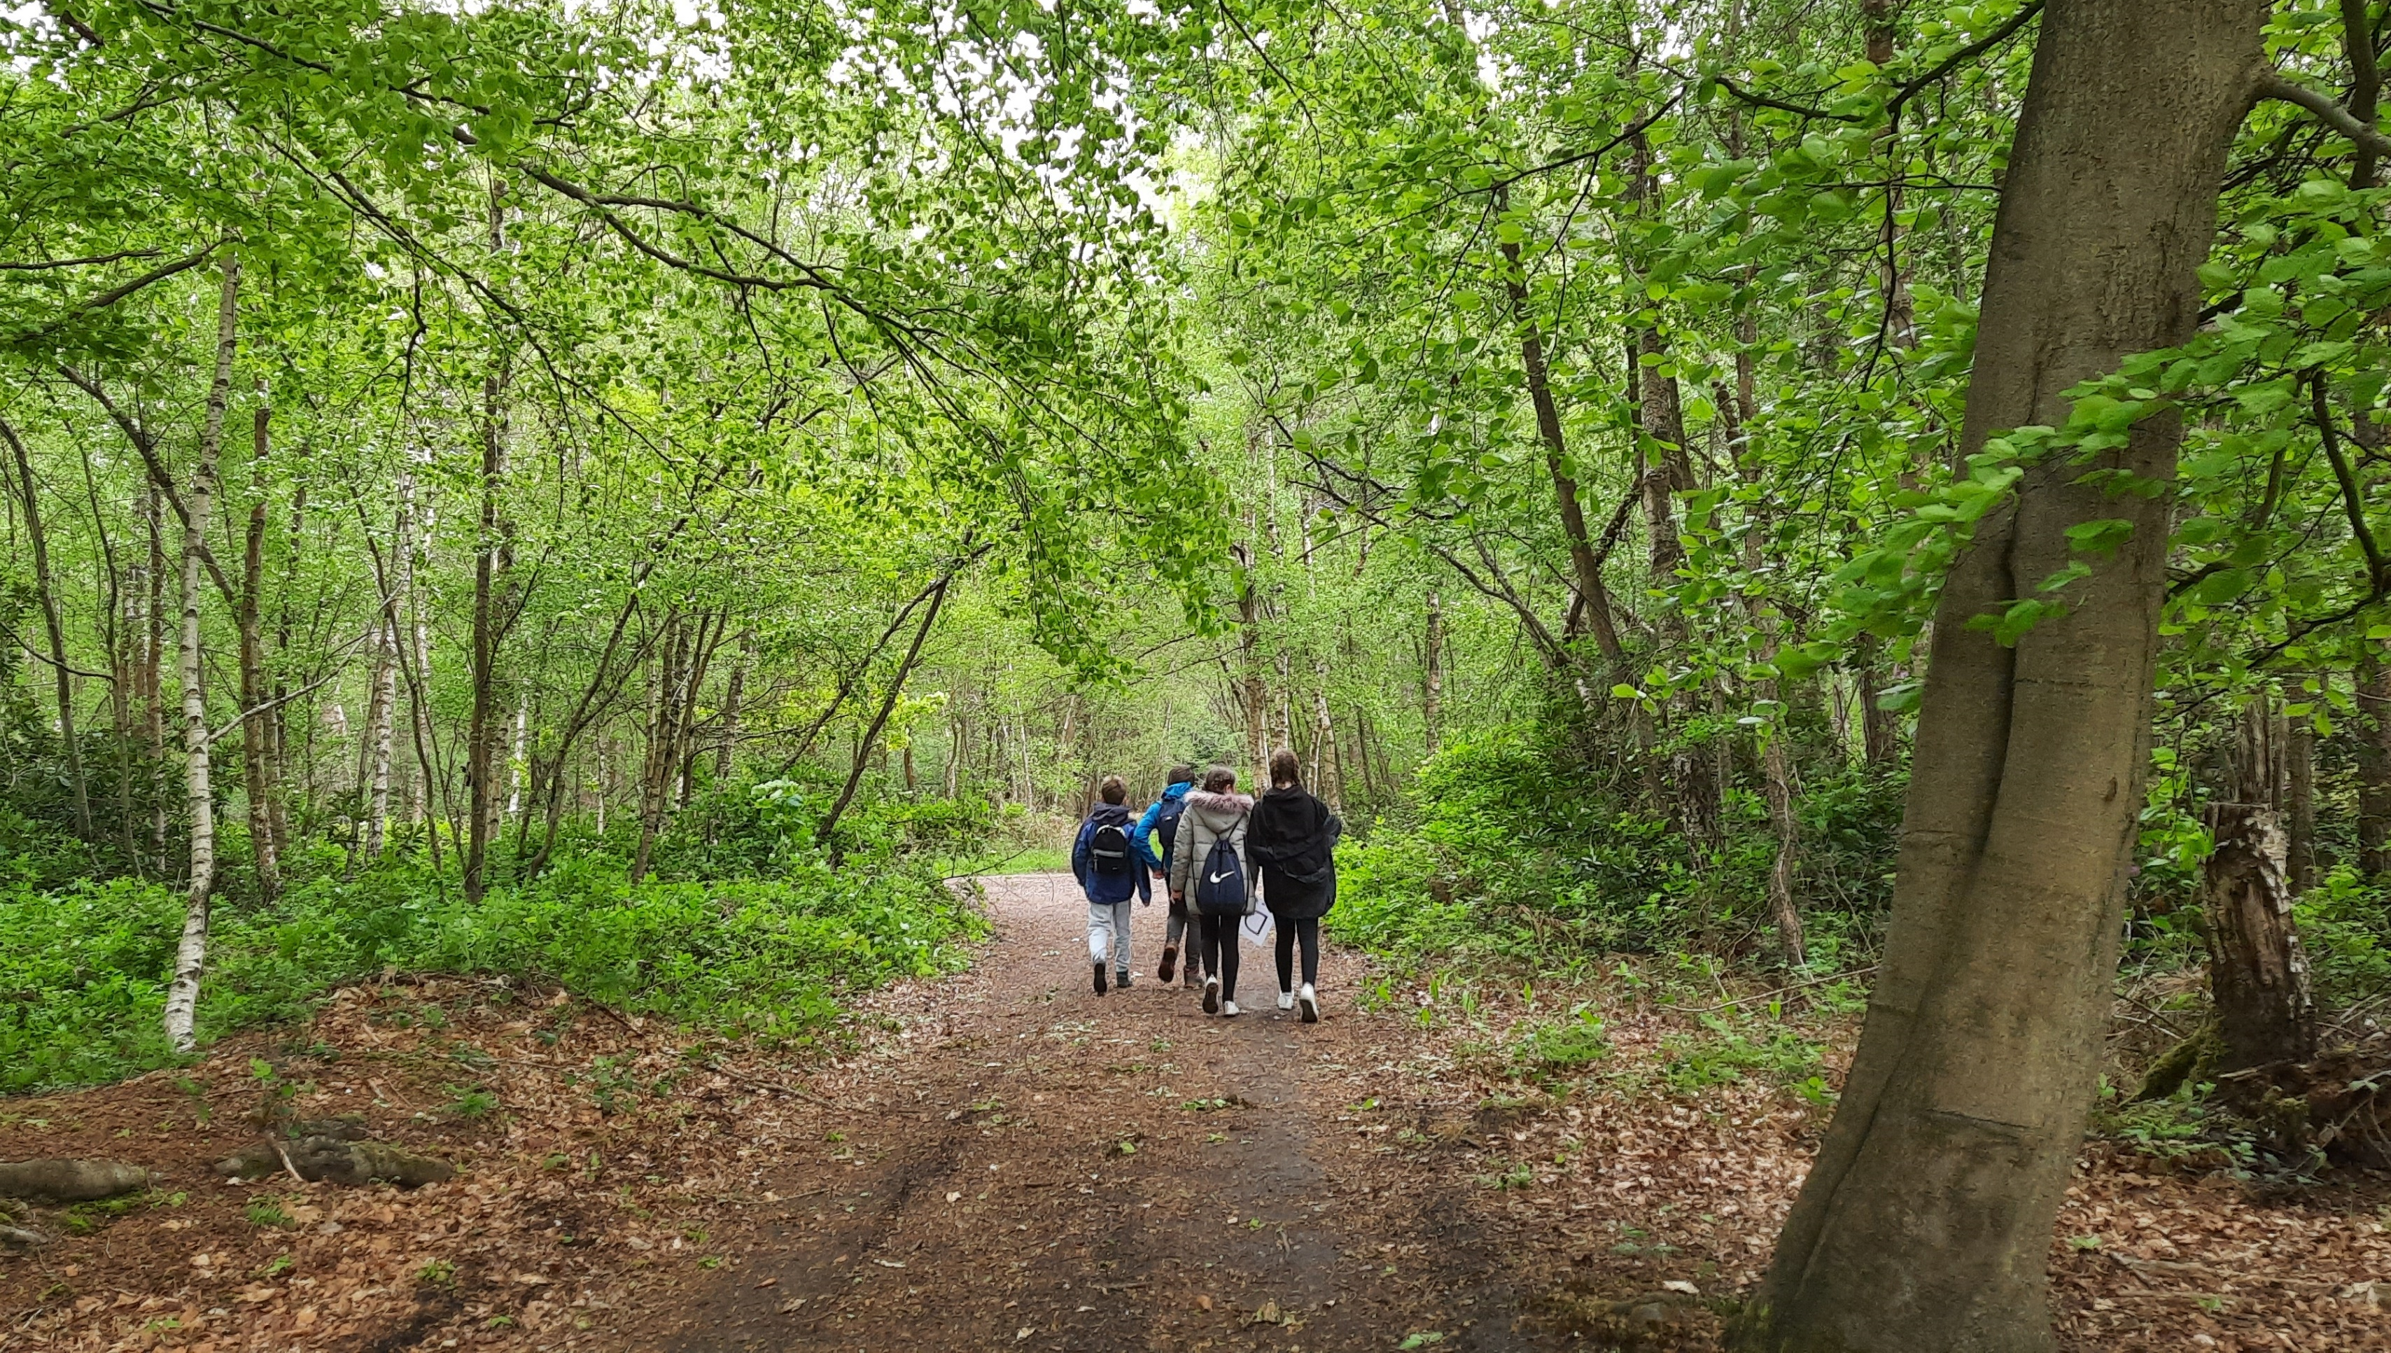
AGM 2023
Stuart Auchterlonie
Notes:
Huānyíng: hwan- yeen

Slide 2
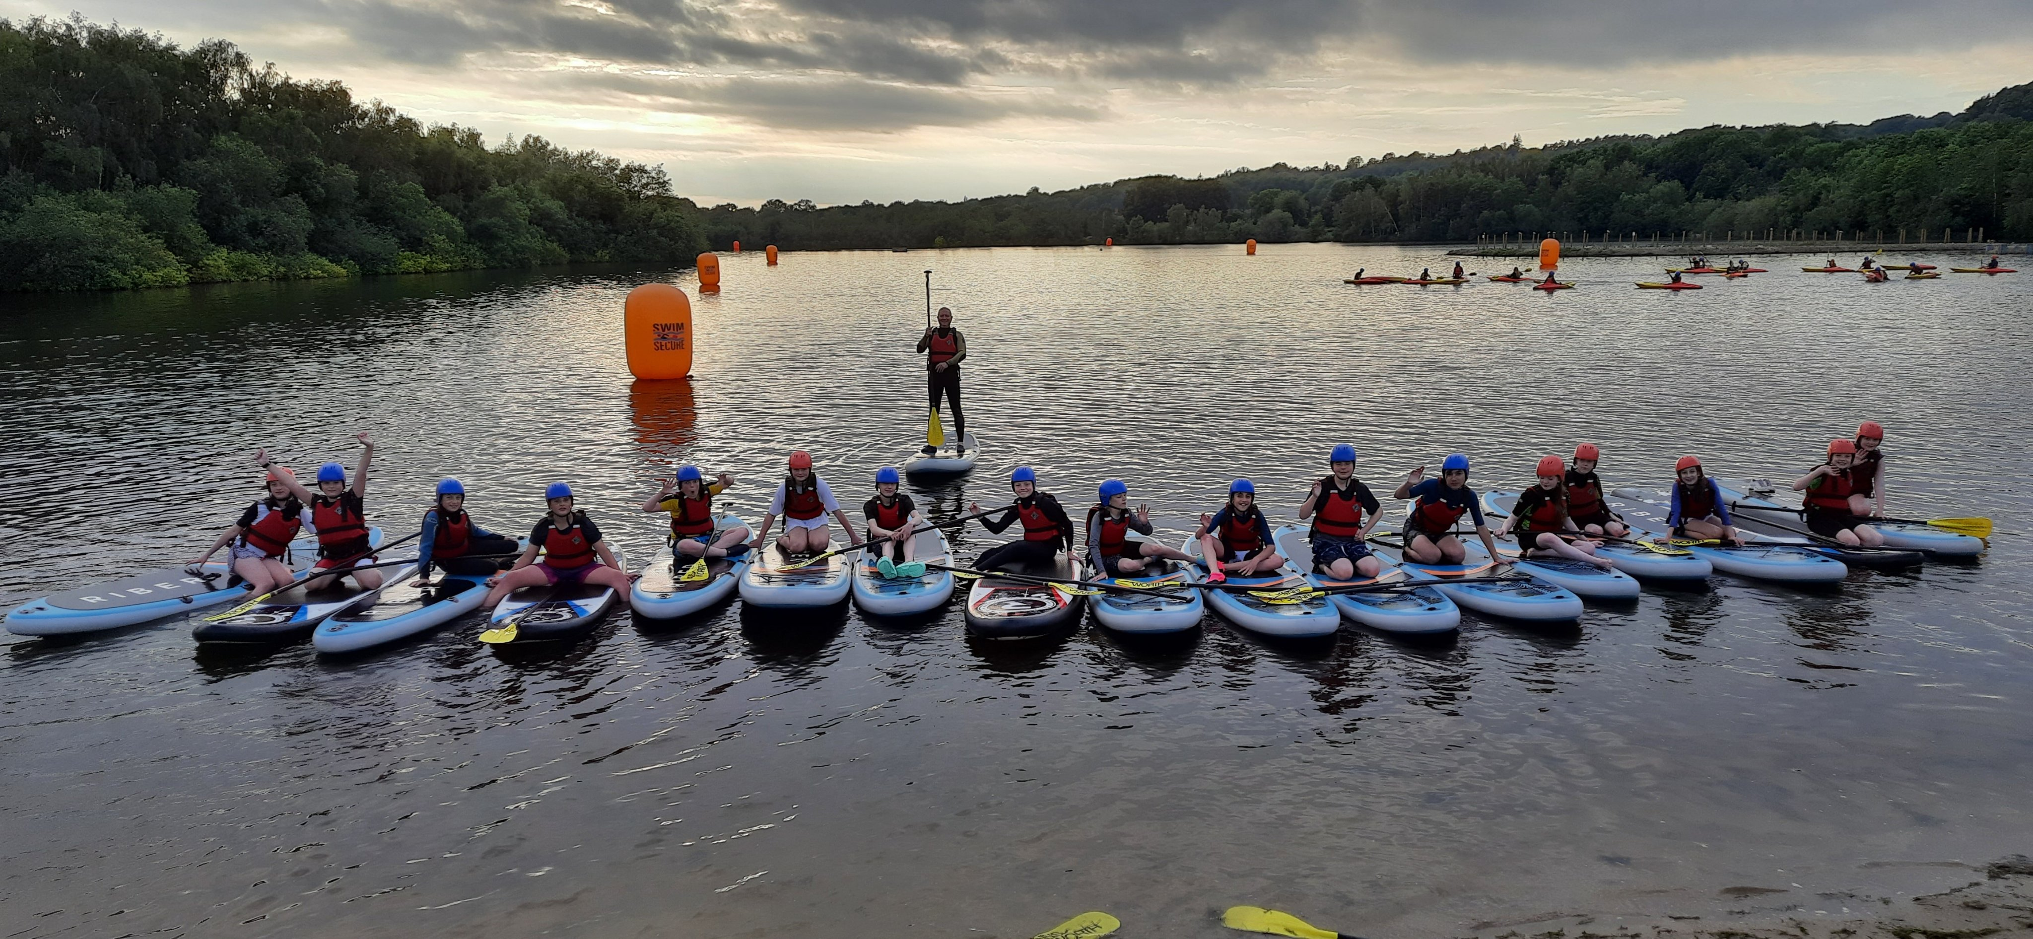
Thursday Scouts – Activities
Notes:
Camp
Hikes
Water sports
Pumpkin carving & conkers
Cooking inside & out
Bike rides
Outdoor skills: firelighting, axes & saws and shelter-building
Science

Slide 3
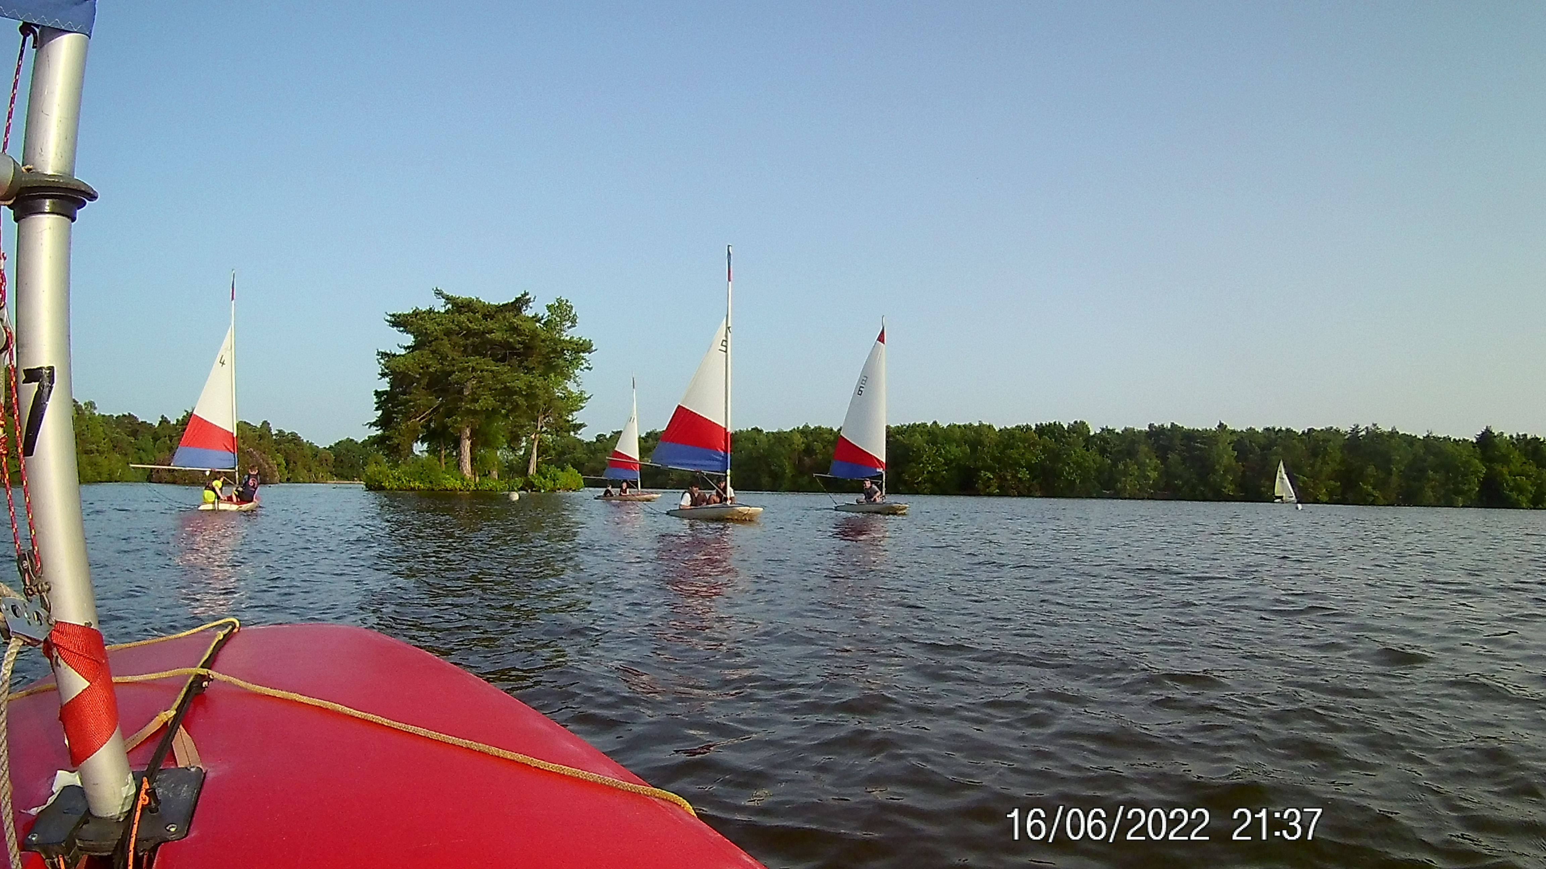
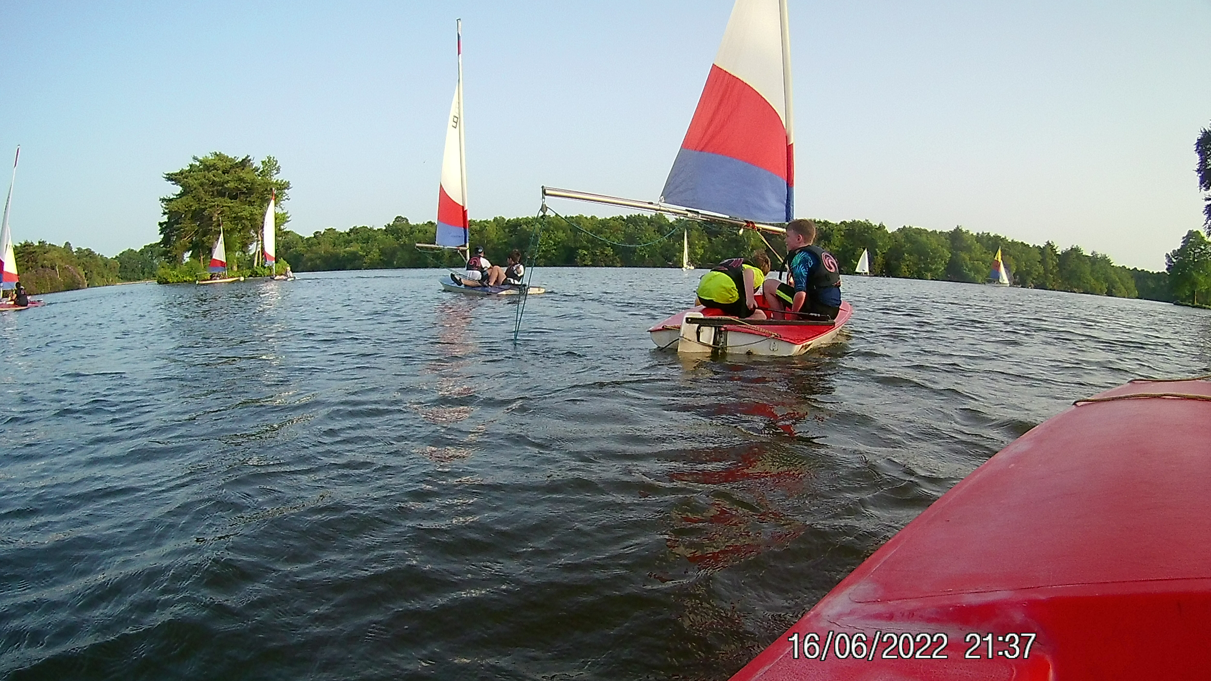
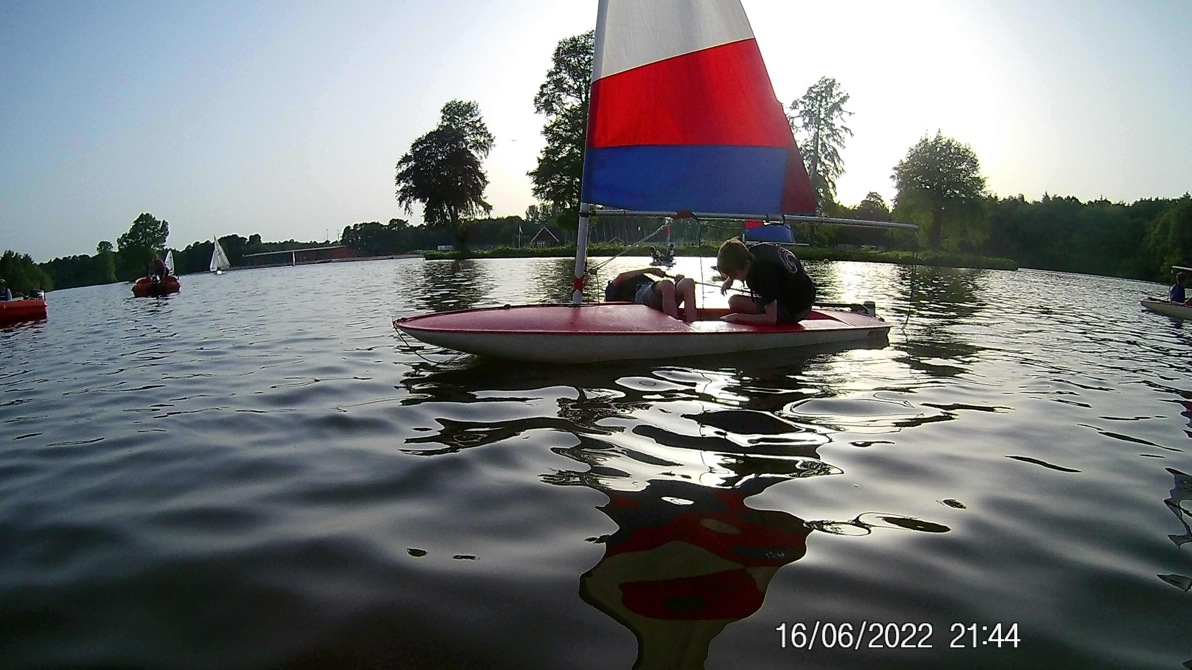
Thursday Scouts – Sailing
Notes:
Camp
Hikes
Water sports
Pumpkin carving & conkers
Cooking inside & out
Bike rides
Outdoor skills: firelighting, axes & saws and shelter-building
Science

Slide 4
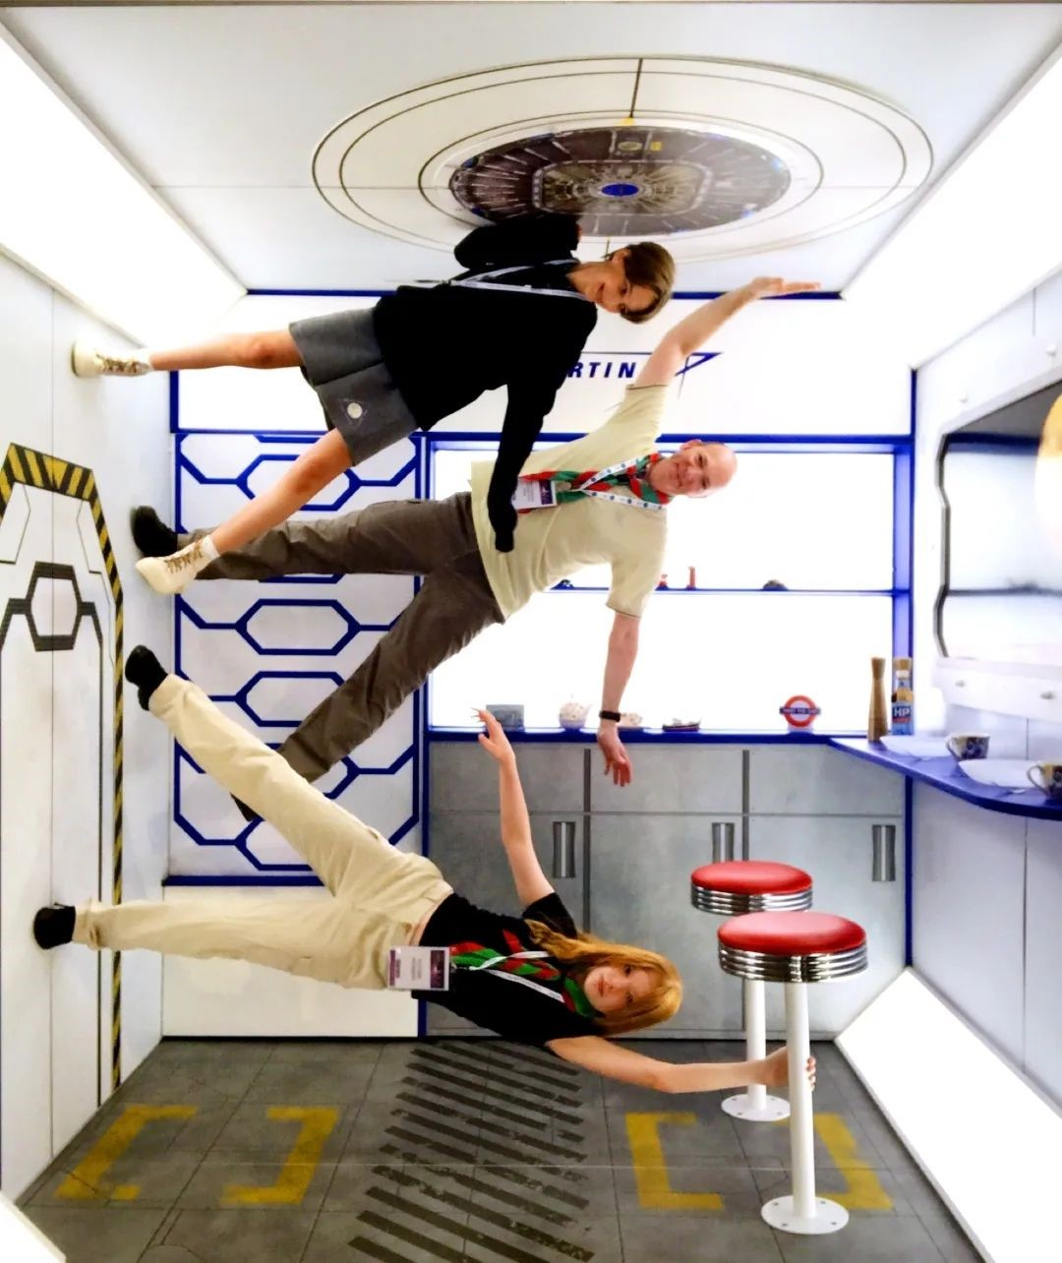
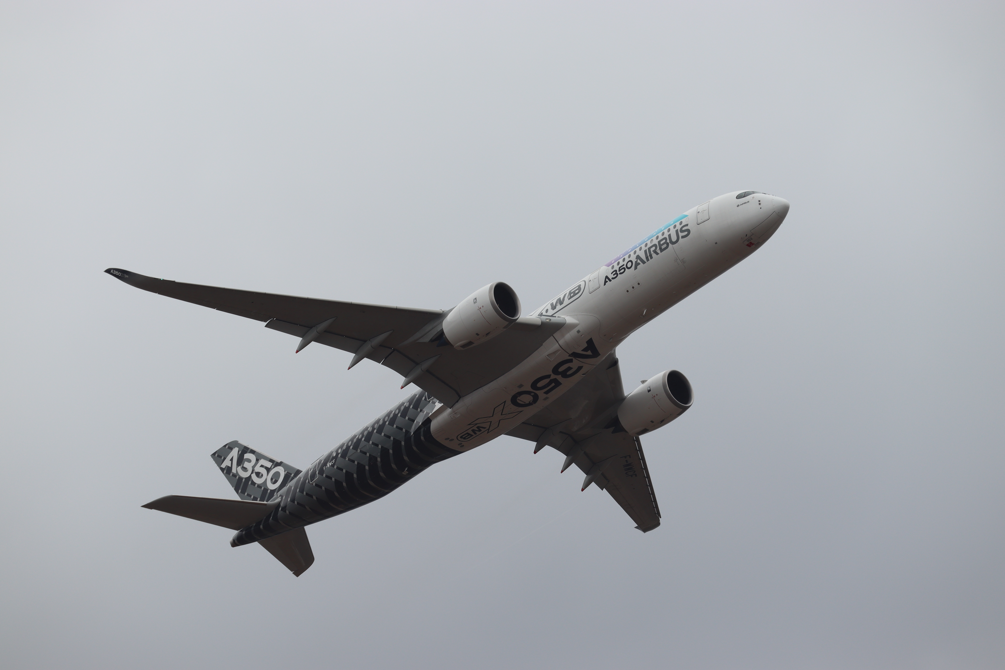
Thursday Scouts – Farnborough Airshow
STEM Activities at FIA2022
Notes:
Camp
Hikes
Water sports
Pumpkin carving & conkers
Cooking inside & out
Bike rides
Outdoor skills: firelighting, axes & saws and shelter-building
Science

Slide 5
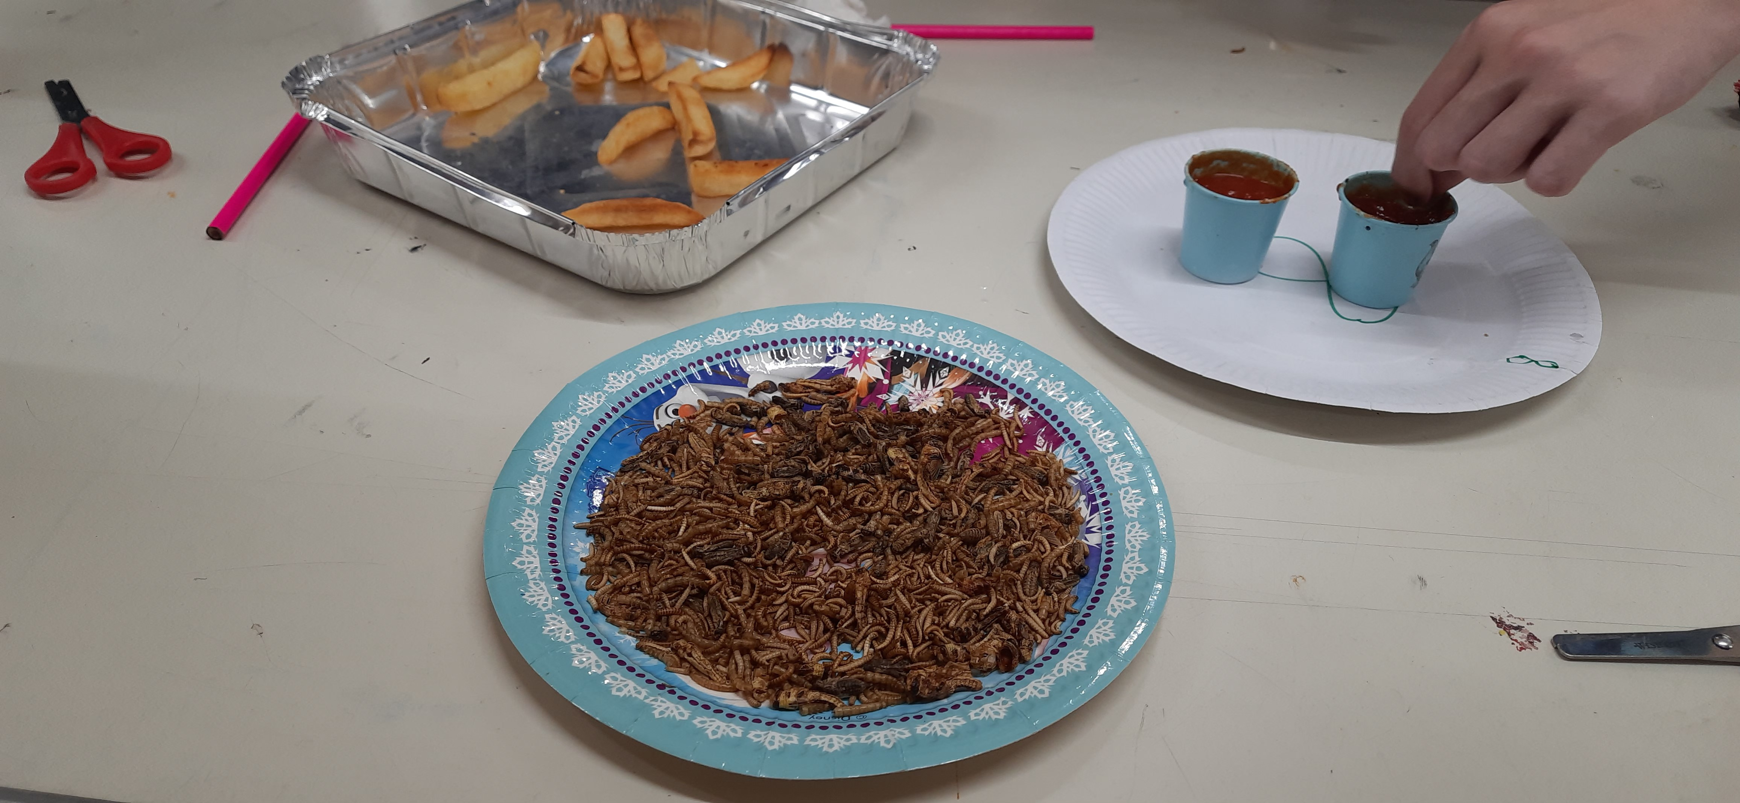
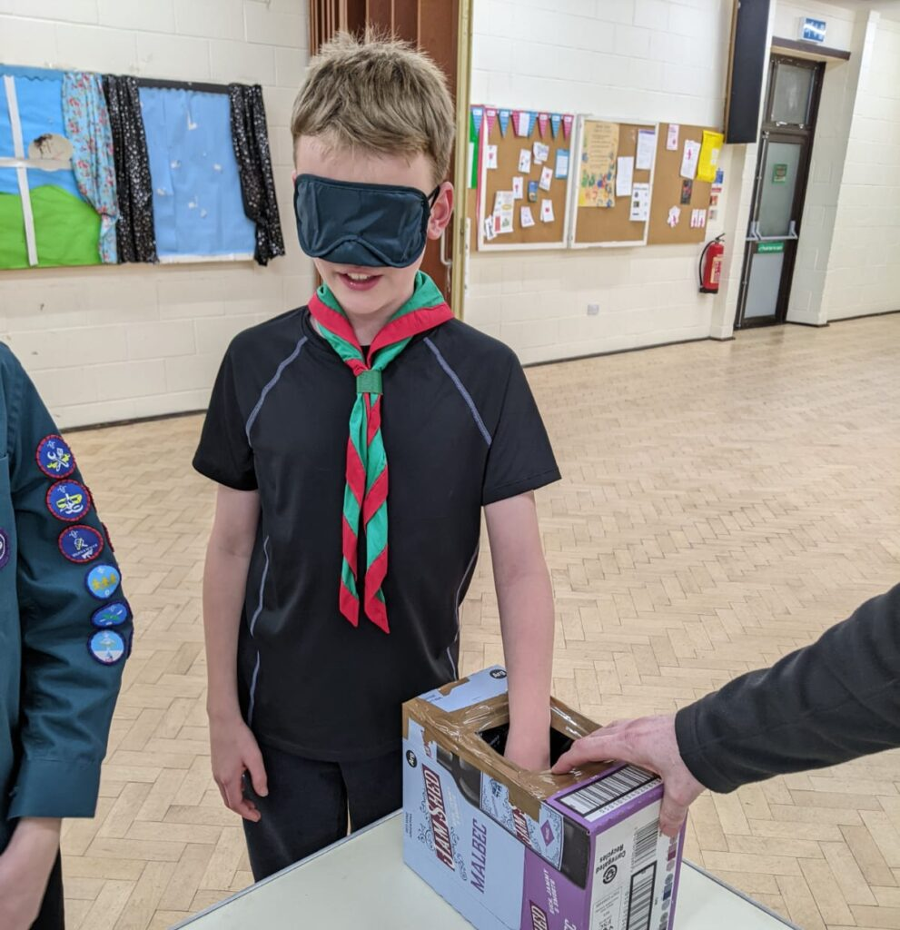
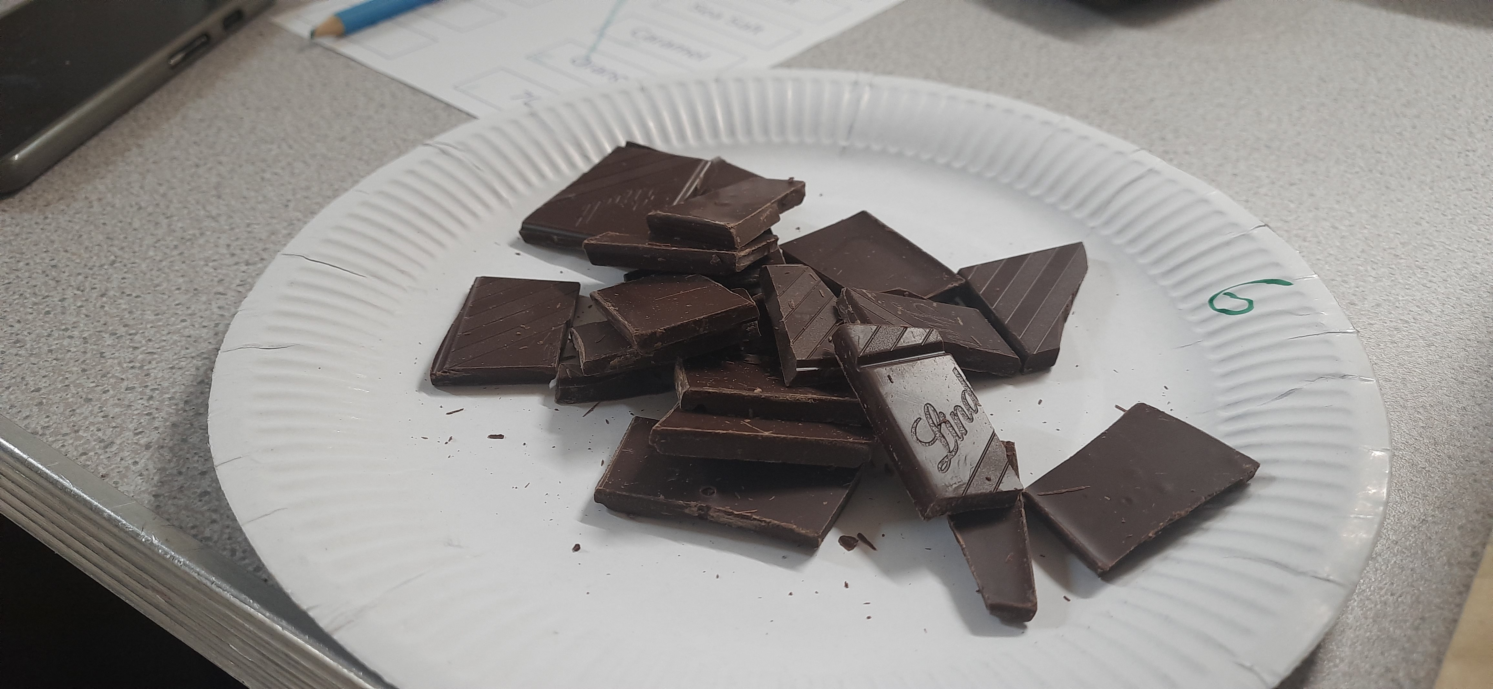
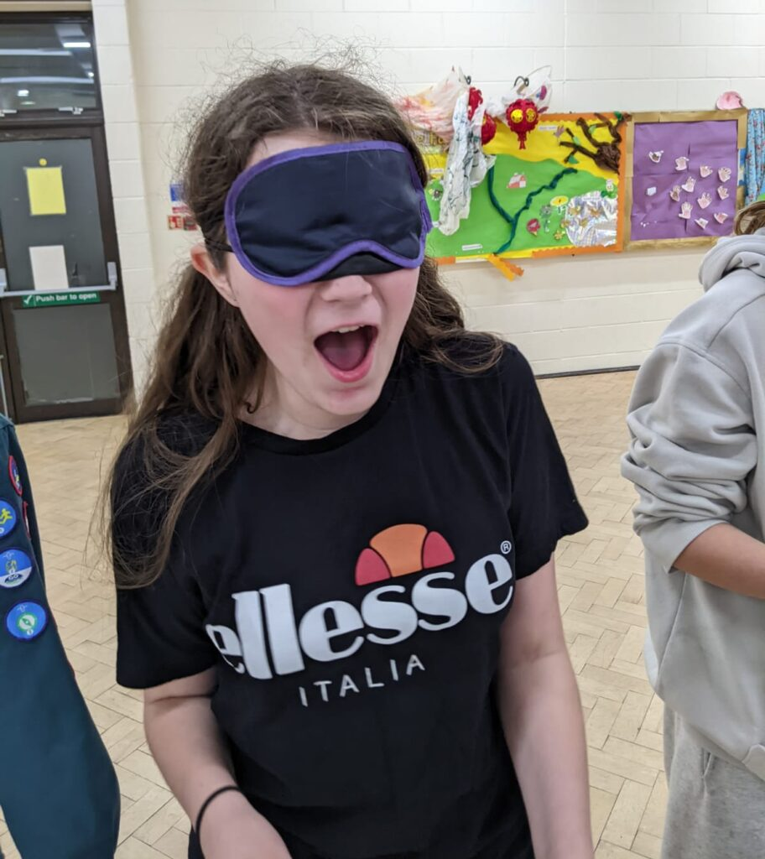
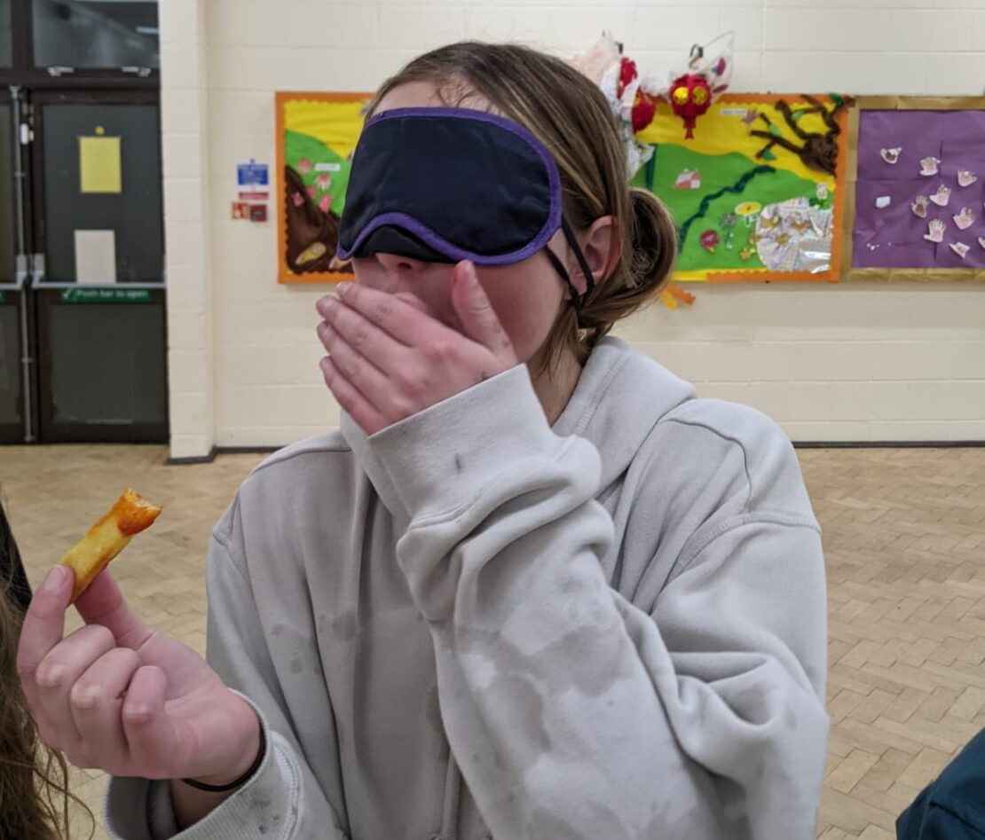
Thursday Scouts – Bush Tucker Trials
Notes:
Camp
Hikes
Water sports
Pumpkin carving & conkers
Cooking inside & out
Bike rides
Outdoor skills: firelighting, axes & saws and shelter-building
Science

Slide 6
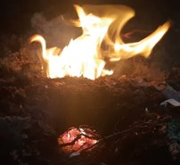
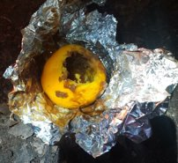
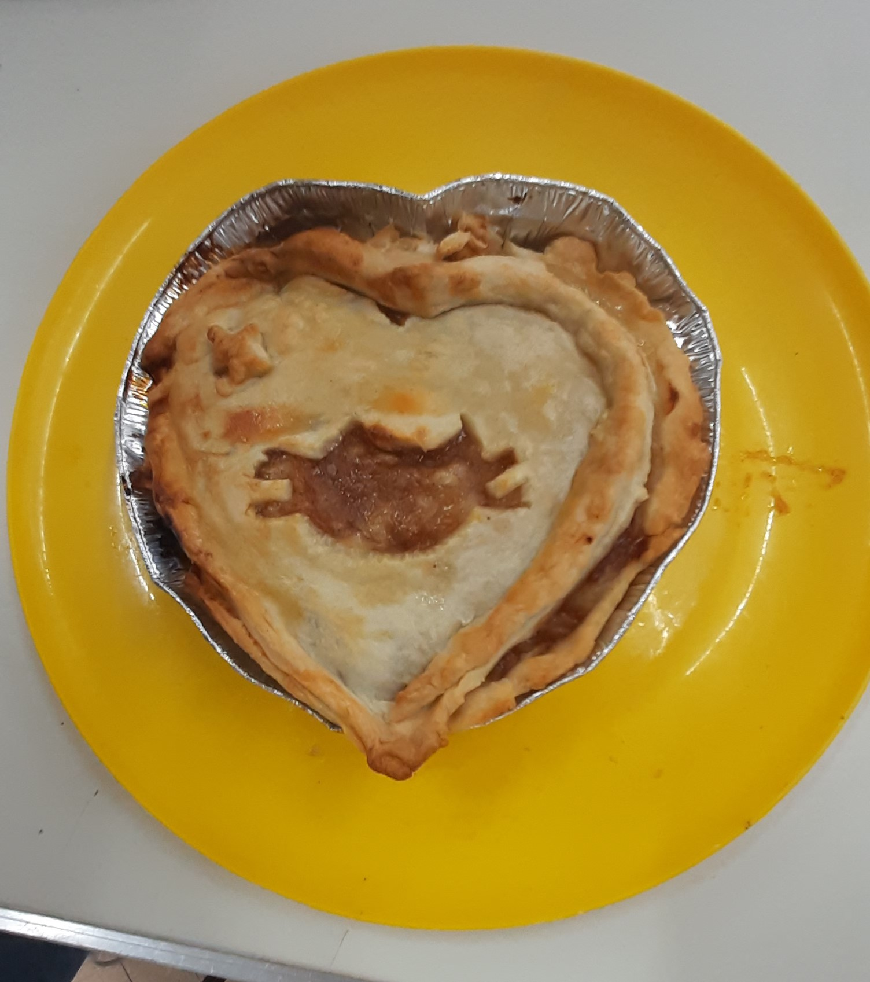
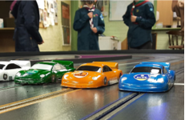
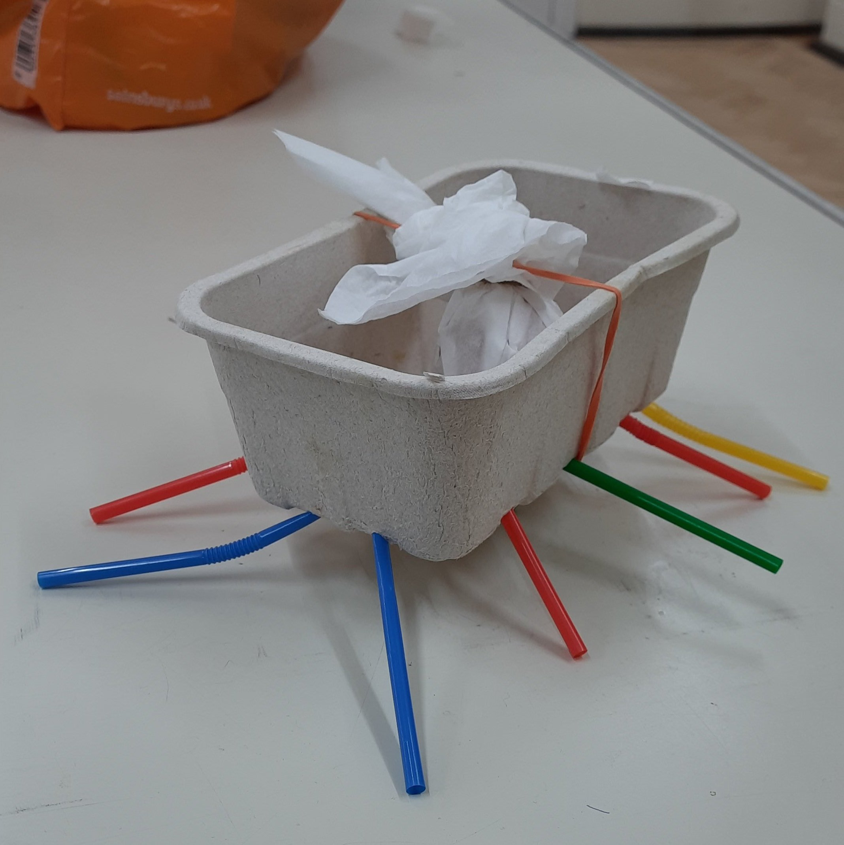
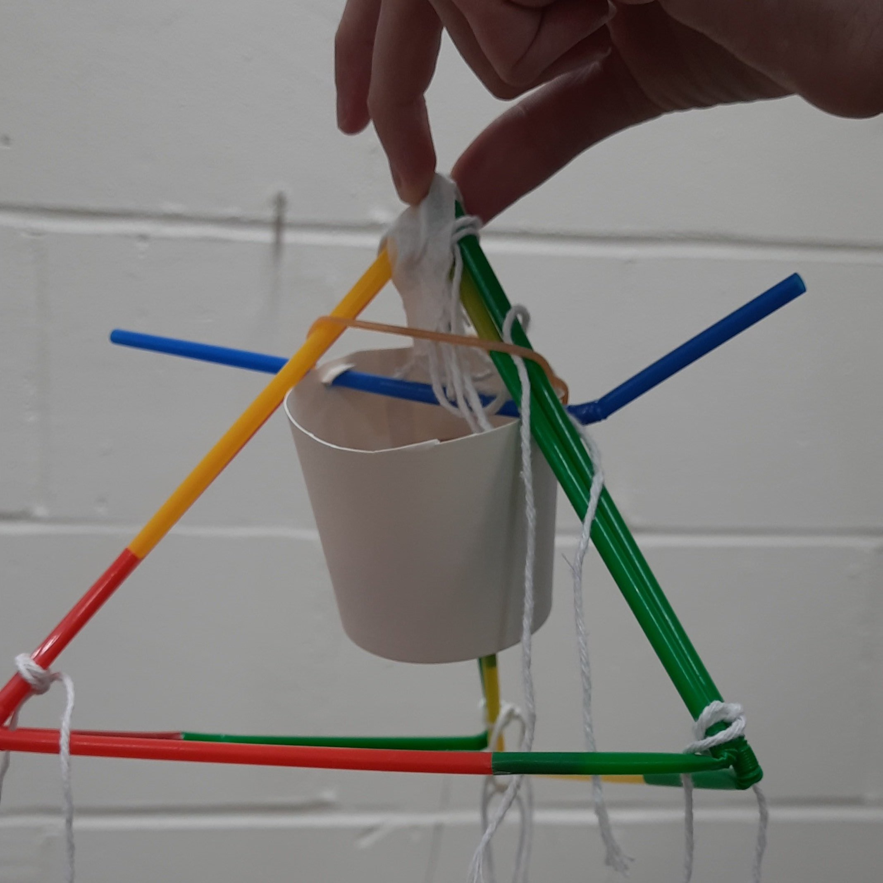
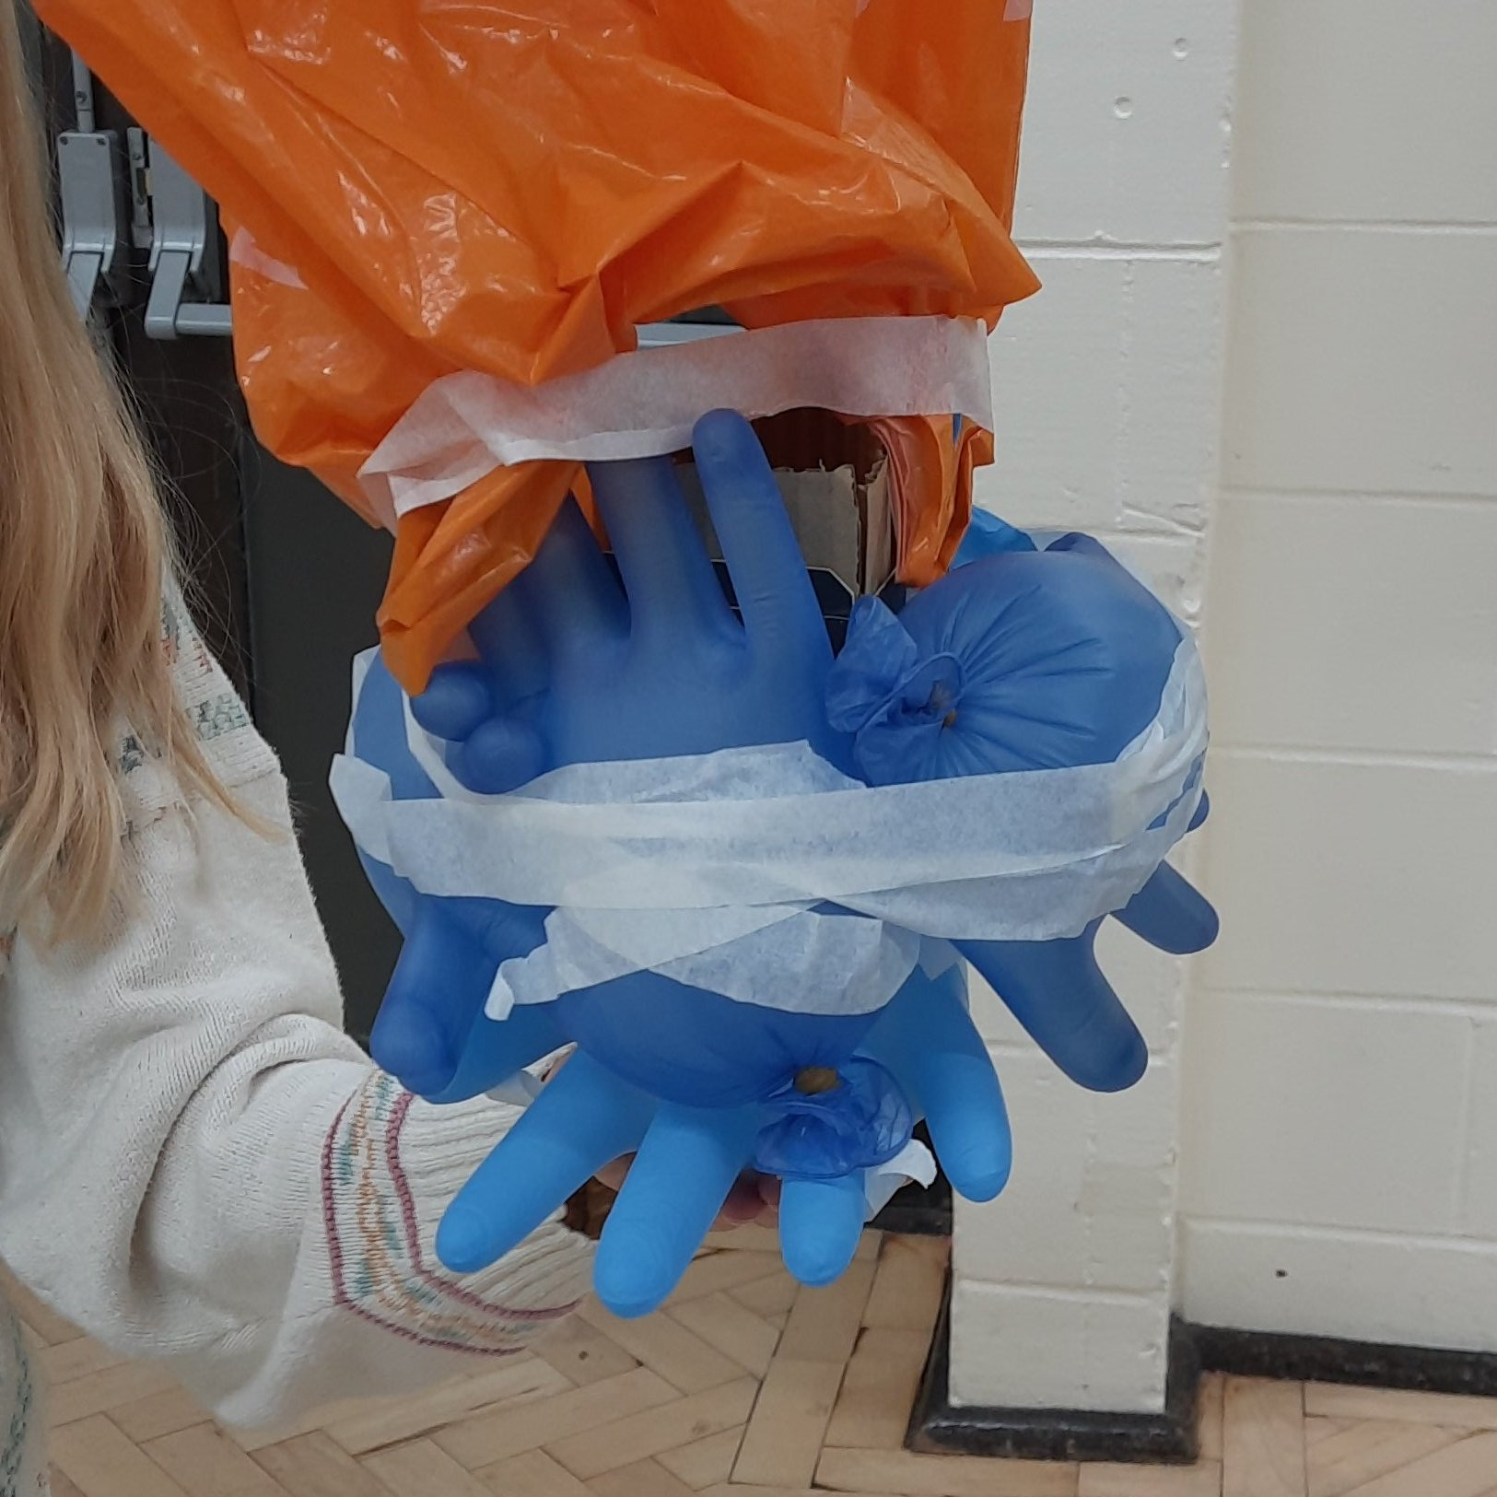
Thursday Scouts – Activities
Notes:
Camp
Hikes
Water sports
Pumpkin carving & conkers
Cooking inside & out
Bike rides
Outdoor skills: firelighting, axes & saws and shelter-building
Science

Slide 7
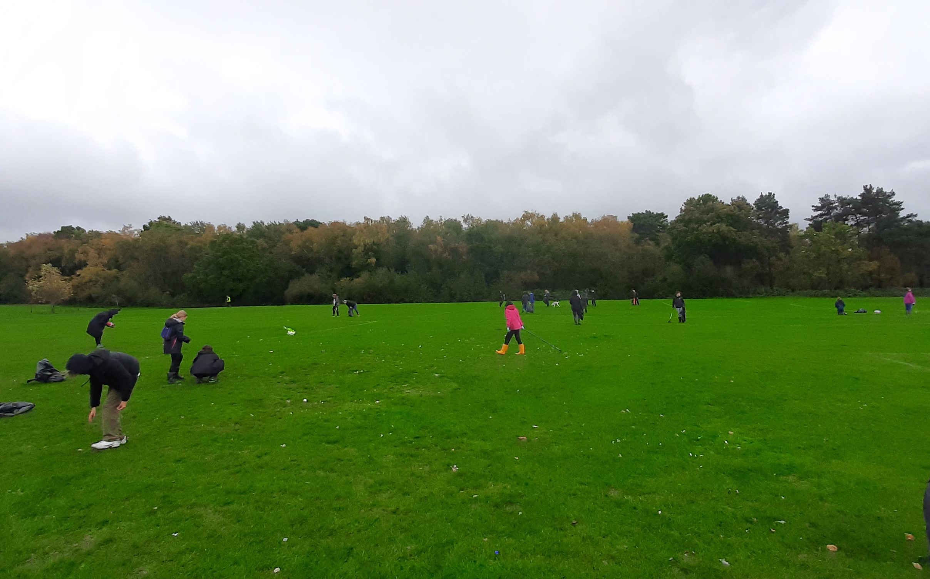
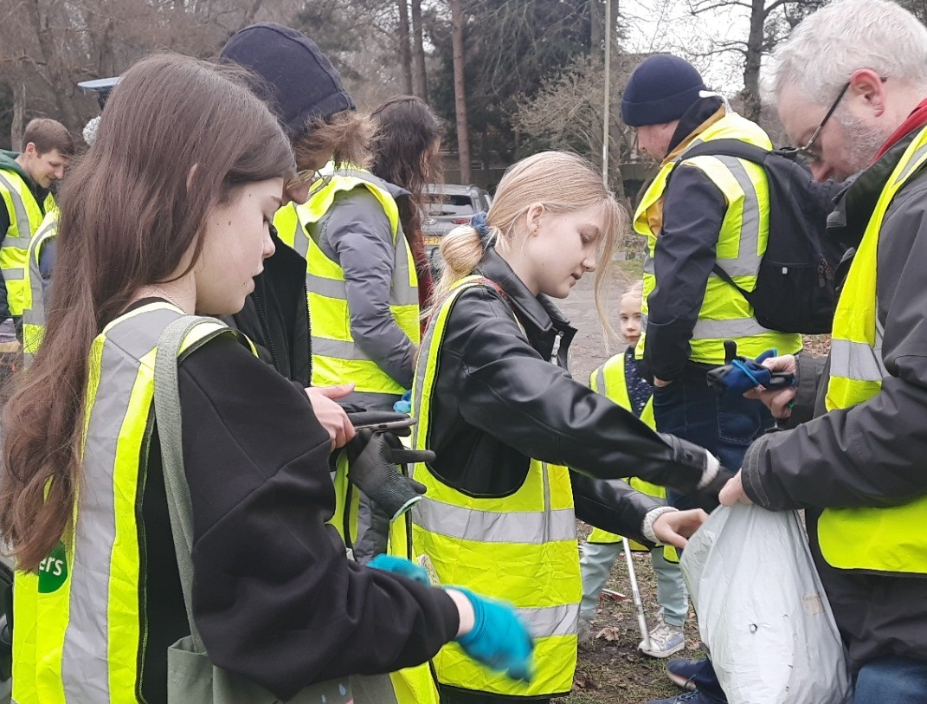
6th Fleet – Community engagement
Litter picking with Fleet Scoop

Slide 8
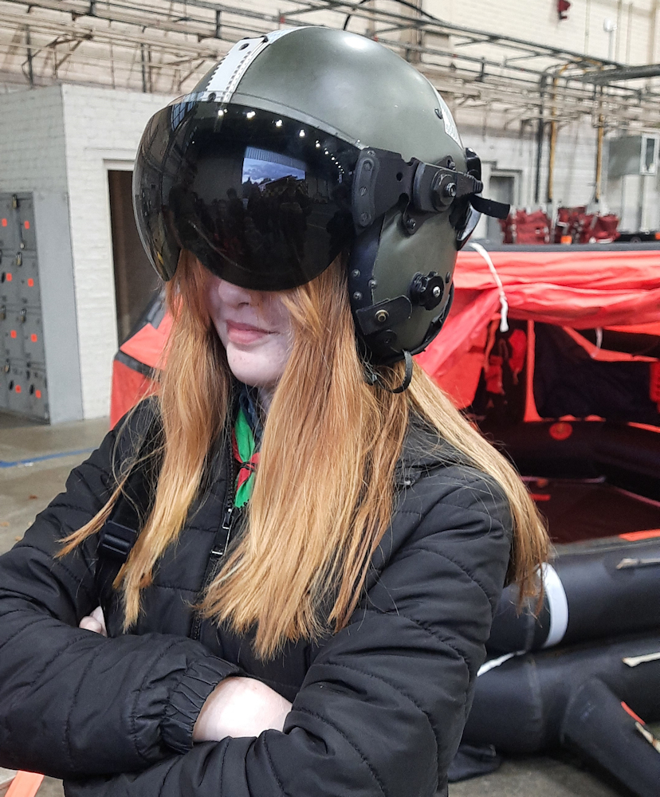
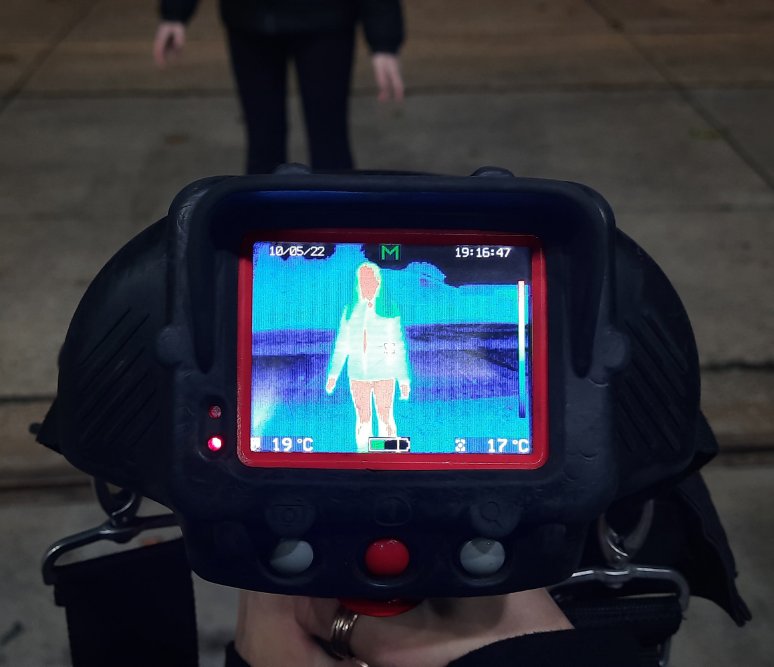
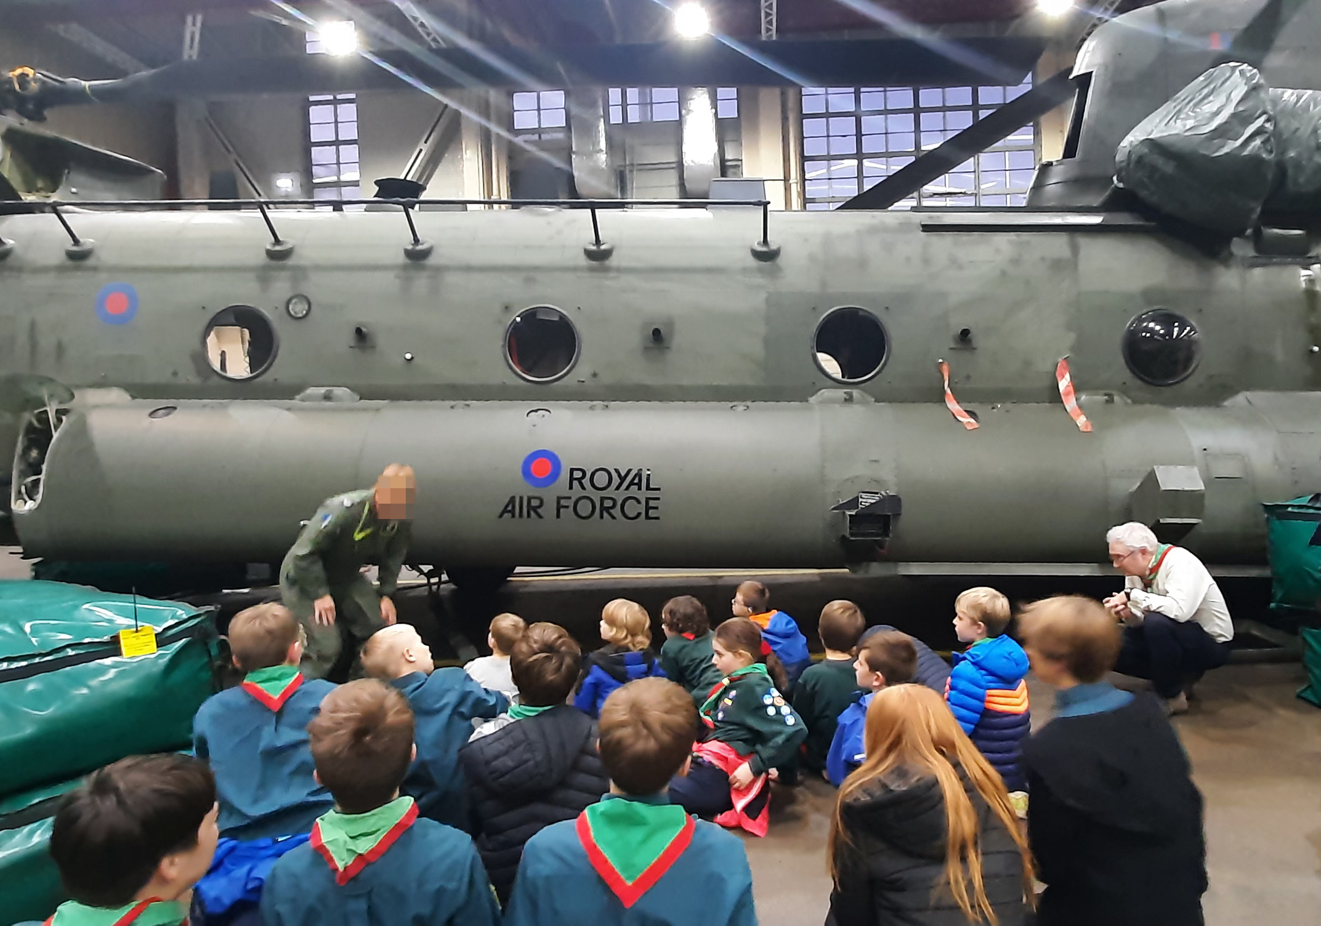
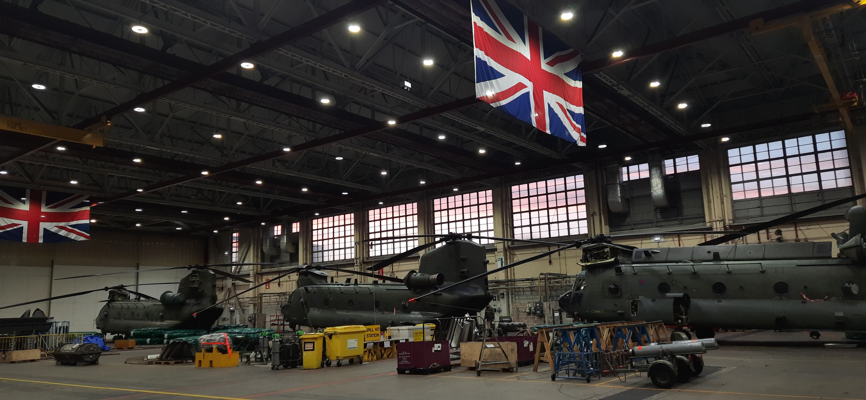
6th Fleet – RAF Odiham

Slide 9
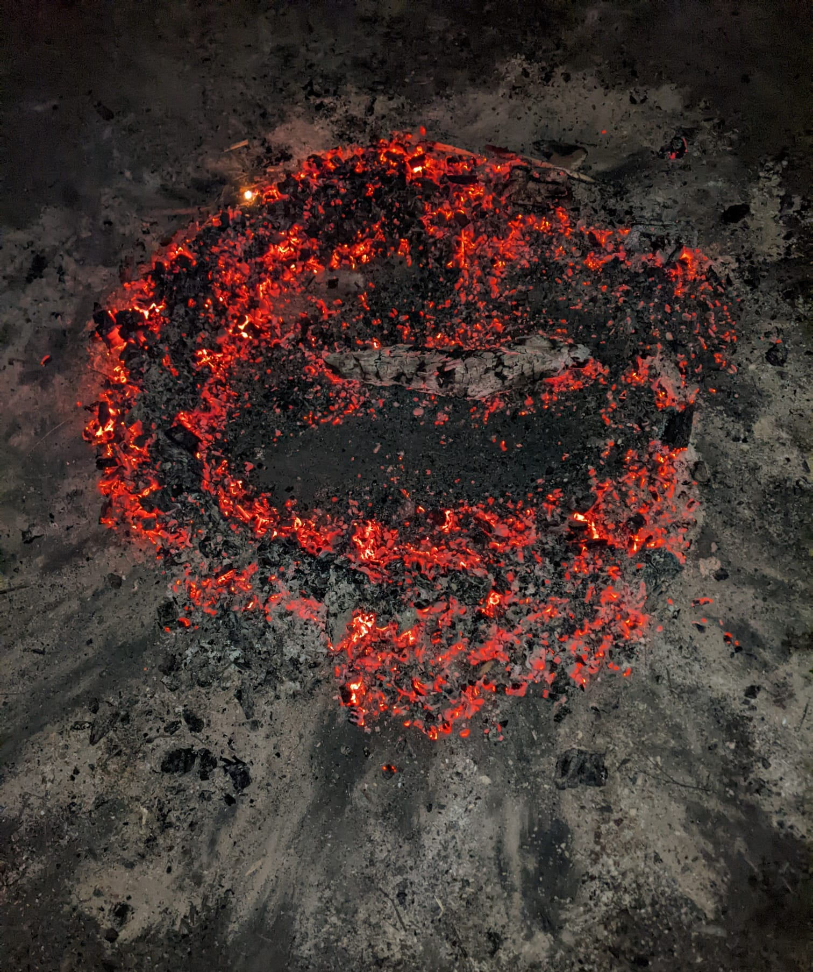
Thank you

