Slide 1
2023 Senior Scouts’ Expedition
6-7 May 2023
Fleet – Aldershot – Farnham – Tilford – Frensham Little Pond
25 km
Caspar Waine
Thomas Howell
Arthur Taylor
Milo Oliver

Slide 2
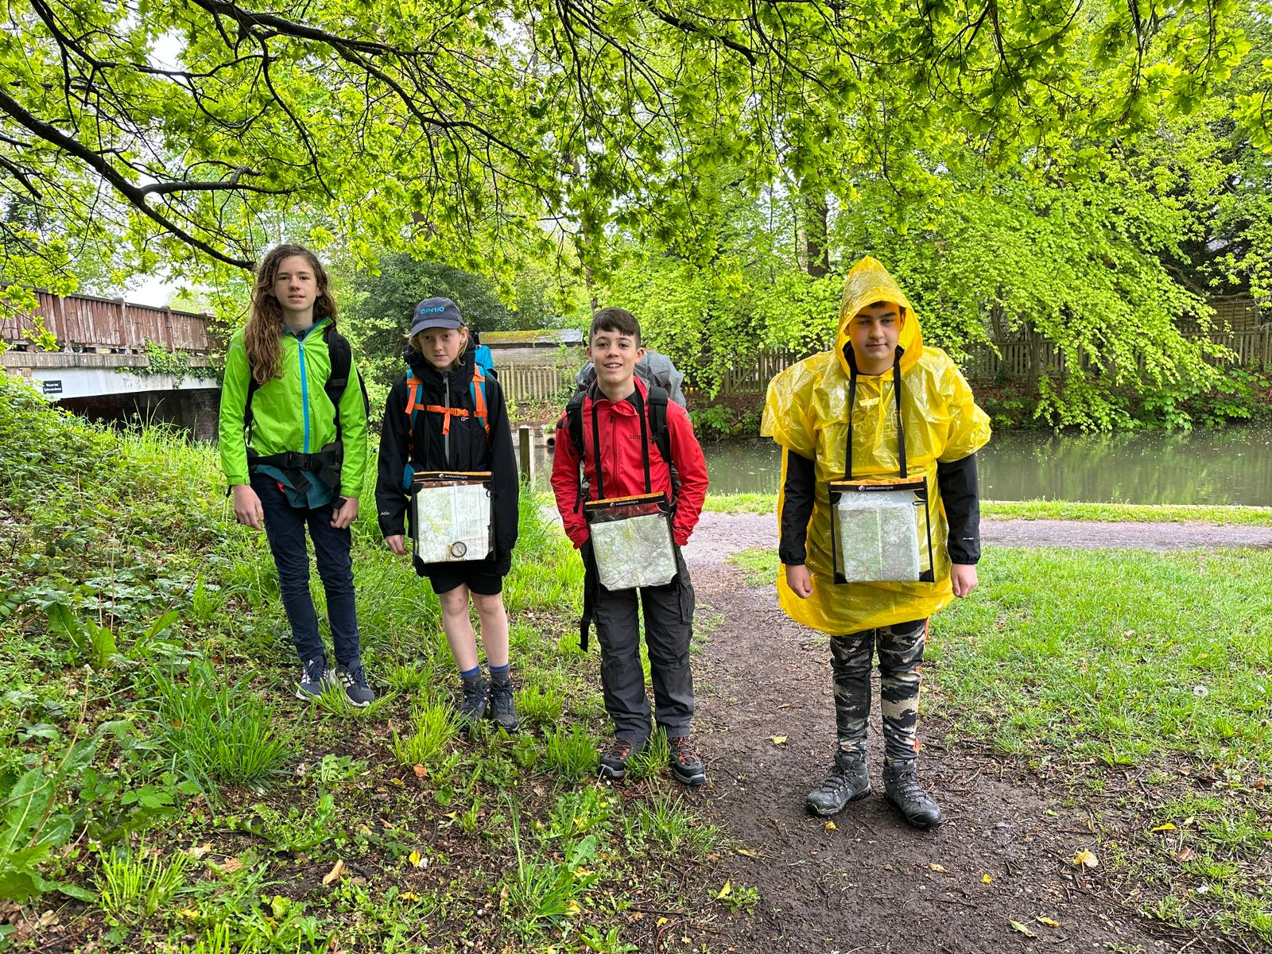
Enthusiastically setting off in the rain

Slide 3
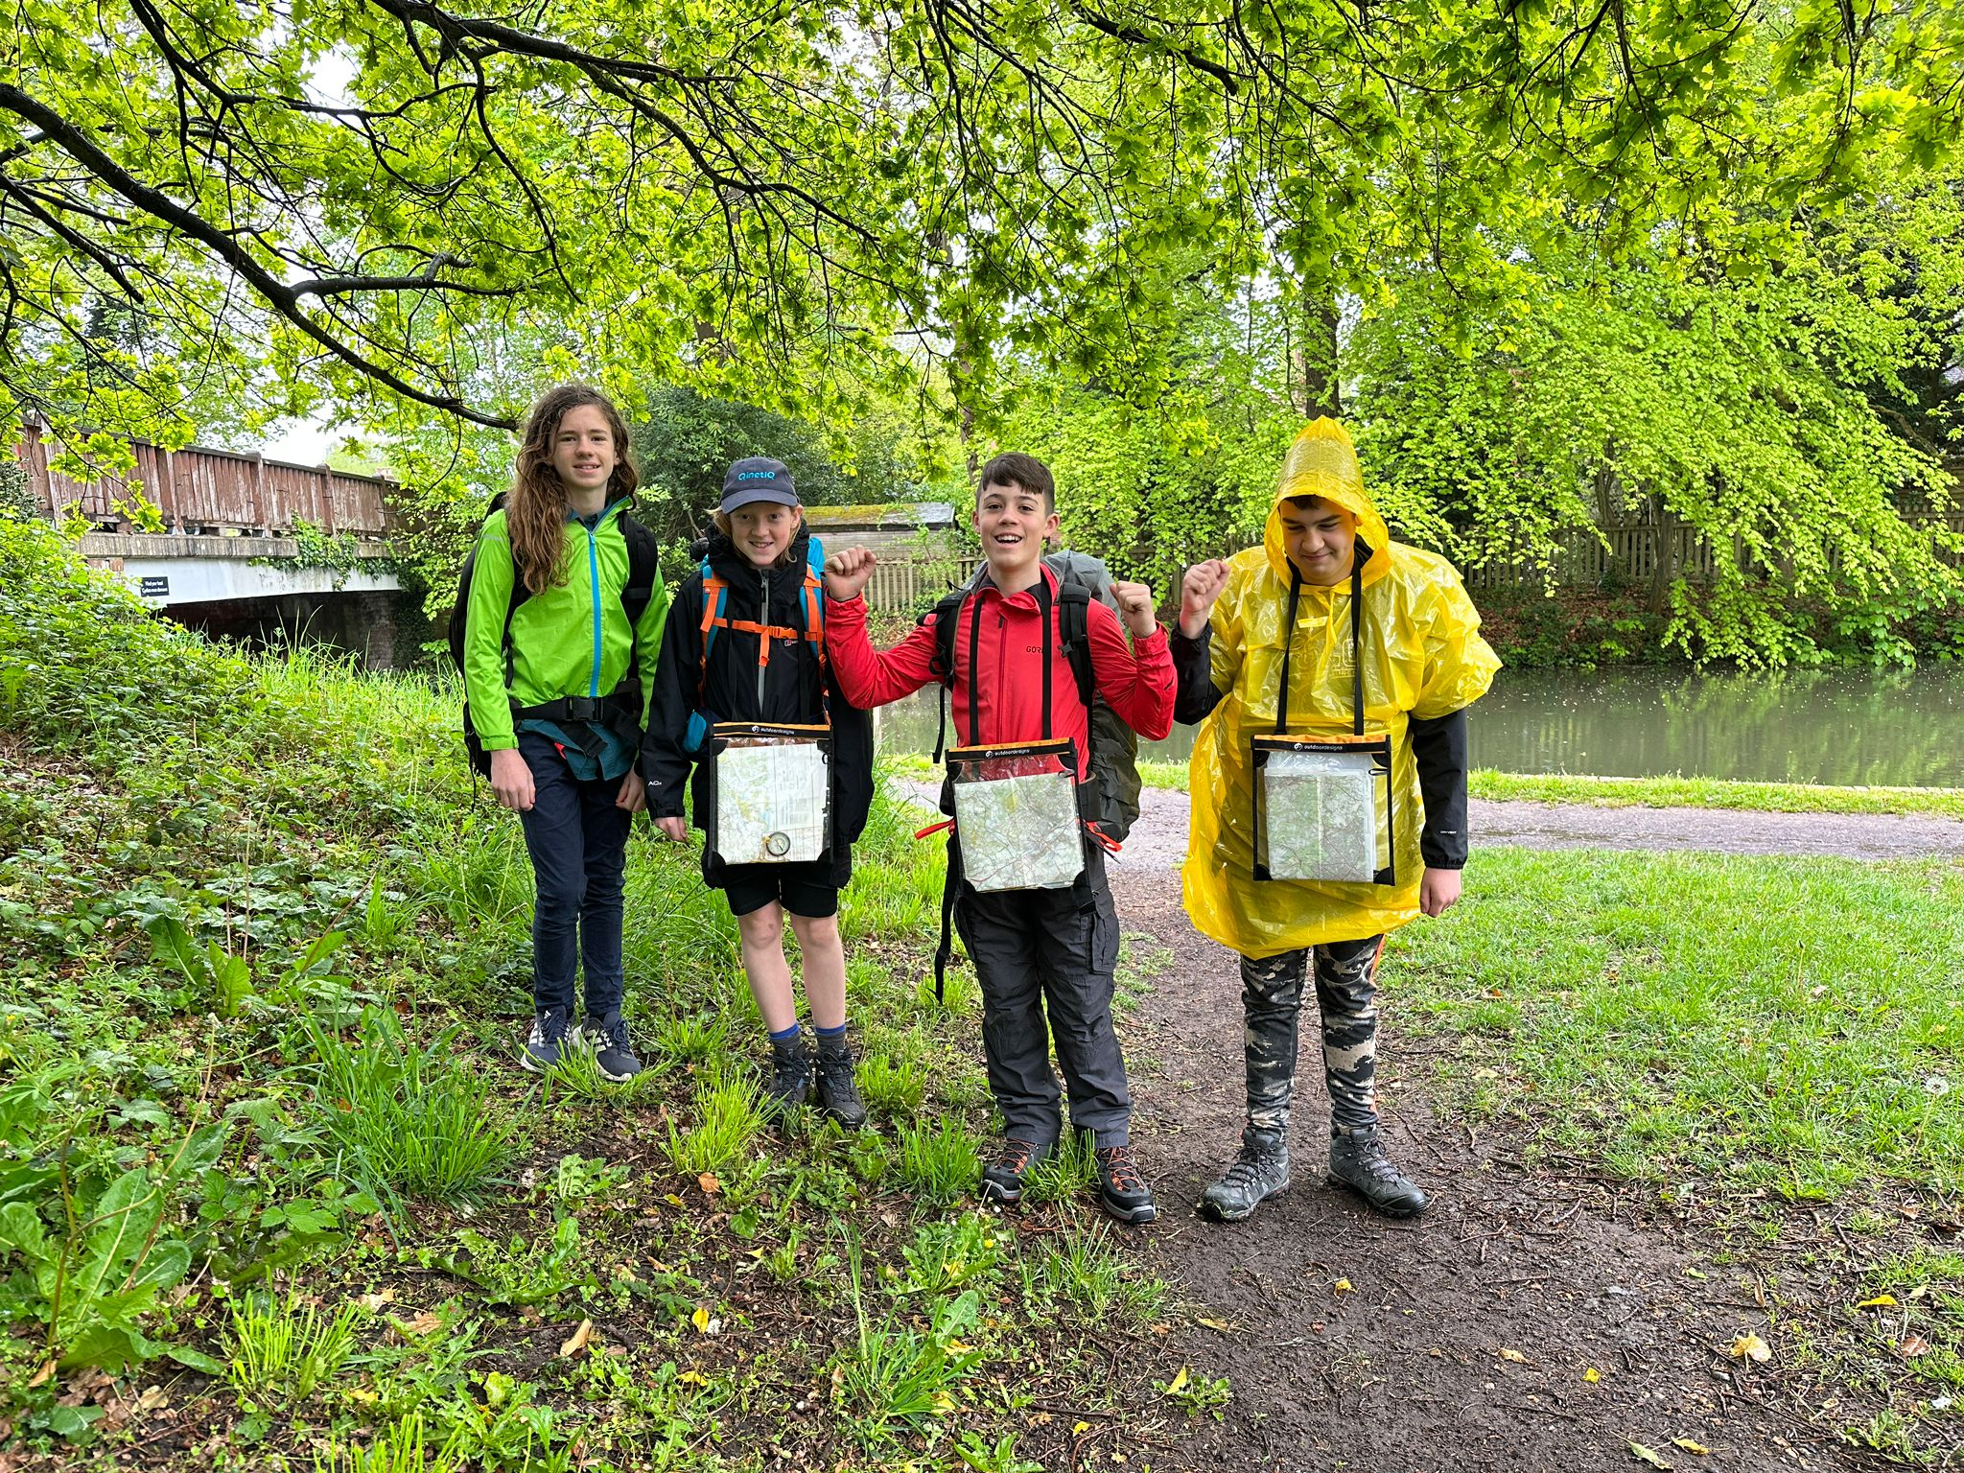
I said, “Enthusiastically setting off in the rain”

Slide 4
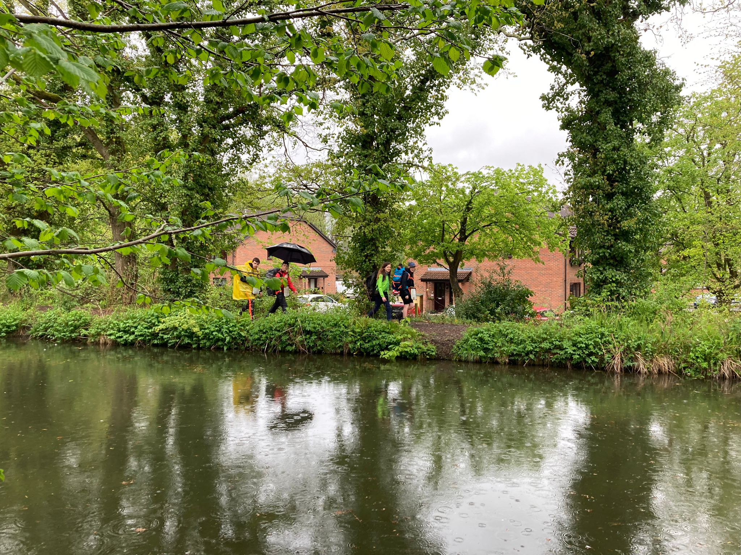
Trekking from Fleet to Aldershot along the canal

Slide 5
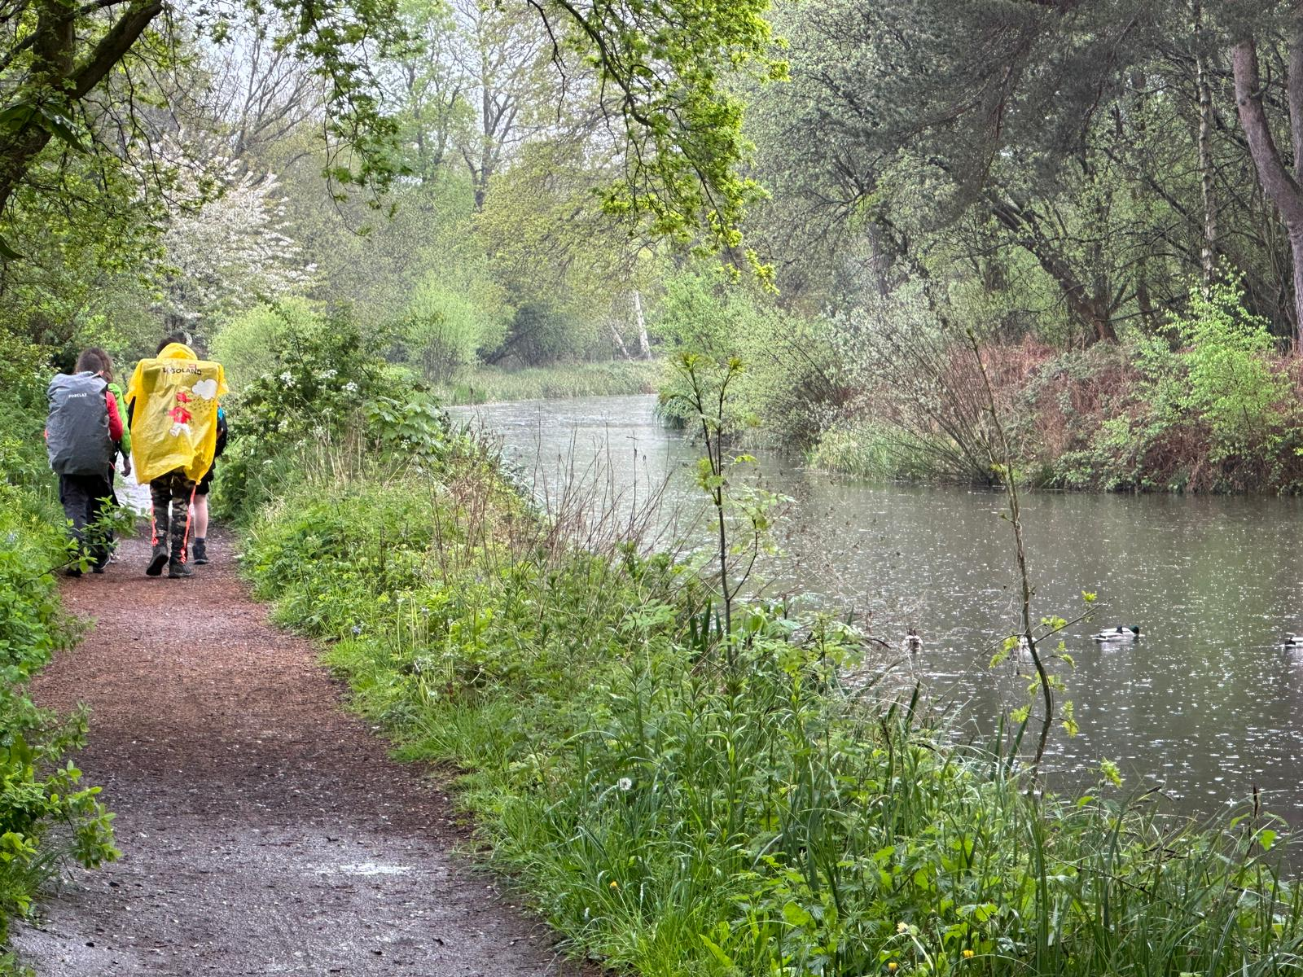

Slide 6
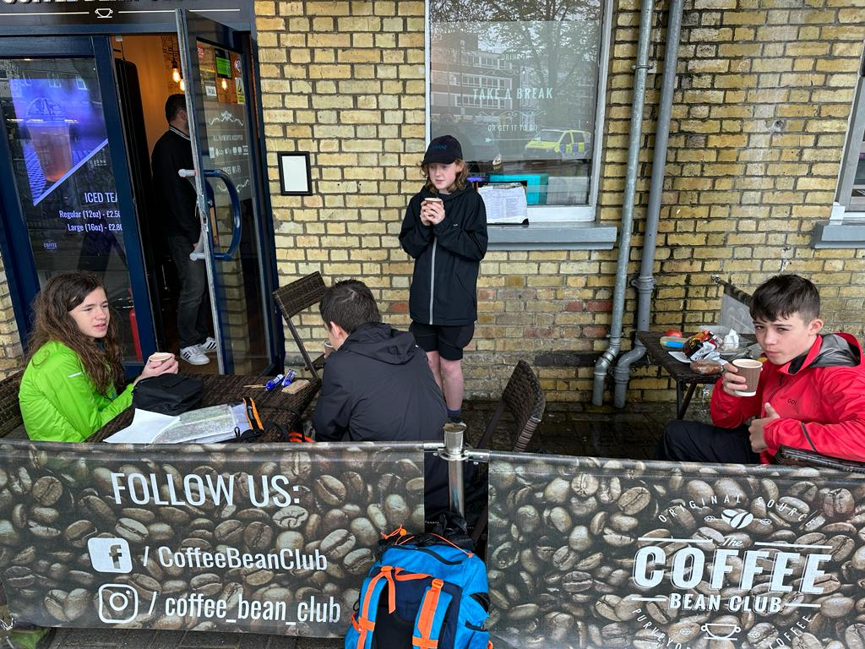
Expeditions in 2023 need posh cafe stops

Slide 7
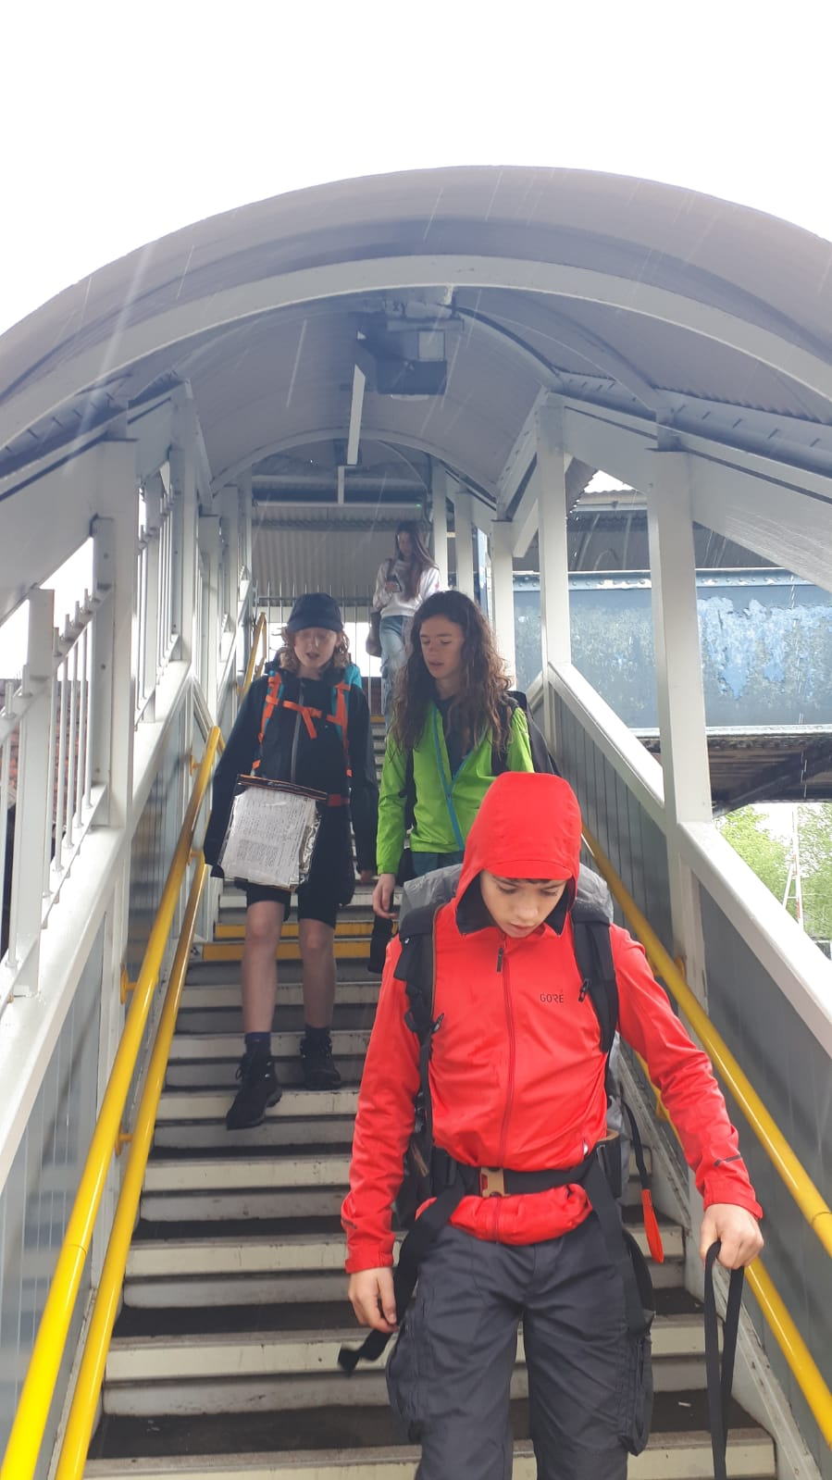
Taking the train from Aldershot to Farnham

Slide 8
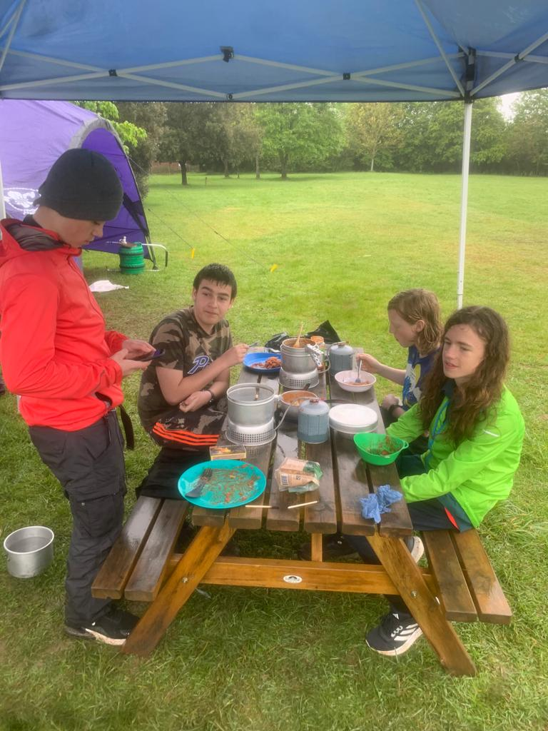
…completing Day 1 by cooking a delicious meal at the campsite

Slide 9
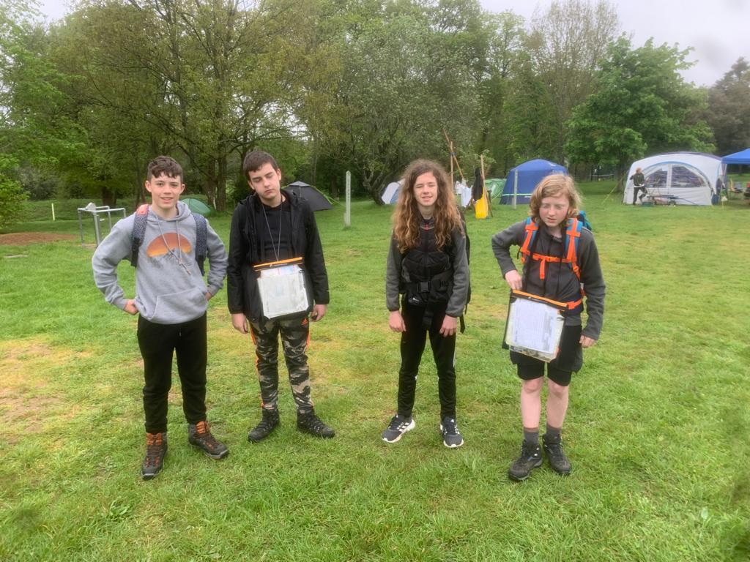
Enthusiastically ready for Day 2’s journey

Slide 10
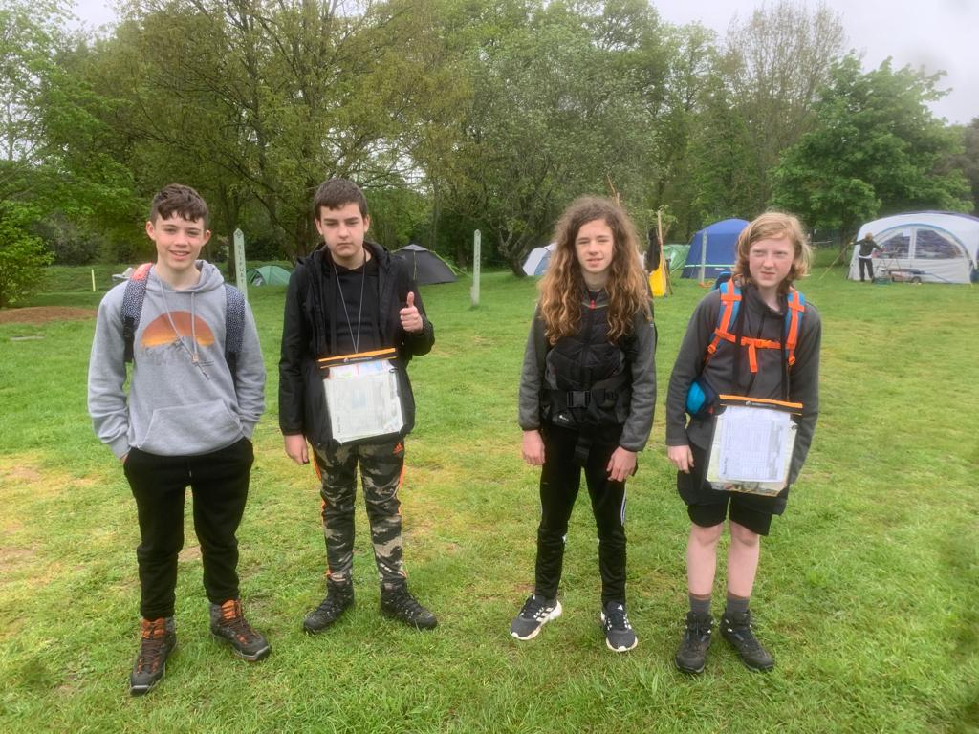
I said “Enthusiastically”

Slide 11
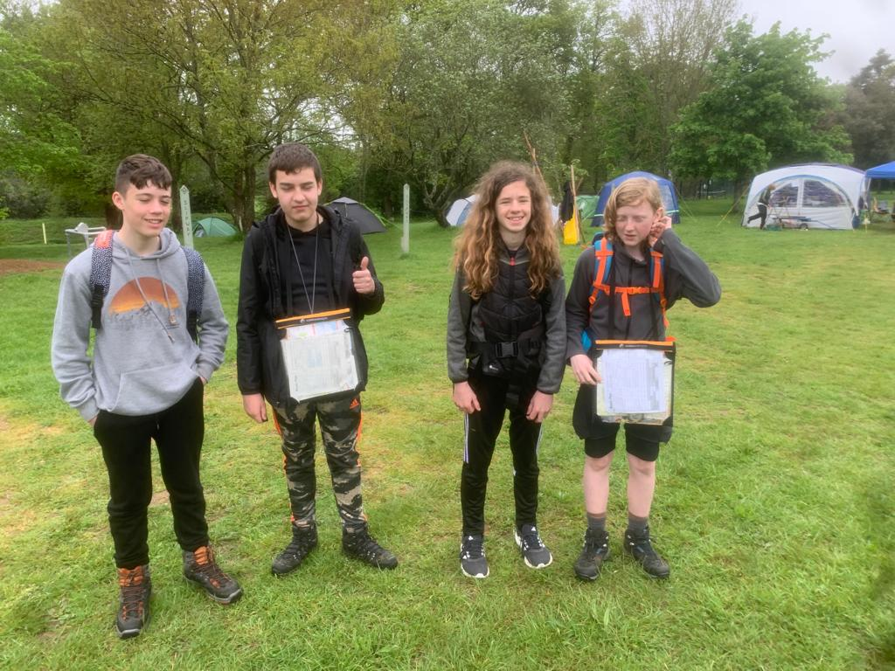
No really, “Enthusiastically”

Slide 12
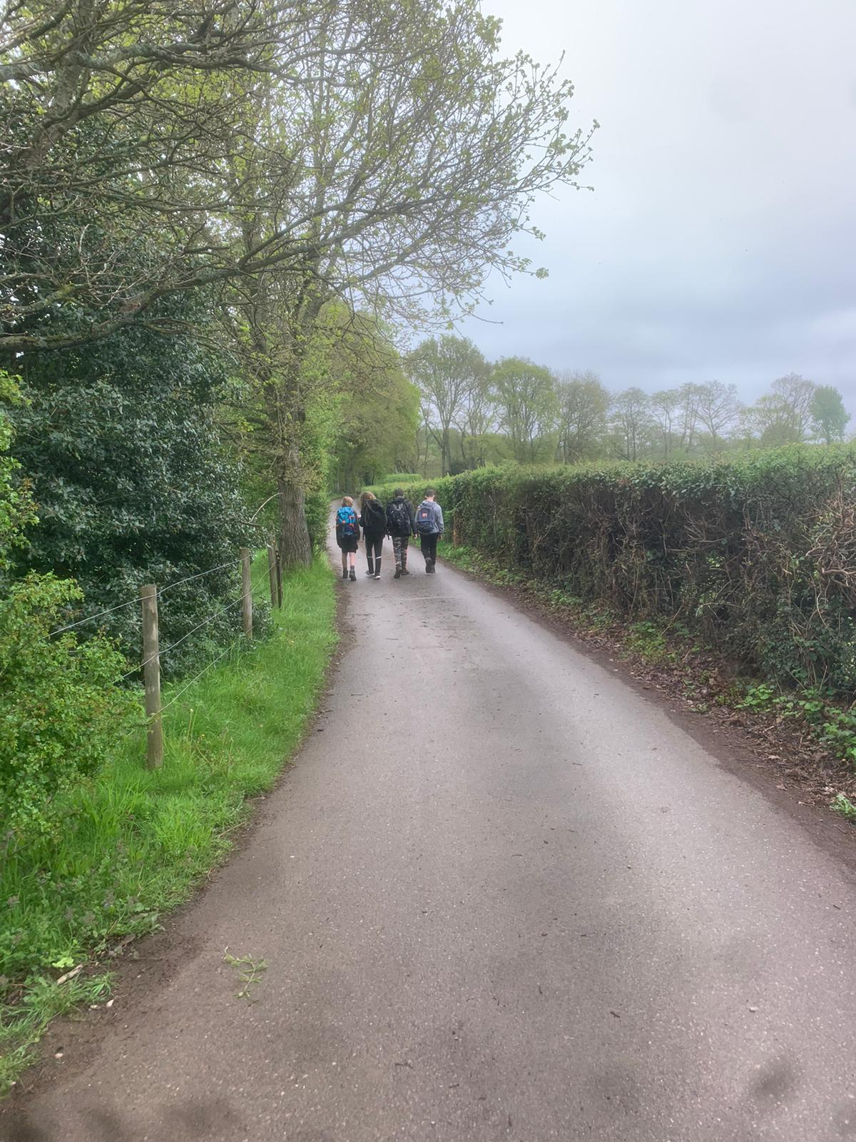
Trekking to Tilford and Frensham Little Pond

Slide 13
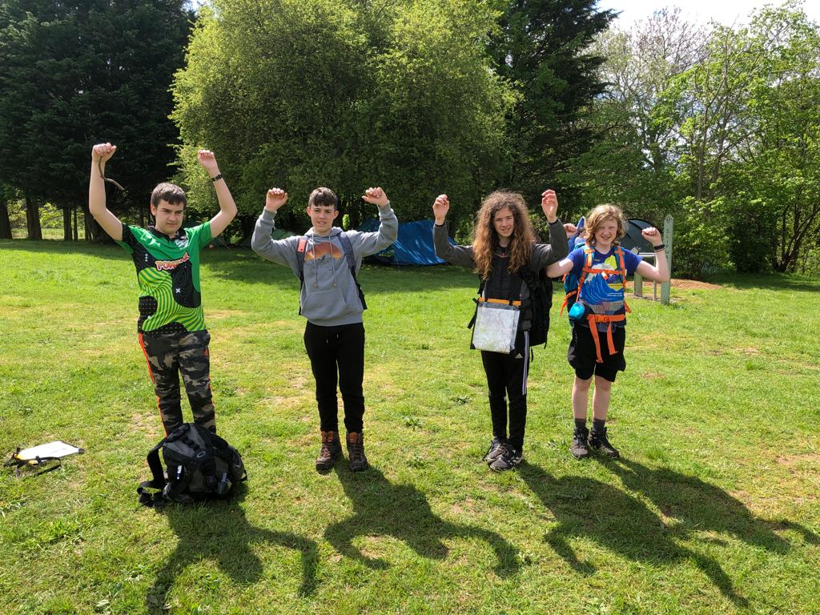
Triumphant success!

Slide 14
EXPEDITION CHALLENGE:
2 days
Plan and navigate the route and timing
4+ hours travel each day
Work as a team
Be entirely self-sufficient
Carry all equipment & provisions needed
Cook at least 1 hot meal as a group
Know what to do in emergencies
Thanks to Stephen Oliver and Russ Howell for Checkpoints and adult support for the group

